Slide 1
Saraland Middle School Veterans Day Presentation

Slide 3
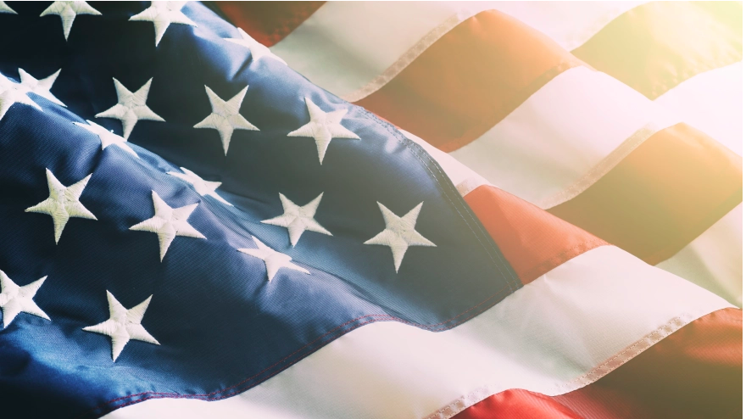
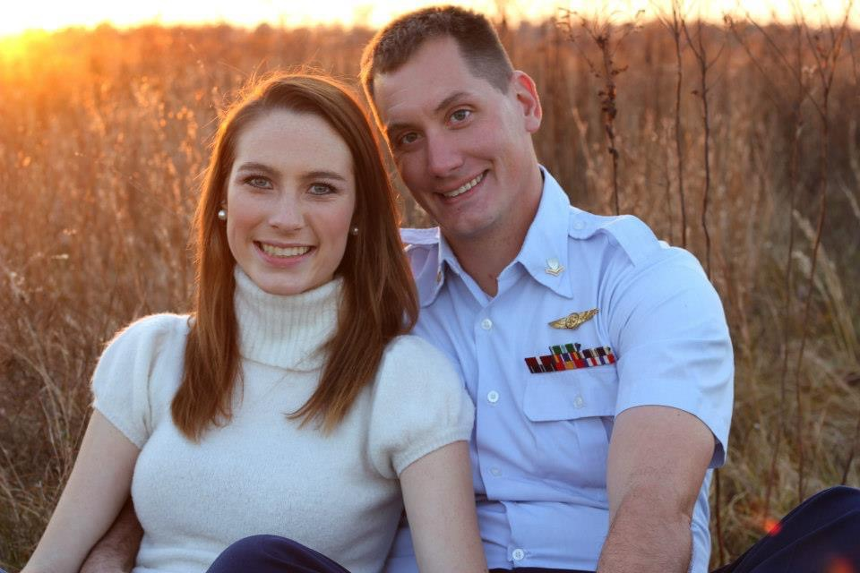
John C. Coster, Jr.
U.S. Coast Guard
Father of Barak Coster
Notes:
<iframe width="560" height="315" src="https://www.youtube.com/embed/TT0hKrNYBD8?start=25" title="YouTube video player" frameborder="0" allow="accelerometer; autoplay; clipboard-write; encrypted-media; gyroscope; picture-in-picture" allowfullscreen></iframe>

Slide 4
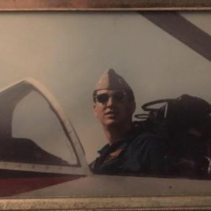
BOB SWEET
U.S. Navy
Grandfather of Hailey Morgan

Slide 5
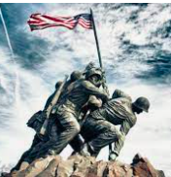

Slide 6
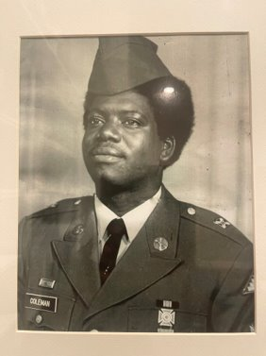
Reginald Coleman
U.S. Army
Father of Jayden Coleman

Slide 7
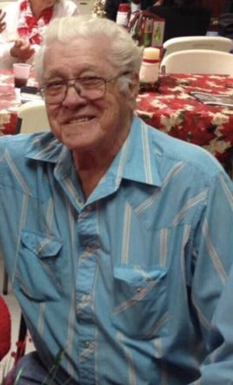
Edward Solomon
U.S. Army
Grandfather of Wyatt Solomon

Slide 8
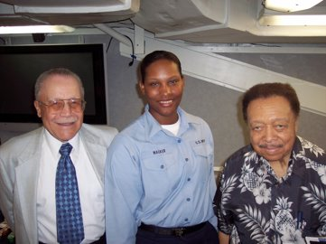
LaTrika Walker
U.S. Navy
Mother of Teaira Parsons

Slide 9
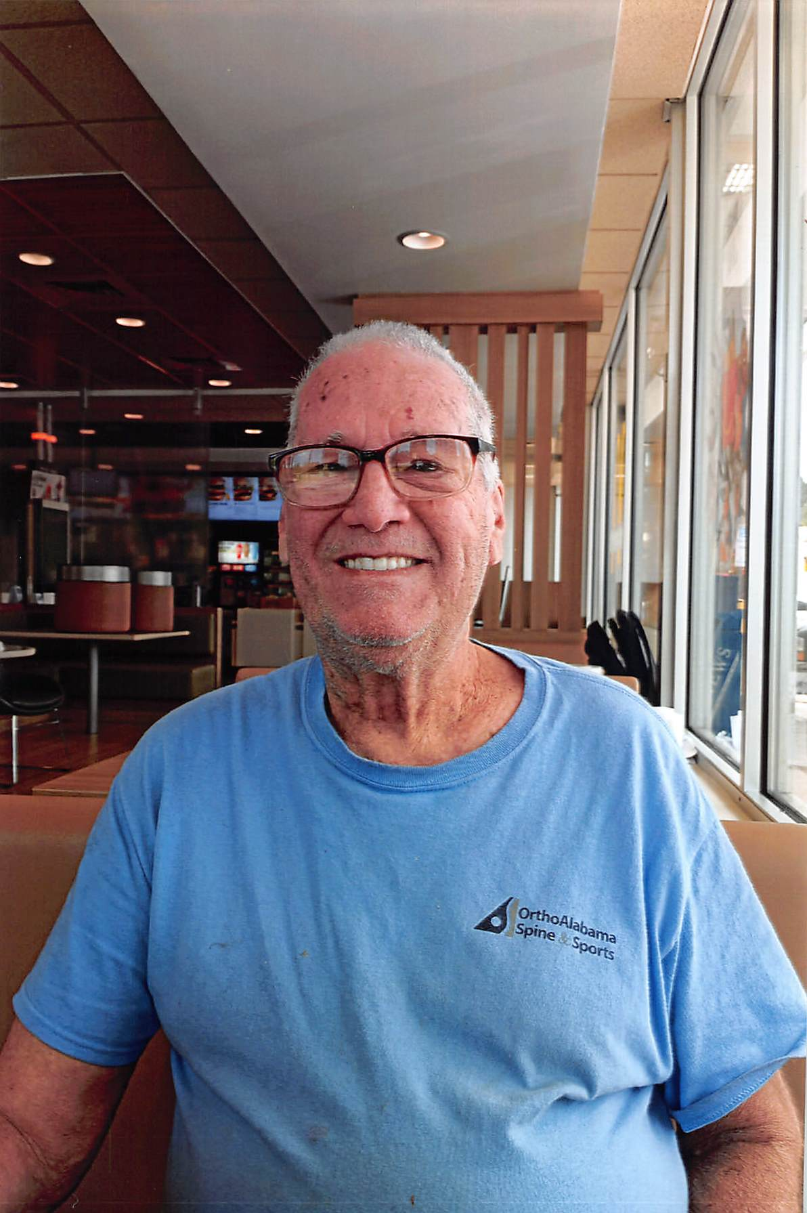
Rich Paternoster
U.S. Navy
Grandfather (Pop) of Nathanial Sawyer

Slide 10
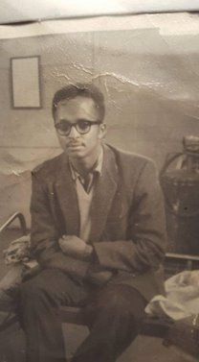
Kenneth Tucker
U.S. Air Force
Great-grandfather of Aaliyah Brown

Slide 11
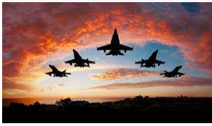

Slide 12
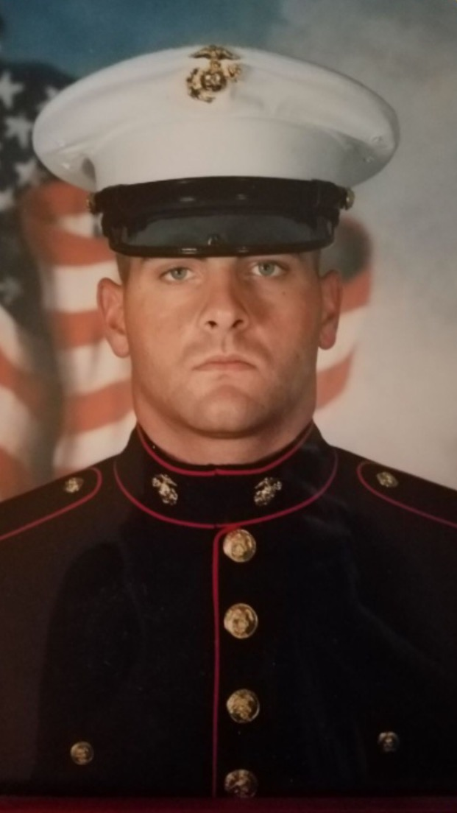
Michael McCormick
U.S. Marine Corps
Family Friend of Kennedy War

Slide 13
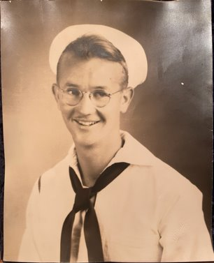
F.G. Zedler
U.S. Navy
Grandfather of Margrit Zedler

Slide 14
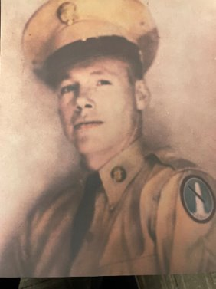
William Terry
U.S. Army (served in Korean Conflict)
Great-grandfather of
Kara Beth Blackwell

Slide 15
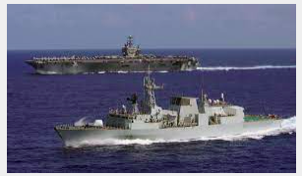

Slide 16
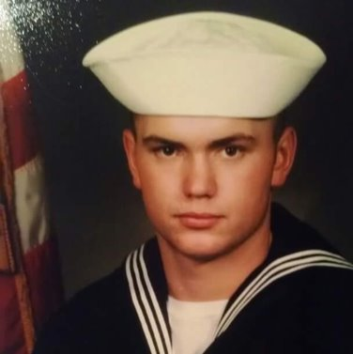
Robert Miller, Jr.
U.S. Navy
Father of Avery Miller

Slide 17
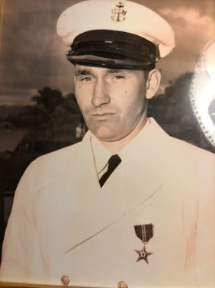
U.J. Cheek
U.S. Navy (World War II)
Great-grandfather of Margrit Zedler

Slide 18
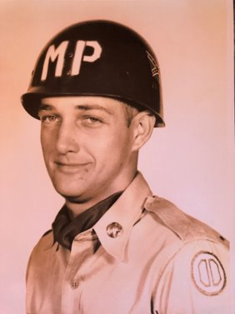
Willie McKenzie
U.S. Army (Military Police)
Great-grandfather of Karsyn Rutledge

Slide 19
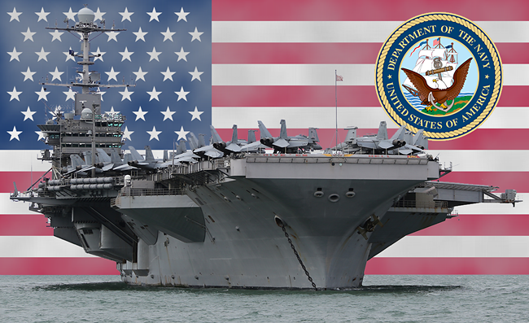
Steve Lofton, Sr.
U.S. Navy
Grandfather of Steve Lofton III

Slide 20
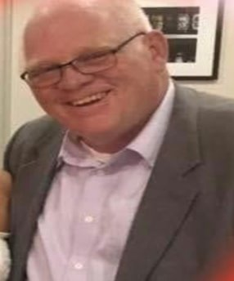
Jess Smith
U.S. Army
Grandfather (Pops) of Grayce Carter

Slide 21
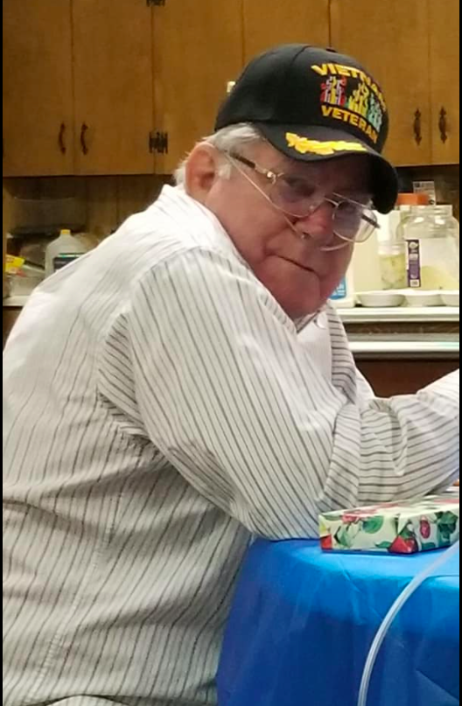
Daran Cassady
U.S. Marine Corps (Vietnam War)
Great-uncle of
Jakeleigh Guy

Slide 22
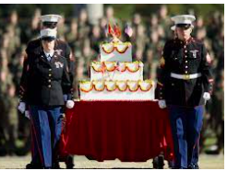
United States Marine Corps
246
Happy Birthday

Slide 23
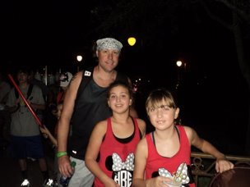
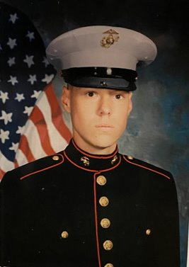
Matt Kirksey
Stepfather of Hannah
and Andre Bumpers
U.S. Marine Corps

Slide 24
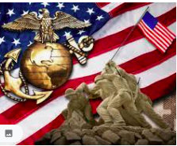

Slide 25
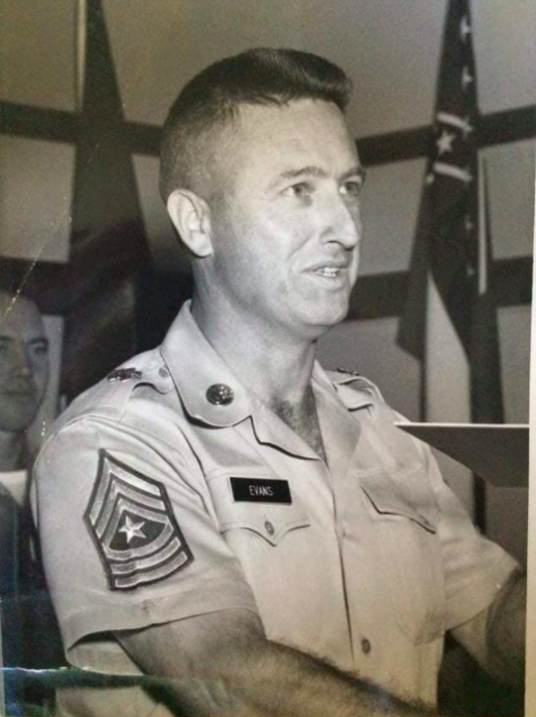
Charles Evans
U.S. Army (Sergeant Major)
Godfather of
Mrs. Nitteberg

Slide 26
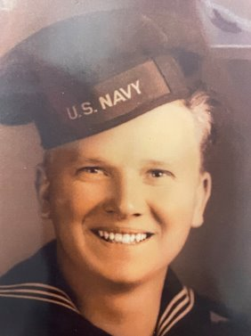
Winfred George Gatlin
U.S. Navy
Great-grandfather of Hannah Klaire Merryman

Slide 27
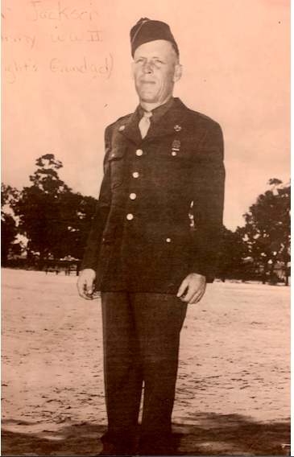
Coma Jackson, Sr.
U.S. Army (Sergeant)
Fought in Europe in WWII/ Wounded at the Battle of the Bulge/Received the Purple Heart
Grandfather of
Mr. Wright

Slide 28
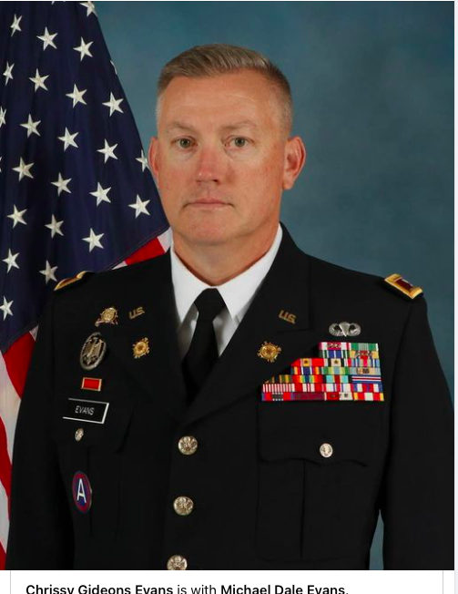
Colonel Michael D. Evans
U.S. Army National Guard
Family of
Mrs. Nitteberg

Slide 29
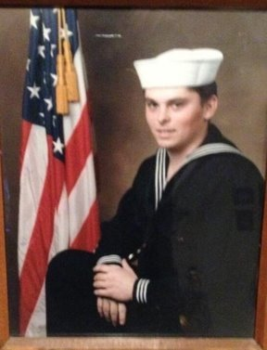
Tracy AuCoin
U.S. Navy
Grandfather (Papa) of Logan Holmes

Slide 30
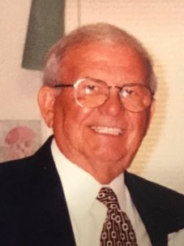
Thomas Shockley
U.S. Navy
Great-grandfather of Grayce Carter

Slide 31
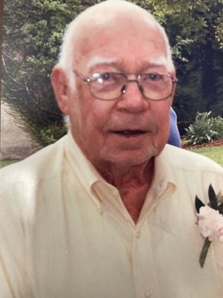
Wallace Kimble Merryman, Sr.
U.S. Army (Paratrooper)
Great-grandfather of Hannah Klaire Merryman

Slide 32
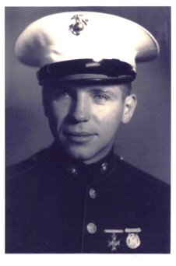
Milton Plesz
U.S. Marine Corps
Grandfather of Zachary Fincher

Slide 33
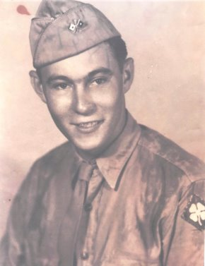
Alcy Kyser
U.S. Army (World War II)
Great-grandfather of
Kara Beth Blackwell

Slide 34
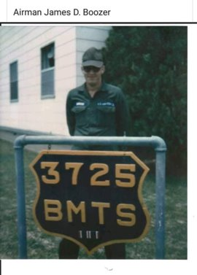
James D. Boozer
U.S. Air Force
Grandfather of Isabella Boozer

Slide 35
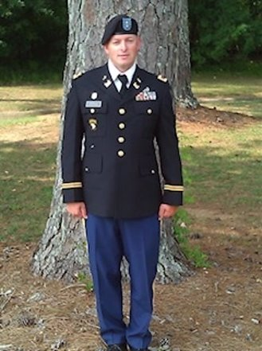
Jody Jackson
U.S. Army
Father of Hannah Jackson

Slide 36
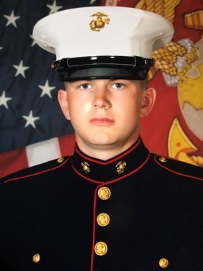
Bryce Stevison
U.S. Marine Corps
Son of Mrs. Stevison
SHS Class of 2016

Slide 37
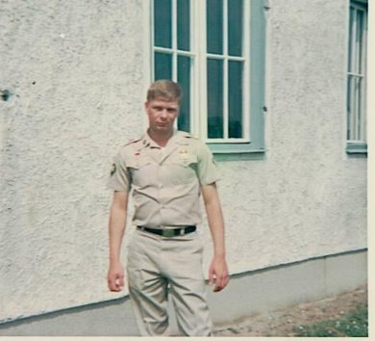
Jerry Suda
U.S. Army
Great-grandfather of Jacob Tyler

Slide 38
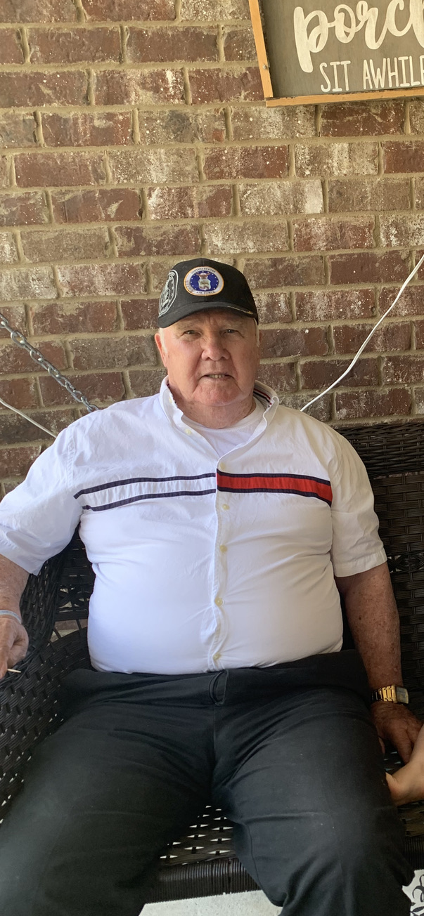
Luther Havard
U.S. Navy (Korean War)
Great-grandfather of Parker and Paisley Lewis

Slide 39
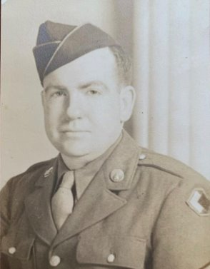
R.P. McLaurin, Sr.
U.S. Army (World War II)
Great-grandfather of Margrit Zedler

Slide 40
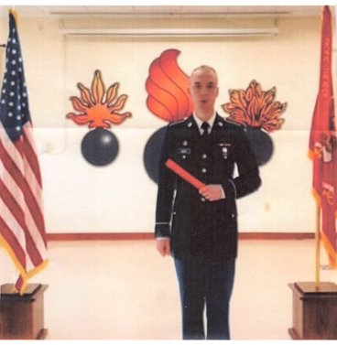
Collin Greer
U.S. Army National Guard
Brother of Haleigh Greer

Slide 41
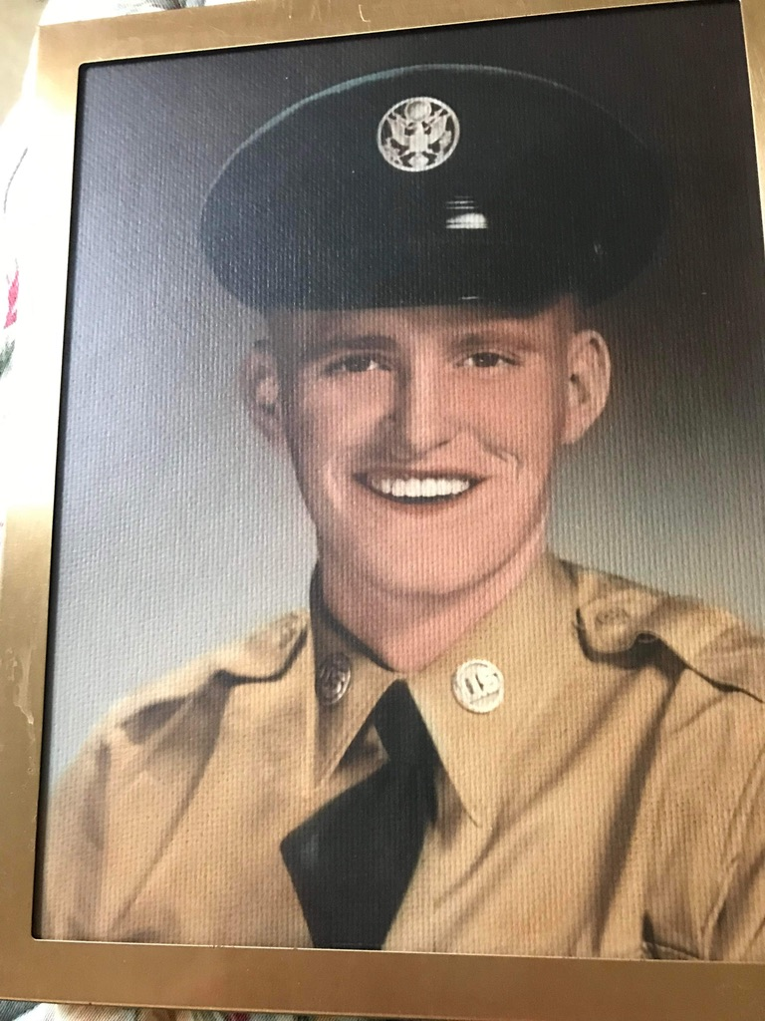
Ray M. Young
U.S. Air Force
Godfather of Mrs. Washburn

Slide 43
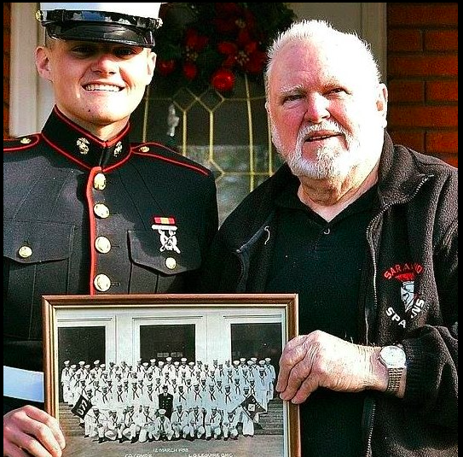
Tommie B. Hicks
U.S. Navy
Grandfather (Popa) of Jakeleigh Guy
Father of Mrs. Nitteberg

Slide 44
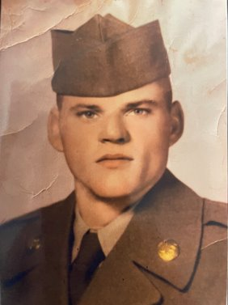
Edward Earl Pitts
U.S. Army
Great-grandfather of Hannah Klaire Merryman

Slide 45
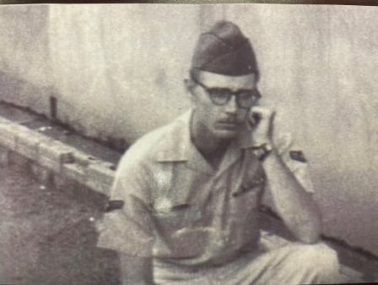
Benjamin Moorer
U.S. Air Force
Great-uncle of Hannah Klaire Merryman

Slide 46
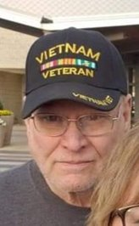
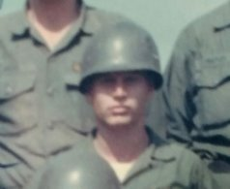
Paul Jernigan
Grandfather of Reagan Marlow
U.S. Army

Slide 47
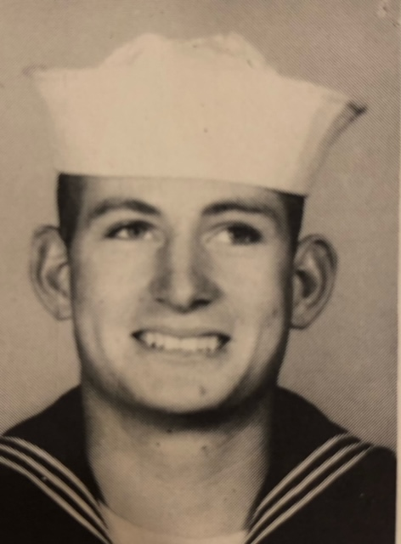
William C. Walley
U.S. Navy
Great-grandfather of Barak Coster

Slide 48
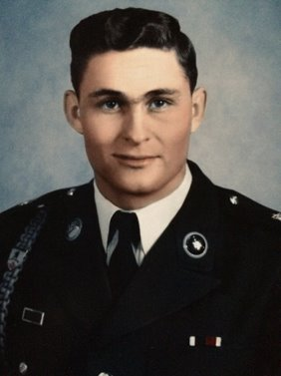
John R. Watson
U.S. Army
Father of Mrs. Stevison

Slide 49
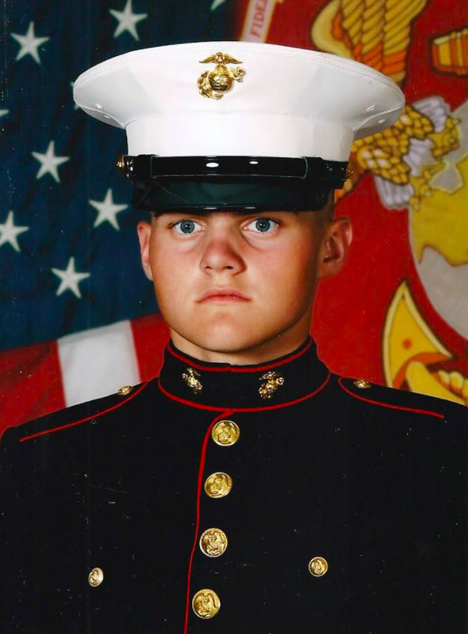
Cole Nitteberg
U.S. Marine Corps
SHS Class of 2015
Cousin of Jakeleigh Guy
Son of Mrs. Nitteberg

Slide 50
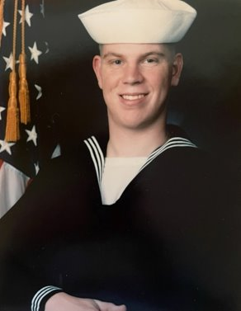
Kevin G. Zedler
U.S. Navy
Father of Margrit Zedler

Slide 51
August Peter Schulte, Jr
U.S. Army
Uncle of Mrs. Washburn

Slide 52
Senior Master Sergeant Mark Crane
Kentucky Air National Guard
Brother of Mr. Crane

Slide 53
Bobby Frank Williams
U.S. Army
Grandfather (Paw Paw) of Byron Lance Overton

Slide 54
Tony Nitteberg
U.S. Army
Uncle of Jakeleigh Guy
Husband of Mrs. Nitteberg

Slide 55
Buddy Floyd
U.S. Army Special Forces
Father of Mrs. Lyla Smith

Slide 56
Billy Frank Thomas
U.S. Air Force
Great-uncle of Hayden Jones

Slide 57
THANK YOU FOR YOUR SERVICE

