Slide 1
Personal Hygiene
Chapter 22
Source: Mosby's Textbook for Nursing Assistants
Notes:
NOTE: Want a different image on this slide? Select the picture and delete it. Now click the Pictures icon in the placeholder to insert your own image.

Slide 2
BELLRINGER Nov. 15, 2019
The skin is the body's first line of defense against disease, the body's largest system and natural covering.
Write the following questions and answer.
1. What are the names of the two layers of the skin?
2. Which one has blood vessels?
3. What helps to regulate your body temperature?
4. List 7 functions of the skin.

Slide 3
Nov. 15, 2019
Assignment:
Put personal hygiene key terms and definitions in your notebook.

Slide 4
Why is personal hygiene important?
Promotes comfort, safety, health
Prevents infection
Prevents body and breath odors
Relaxing
Increases circulation
Skin is the first line of defense against disease
What can affect hygiene needs?
Perspiration, elimination, vomiting, wound drainage, bedrest, activity

Slide 5
Follow the nurse's direction and the care plan to meet a person's hygiene needs.

Slide 6
Bellringer Nov. 18, 2019
Write the question.
What observations should you report and record when providing oral hygiene?

Slide 7
What can affect personal hygiene?
Culture
Personal choice
Shower or bath?
Time of day for bath
Frequency of bathing

Slide 8
DAILY CARE
Before Breakfast
Routine care given before breakfast is early morning care or AM care
When giving daily care, ALWAYS protect the person's right to privacy
and personal choice.
After Breakfast
Morning care is given after breakfast.
More thorough at this time.
Afternoon Care
Let the person do as much for themselves as possible.
Routine hygiene done after lunch and before evening meal.
Evening Care
Care given in evening at bedtime is evening care or PM care.

Slide 9
Examples of care given during each time frame
AM care or early morning care:
Elimination needs, cleaning incontinent persons, changing soiled or wet linens, assisting with hygiene (face, hand, oral), dressing, grooming (hair), positioning person for breakfast (dining room, bedside chair or in bed), making bed
Morning care:
Hygiene needs: face, hand and oral), bathing, perineal care, grooming (hair care, shaving, dressing), assisting with activity (ROM, ambulation), make bed, straighten the person's unit/room

Slide 10
Examples of care given during each time frame
Afternoon care:
Assist with elimination before and after naps, clean incontinent persons, change soiled linens and/or garments, provide hygiene care (face, hand, oral), hair care
Evening care:
Given to relax and promote comfort, assist with elimination, cleaning incontinent persons, change soiled linens and/or garments, assist with hygiene (face, hand, oral), back massages, help into sleepwear

Slide 11
Focus on the person.
When giving personal hygiene, check on person:
"Is water warm enough?"
"Are you warm enough?"
"Do you need another bath blanket?"
"Is the water starting to cool?"

Slide 12
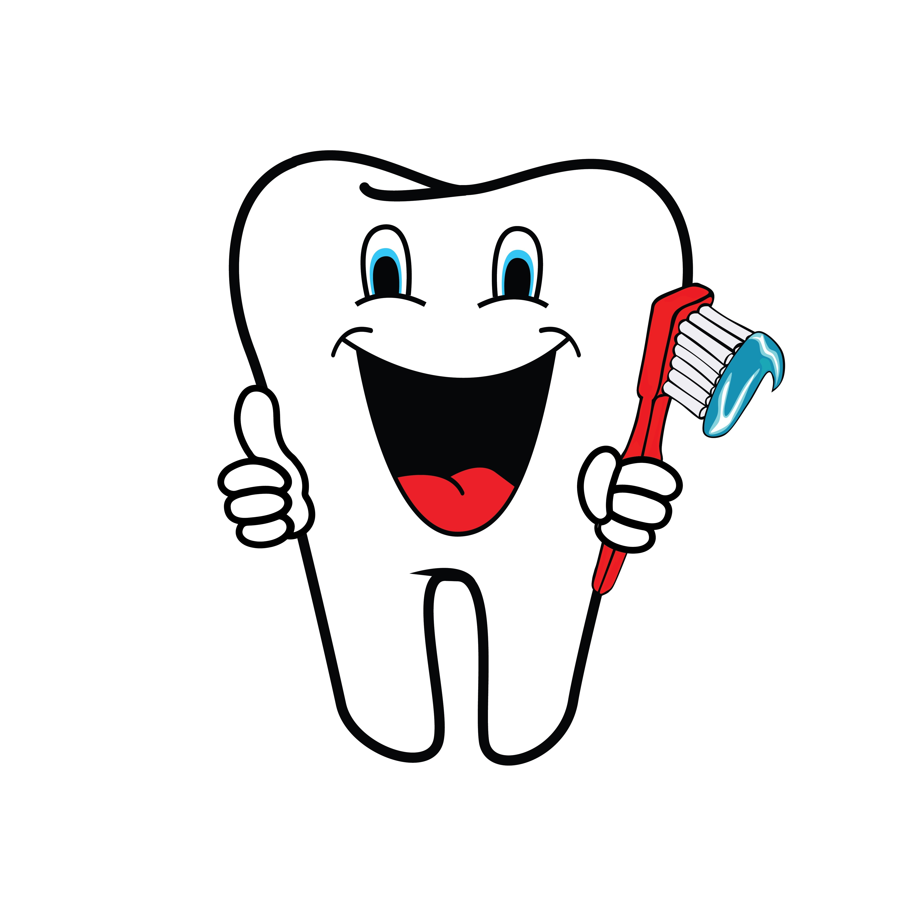
Oral Hygiene (mouth care)
Keeps mouth and teeth clean
Prevents odors and infections
Increases comfort, makes food taste better, reduces risk for cavities and periodontal disease
Periodontal disease (gum disease, pyorrhea) is an inflammation of tissues around the teeth. Gums become swollen, bleed easily, bone is destroyed, tooth loss is common.
Who can assess the person's need for mouth care?
Nurse, speech/language pathologist , dietitian

Slide 13
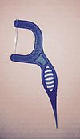
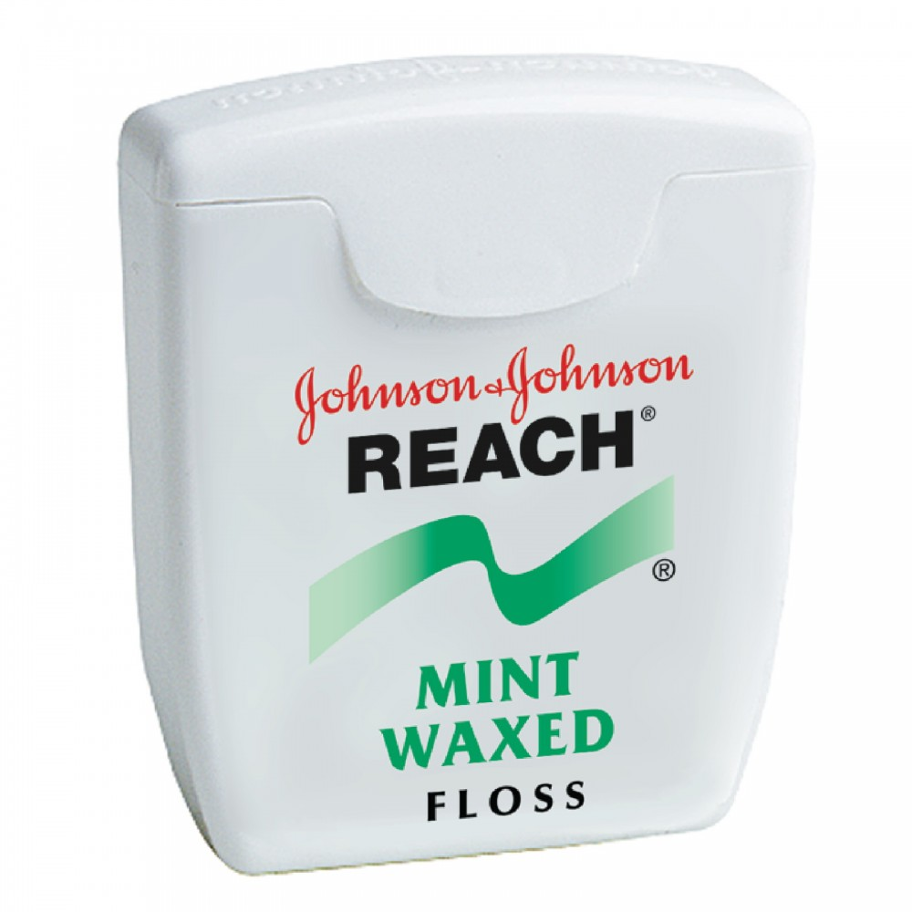
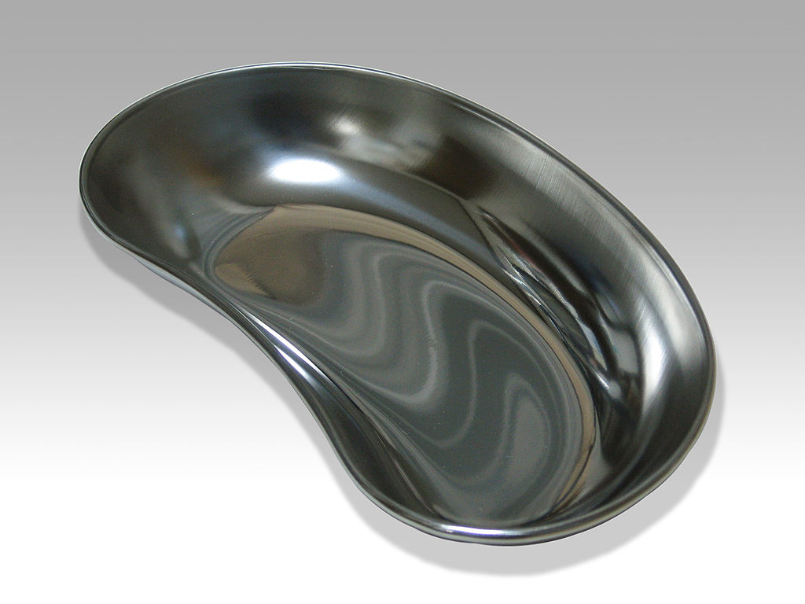
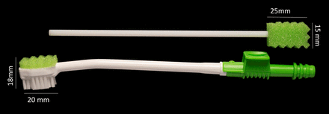
Oral Hygiene (mouth care)
Flossing
Removes plaque, tartar, food between teeth
Floss for persons that cannot do themselves
Equipment
Toothbrush with soft bristles is best
Sponge swabs for persons with sore mouths, and unconscious persons.
Important to check the foam pad to make sure on tight. Need kidney basin, water cup, straw, tissues, towels, gloves

Slide 14
Mouth Care for the Unconscious
To prevent aspiration:
Position person on one side with head turned well to side. This way, excess fluid drains out
Use only a small amount of fluid to clean the mouth
Do not insert dentures.
Mouth care is given at least every 2 hours
Protect unconscious persons from aspiration. Aspiration can cause pneumonia and death.

Slide 15
Denture Care
Full denture – Person has no upper or lower natural teeth
Partial denture: Person has some natural teeth
Remember -
Dentures are expensive! Be careful.
They easily break or chip if dropped
Do NOT wrap dentures in tissues or napkins
Use the proper cleaning agents and water temp
Line sink with towel to prevent damage if dropped
If not worn, store in container with soaking solution or cool/warm water. NOT hot water.

Slide 16
Bellringer Nov. 19, 2019
Read about bathing an older person on page 348.
What are 10 measures you can take if a person with dementia resists bathing?
Read the rules for bathing on page 347.
List 9 rules you should follow when bathing a person.

Slide 17
Bathing
Benefits:
Removes microbes, dead skin, perspiration and excess oils
Stimulates circulation
Relaxes person
Bariatric Needs:
Clean and dry under skin folds
Products to place under skin folds ( gauze or cotton fabric)
Powder, lotion (according to care plan)

Slide 18
Types of Baths
Complete bed bath
Water temp is usually 110 degrees F to 115 degrees F
Wash entire body in bed
Do not use soap around eyes
Change soapy or cool water
Unconscious, paralyzed, casts or traction, weak from surgery or illness
Can be embarrassing for person, provide privacy
Towel bath
Use over-sized towel to cover from neck to feet
Towel is wet with a solution
Persons with dementia usually respond well to

Slide 19
Types of baths (continued)
Bag Bath
8 to 10 washcloths moistened with no rinse cleaning agent
Warm in microwave
Use a new cloth for each body part
Let skin air dry
Partial Bath
Involves face, hands, axillae, back, buttocks, and perineal area
In bed or at sink
Assist as needed
Some persons bath themselves

Slide 20
Types of baths (continued)
Tub Bath
Should last no longer than 20 minutes
Falls, burns, chilling from water are risks
Avoid bath oil. Makes surface slippery.
Clean and disinfect tub before and after use
To get in and out of a tub bath, the person may need:
A tub with a side entry door
Wheelchair (used to transfer to the tub room)
Mechanical lift

Slide 21
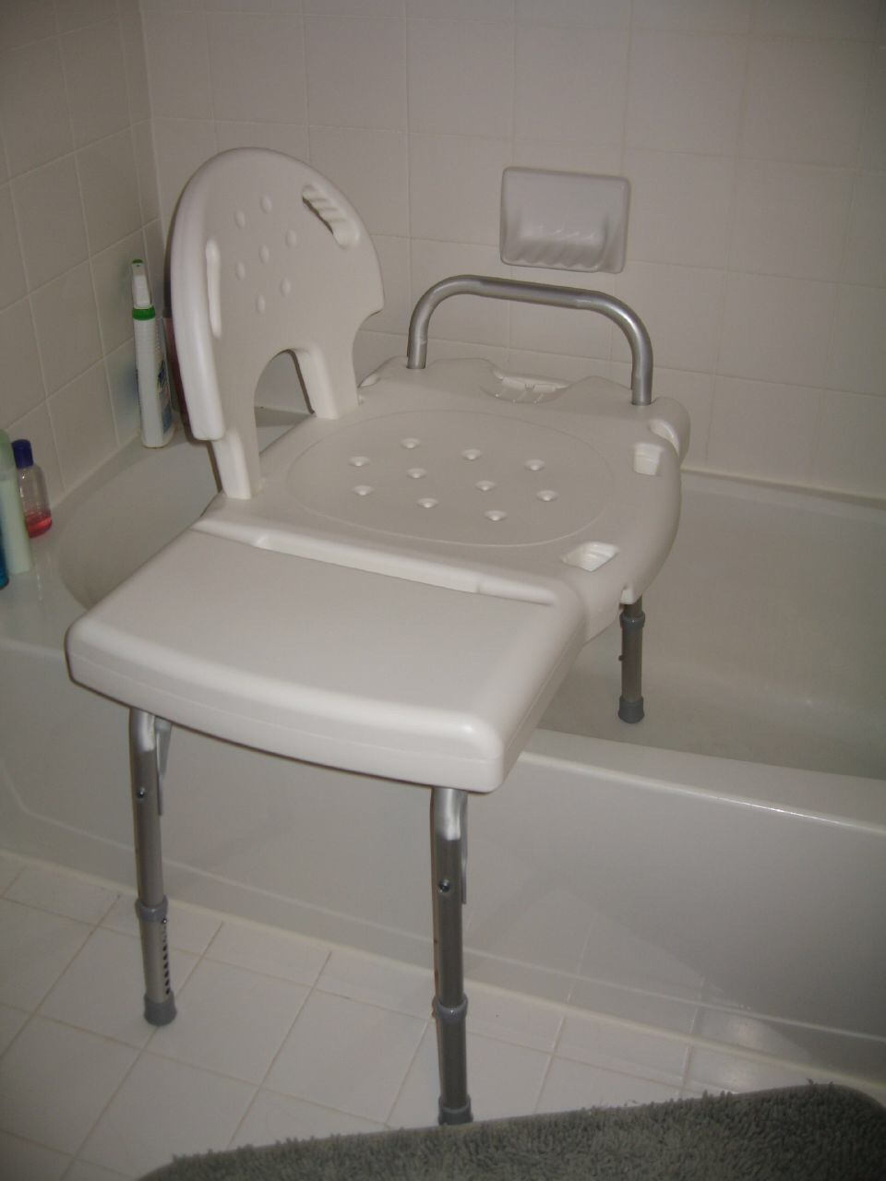
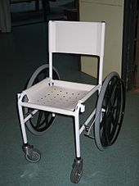
Types of baths
Showers
Never let weak or unsteady stand in shower
Use a shower chair
Shower stalls – person walks in or is wheeled in
Never direct water spray towards
Persons face. This can frighten.
For tub bath or shower, first make sure there is a rubber bath mat in place

Slide 22
Back Massage
What do you need from nurse and care plan before giving a back massage?
Can person have massage? When do they get massage?
How to position person. Do they have position limits?
Does person need frequently for comfort and to relax?
Observations to report and record:
Observe skin before massage
Breaks in skin
Bruising
Reddened areas
Signs of skin breakdown

Slide 23
Back Massage
Relaxes the person
Stimulates circulation
Give after baths, showers, after re-positioning, evening care or anytime the person need to relax
Last 3 to 5 minutes
Warm lotion in your hands before applying
Keep hands in contact with person's skin

Slide 24
Back Massage
Safety
Can be dangerous for persons with certain heart diseases, back injuries, certain surgeries skin diseases, lung disorders.
DO NOT massage bony red area. Could lead to more tissue damage.
If person's skin not intact, wear gloves
Comfort
Prone position is best, side-lying can be used (more comfortable for older and disabled)
Explain procedure to person, if they do not want buttocks exposed and touched then stroke down to the waist

Slide 25
Perineal Care
Cleaning the genital and anal areas
Cleaning prevents infection, odors, and promotes comfort. These areas are a warm, moist place for microbes to grow.
Done during bath or area is soiled with urine/feces
Let person do care if able
Use terms person will understand
Work from cleanest area to dirtiest, "front to back"

Slide 26
Perineal Care
Very important for persons with:
Urinary catheters
Rectal or genital surgery
Are menstruating
Incontinent of urine and/or feces
Are uncircumcised

