Slide 1
Unit 1
Banking

Slide 2
Section 1.01
Evaluating Banking Services

Slide 3
Questions…
Do you keep your cash in your wallet or always use a card?
How can you keep track of your money?
How can you be sure that you will have enough money to pay
your bills?

Slide 4
Banking Services
Types of Banks
Commercial Banks are what most of us relate to when we think of banks and banking services.
Can you think of any commercial banks?
Regions, Wells Fargo, BB & T

Slide 5
Banking Services
Credit Unions – These are a popular banking choice. They can offer better rates because of how they see customers, which is members. Members are owners of the credit union.
When a credit union is making a profit, the profit is returned to the members in the form of interest rates what commercial banks can offer.
Can you think of any credit unions?
Alabama Credit Union, Blue Flame Credit Union, Keesler Federal Credit Union

Slide 6
Banking Services
Other Types of Banking and Financial Institutions
Pawn Shops
Payday Lenders
Check Cashing Services
Mortgage Companies

Slide 7
Five Types of Banking Services
Savings Services
Payments – The most common payment service is a checking account.
- When depositing money, you have multiple ways of spending the money.
Traditional Savings Accounts
Certificates of Deposits (CDs)
Money Market Accounts
Writing Checks
Using a debit card
Receiving cash from an ATM
Making payments or online transfers

Slide 8
Five Types of Banking Services
Loans – These are secured loans and backed up by something of value, such as car loans and mortgages.
*Credit cards are unsecured loans and are not backed by something of value.
4. Investments – These types of services can be offered by banks and may or may not be free.
The reason to consider investments over
traditional savings is the possibility of greater
return on your money.
What do you think would happen if a person
Does not make payments on his/her car loan?

Slide 9
Five Types of Banking Services
5. Electronic Banking
Examples:
Direct Deposit – Money directly deposited into checking or savings.
ATM – Anytime Teller Machines (stop anytime, day or night)
Internet Banking – Sign into an account to check balances and pay bills.
Apps – Many banks offer apps for smartphones or tablets that allow
you to take a picture of a check and deposit directly.

Slide 10
Why Do I Need A Bank Account?
When your money is in an account at a commercial bank or a credit union, it is insured by the FDIC (Federal Deposit Insurance Corporation) for up to $250,000.
So, even if
The bank is robbed,
The bank catches fire and burns down,
The bank merges with another bank, or
The bank “runs out of money”.
YOUR MONEY IS INSURED!!
Can you think of any other situation where your money would be insured?

Slide 11
Accounts in Alabama
You have to be 19 to open a checking account by yourself, without a co-signer.
That should not stop you from opening an account!
Simply open a joint account with one of your parents/guardians. When you turn 19, you can have them removed from the account.

Slide 12
Section 1.02
Banking Documents

Slide 13
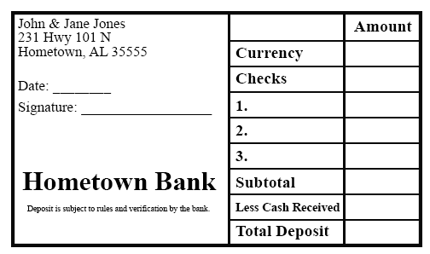
Deposit Slips
The first thing you need to do when opening a checking account is to deposit money into the account. For further deposits, it will either be direct deposit, or with the use of a deposit slip. Deposits are credits to your account.

Slide 14
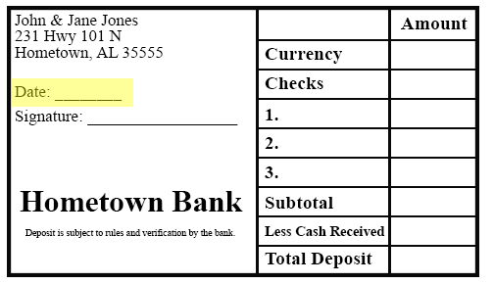
Deposit Slips - Step 1
Enter the date of the deposit.
Enter today’s date

Slide 15
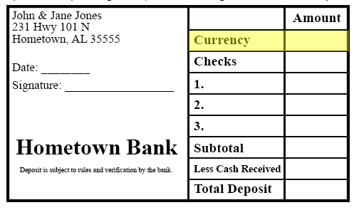
Deposit Slips – Step 2
If you are depositing cash, the amount goes in the Currency row.
You are depositing
$125.00 cash.

Slide 16
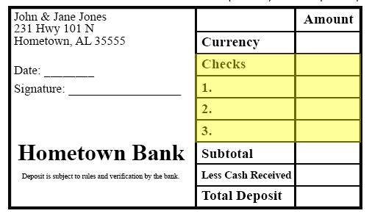
Deposit Slips – Step 3
Each check amount must be entered separately in the spaces provided. You must include the check numbers on the deposit slip.
You have received two checks
in the amounts of:
Check # 123 for $147.50
Check #124 for $39.55.

Slide 17
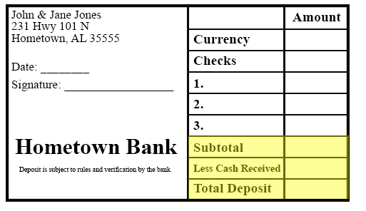
Deposit Slips – Step 4
You now need to subtotal the checks and currency. Put the amount of money you would like back, if any (less cash received). Fill out the amount of the total deposit.
You would like to receive $25 in cash.

Slide 18
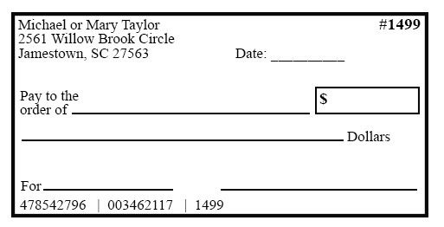
Writing Checks
Writing checks are considered a debit to your account. Many people prefer using a debit card over writing checks.

Slide 19
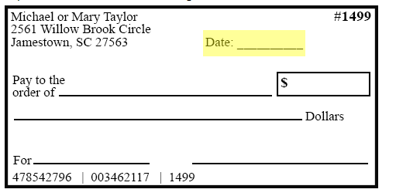
Writing Checks – Step 1
Make sure that you date the check correctly. Include the month, day, and year. You may write it out or enter using all numbers.
Enter today’s date

Slide 20
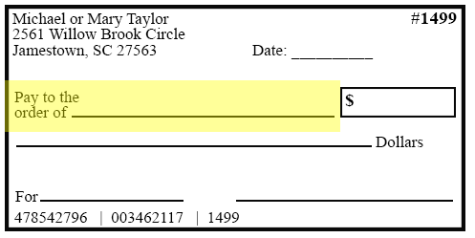
Writing Checks – Step 2
Put the name of the person or business you are writing the check to on the line following Pay to the Order of.
Make this check payable to
Saraland High School

Slide 21
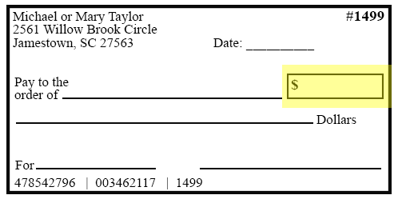
Writing Checks – Step 3
Enter the amount of the check using numbers. Be sure to place the decimal point between the dollars and center.
You are writing this check in the
amount of $65.00

Slide 22
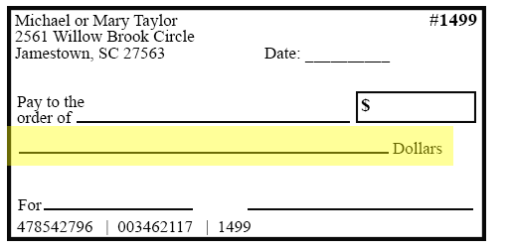
Writing Checks – Step 4
Enter the amount written out in words on the line ending with the word Dollars.

Slide 23
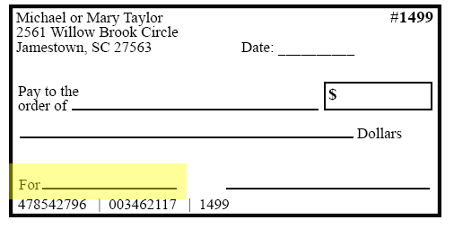
Writing Checks – Step 5
The line at the bottom labeled For or sometimes Memo provides you with a place to note what the check was written for.
This check is for a prom ticket.

Slide 24
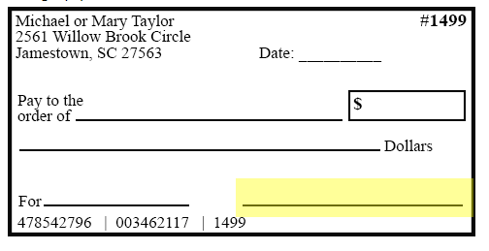
Writing Checks – Step 6
Make sure you sign all of your checks using the signature you entered on the signature card at the bank when you set up the account.
Sign the check.

Slide 25
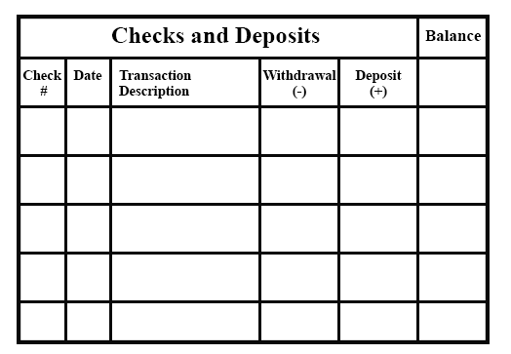
Check Register
It is important to keep a check register, even if you do not write checks. This is where you keep up with your checking account balance. You will enter deposits, as well as money spent by writing a check or using your debit card.

Slide 26
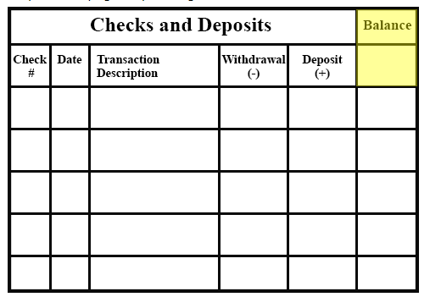
Check Register – Step 1
You will enter your initial deposit here when you set up your register.
When you set up your account
you deposited $200.00

Slide 27
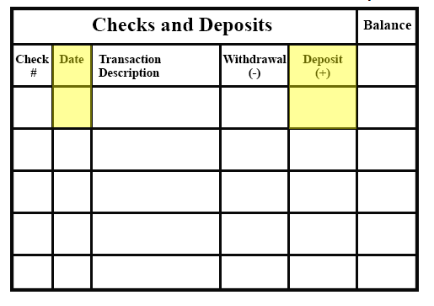
Check Register – Step 2
You will need to put the amount of each deposit as well as the date.
Use the deposit amount from the deposit slip we filled out together.

Slide 28
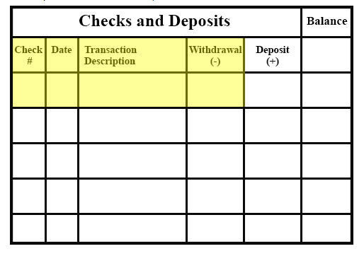
Check Register – Step 3
When entering checks you have written, be sure to enter the check number, the date you wrote the check, to whom you wrote the check, and the amount of the check.
You wrote two checks:
Check #100 for $24.55
Check #101 for $13.78

Slide 29
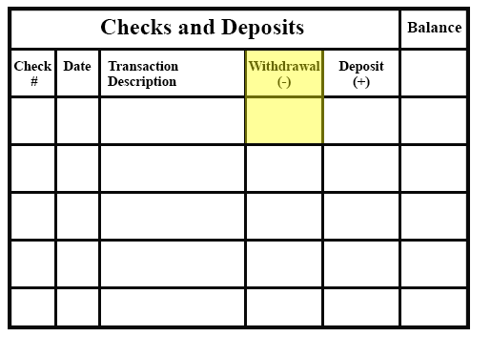
Check Register – Step 4
In addition to checks, you will want to be sure to enter all of your debit card purchases as you go along as well. These will be entered as withdrawals.
-You made an ATM withdrawal
of $20.00.
-You used your debit card at
Target in the amount of $15.76.

Slide 30
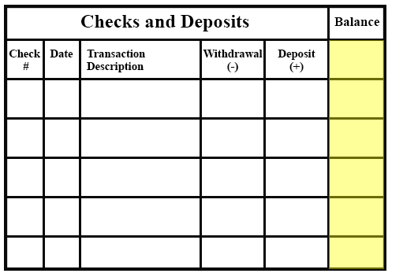
Check Register – Step 5
To maintain your balance, you will subtract the amounts of checks, debit card purchases, and ATM withdrawals and add the deposit amounts as you go along.
What is your balance?

Slide 31
Section 1.03
Banking Terminology & Interest

Slide 32
Banking Terminology
Principle – The amount of money you start in your account. If you are borrowing money,
it is the amount you borrow. If you are saving money, it is the amount you open your account
with.
Interest – Interest is the amount charged by a lender or paid on an investment (savings)
account. The interest is usually expressed as a percentage (%) and quoted for a year
which is know at the annual percentage rate (APR).
Rate – The actual percentage of interest you will pay on a loan or earn on an investment
(savings) account. It is usually quoted for a year and is called the APR.
Time – How long you will have to pay off your loan or how long you will be leaving your
money in savings. Time is normally expressed in years or fractions of years. For example,
a month would be expressed as 1/12 of a year because there are 12 months in a year.

Slide 33
Banking Terminology
Credit Score – Used to determine if you qualify for a loan and if so, what interest rate
you qualify for. It is a number between 300-850 and is based on your financial history.
You want your number to be as high as possible.
Ways to raise your credit score:
Pay bills on time.
Get a credit card if you do not have one.
Keep credit card debt to a minimum.
Keep the amount of money you own as a whole to a minimum.
Amortization – Payments on a loan over a period of time with a fixed payment schedule.
These payments will be the same amount each time.
A portion of each payment goes to pay off the amount borrowed, and the remaining portion
pays for the interest for the period as well as any other expenses of the loan.

Slide 34
Banking Project
Banking Research Project

Slide 35
Section 1.04
Cost of Borrowing Money

Slide 36
Cost of Borrowing Money
How much would you pay for a new car?
Some people may drive away in a new car paying $25,000.
Others may pay $27,856 for the same car.
What price do you want to pay?
Why do some people pay more?
A car cost $25,000 and is financed for 5 years at 4.34%. Your total cost will increase to
$27,856. That means you have paid $2,856 in interest over 5 years.

Slide 37
Cost of Borrowing Money
BIG QUESTION: Do I Need It?
It is important to ask yourself if you really need an item before you borrow money to pay for it.
Once you decide to borrow money, you need to make additional decisions.
Where will you borrow the money?
How much will you borrow?
How much can you afford to pay in monthly payments?

Slide 38
How Much Money Will You Borrow?
It is advised to borrow ONLY what you need!
Example: When you borrow money for a home, do not borrow additional for furnishings and decorative items.
A good rule of thumb when borrowing for a home is to not spend more than 2.5 times your gross annual salary.
One way to increase the amount you could spend for a house is to save for a down payment.

Slide 39
Other Loan Information
Origination Fees – Charged by a lender on entering into a loan agreement to cover the cost of processing the loan of 3-4% of the amount of the loan.
EX: On a $100,000 loan, it could be as much as $4,000.

Slide 40
Example Problem #1
Let's say you borrow $150,000 for a new home. How much will this actually cost you?
Your bank will be charging a 4% origination fee, so you are actually have to borrow $156,000. $6,000 of the amount will go to pay for the origination fee.
If you finance for 30 years at 4% interest, your estimated monthly payment will be $744.77.
This means you will be paying back $268,117.20 in total.
If you subtract the amount you needed to borrow ($150,000) from the amount you have repaid ($268,117.20), you will find that it cost you $118,117.20 to borrow the money. This is almost 80% of the amount that you needed to borrow.
It would have only taken you just under 17 years to save enough to pay cash for the house if you saved the amount of your monthly payment ($744.77) each month. We got this number:
$744.77 per month × 12 months = $8,937.24 a year
$150,000 total house cost ÷ $8,937.24 a year = 16.78 years

Slide 41
Other Loan Information
Late Fees – If you do not pay your loan payment on time, you will be charged a late fee. The amount depends on the type of loan and on the amount of your payment. It is usually a percentage.
Example Problem #2
You have a payment of $1,000.00 that is paid late. The late fee is 5% of your payment. How much do you now owe?
The late fee is 5% of $1000, which $50. Therefore, you now owe the $1,000 plus the $50 late fee, which equals $1,050.00.

Slide 42
Other Loan Information
Bank Draft – If you have difficulty paying bills on time, you can set up payments as an automatic bank draft. The ensures payments are made on time. You will not be charged late fees and it can help protect your credit rating.
Fees – Other fees that can be charged by the bank could be finance charges, loan processing fees, administrative fees, and application fees.

Slide 43
Section 1.05
Credit Cards

Slide 44
Credit Cards
Credit cards are neither good nor bad. People sometimes make bad decisions concerning how they use their credit cards.
It is difficult to live without a credit card today. From renting a car to reserving an airline ticket or hotel room, credit cards have become a necessary convenience.
It is important to use credit cards wisely. In this lesson we will look at benefits and costs associated with credit cards.

Slide 45
Credit Card Terminology
Annual Fee – A yearly charge for use of the credit card.
Annual Percentage Rate – Measures the cost of credit expressed as a yearly rate. Truth-In-Lending law requires lenders to include all loan costs in the APR.
Cash-advance Fee – Fee Charged who you get cash using your credit card (this is in addition to interest).
Finance Charge – Dollar amount you pay to use credit.
Free (Grace) Period – Period of time (usually 20-30 days) during which you can pay your bill without finance charges.

Slide 46
Credit Card Terminology
Interest Rate – Measure of the cost of credit, expressed as a percent.
Late Fee and Transaction Fee – A credit card may also involve other types of costs.
If you go over your limit
Late Payment
Payment received after the grade period
Some charge a penalty rate if you have more than one late payment within several months.

Slide 47
Types of Credit Cards
Major Credit Cards – Issued by banks and can be used at any business that accepts credit cards.
Store-Branded Credit Cards – Can only be used at the retailer that issued the card.

Slide 48
Credit Card Disclosures
The Fair Credit and Charge Card Disclosure Act mandates a box on credit card applications that describes key features and costs.
Credit Card Disclosures

Slide 49
Things to Consider
If you are going to have a credit card, you should shop around and find the best one for your situation. Things to consider are:
Costs
Terms
Benefits

Slide 50
Costs Associated with Credit Cards
High interest rates
May have a yearly fee
Increased impulse to buy
Fees for late payments
Fees for cash advances
Poor decisions could lead to a low credit score

Slide 51
Credit Card Terms and Conditions
What is the APR?
How will Claims and Disputes be handled?
Fees – late, annual, over-the-limit fees
Finance charges
What is their method of computing balances for purchases?
How do they determine the monthly minimum payment?
Transaction fees – balance transfers, cash advances, purchases in foreign countries

Slide 52
Benefits of Using a Credit Card
Special store discounts
Rewards programs
Cash back
Interest-free grace period
Ability to buy needed items even if you do not have the money to do so
Proper use of store-branded credit card with a low credit limit could be a good way to establish credit

Slide 53
Using Credit Cards Responsibly
Spend only what you can repay
Pay entire bill on time
Report lost or stolen credit cards promptly
Never give your card number over the phone unless you initiated the call or are certain of the caller’s identity

Slide 54
Credit Card Research Project
Some credit card providers offer student credit cards.
Research this type of card and discuss how it differs from a regular credit card.
Find two different examples of student credit cards and list their cost/terms.

Slide 55
Section 1.06
Cost of Credit Cards

Slide 56
Calculating Credit Card Interest
Daily Interest Rate – To find the daily rate, divide your annual rate by 365.
For Example: Annual Rate 20%
Daily Interest Rate = 0.20 / 365
Daily Interest Rate = 0.00054795
Calculate the Daily Interest Rate
Annual Rate = 34%
Daily Interest Rate - .34 / 365
Daily Interest Rate - 0.0009315

Slide 57
Calculating Credit Card Interest
Average Daily Rate – You only pay interest on your balance after the grace period.
For Example: You have a balance of $5,000. On day 7, you pay $2,000 and on day 20 you pay $2,000 more. Your average daily balance is:
Average Daily Balance = [(6 days x $5,000) + (13 days x $3,000) + (11 days x $1,000)] / 30 days in the payment period
Average Daily Balance = ($30,000 + $39,000 + $11,000) / 30
Average Daily Balance = $80,000 / 30
Average Daily Balance - $2,666.67

Slide 58
Calculating Credit Card Interest
Once you have found your daily interest rate and your daily average balance, you multiply these together and you multiply the answer by the number of days in the month (28, 29, 30, or 31).
This will give you the interest you will be charged for the month.
Interest charged for the month – 0.00054795 daily interest rate x $2,666.67 average daily balance x 30 number of days in the month
Interest charged for the month = $43.84
*This means that next month, you enter with your balance of $1,000 plys the $43.84 interest.

Slide 59
Calculating Credit Card Interest
Example:
You have a balance of $12,000. On day 6, you pay $4,000 and on day
21 you pay $4,000 more. What is your average daily balance?

Slide 60
Section 1.07
Amortization Schedules

Slide 61
Buying a House
Buying a home will probably be your largest purchase.
You need to shop around to find the lowest interest rate.
What is a good rule of thumb on what to spend on a house?

Slide 62
A Loan for a House
A loan taken out to purchase a home is called a mortgage.
There are two types of loans to choose from:
A fixed rate mortgage
An adjustable rate mortgage

Slide 63
Fixed Rate Mortgage
With a fixed rate mortgage, your rate and payment will stay the same for the life of the loan.

Slide 64
Adjustable Rate Mortgage
The rate will start out lower for a certain period of time and will then fluctuate by the rise and fall of the Federal Reserve.
The Federal Reserve is the central banking system of the United States.
NOTE: It is always a good idea to get pre-approved for a mortgage. This will allow you to know how much you can spend on a home and how much money you are required for a down payment.

Slide 65
Mortgage Rate Research Activity

Slide 66
Mortgage Terms To Know
Amortization – A fixed repayment schedule for a loan like a mortgage.
Amortization Table – A table listing all payments for a loan and breaking them down into principle and interest.
Annual Percentage Rate (APR) – The annual rate charged for borrowing or earned through and investment.

Slide 67
Below, you can see the first twelve payments of a $100,000 loan for 30 years at 4.5% APR. There are different parts to an amortization schedule.

Slide 68
Using an Amortization Table Activity

Slide 69
Section 1.08
Credit Score

Slide 70
What is a Credit Report?
A credit report is simply a history of your credit. A credit report contains:
All credit card accounts
All loans
Current balances
Credit limits
Late payment history
Checking and saving account balances
Any bankruptcies in the last 10 years
Unpaid taxes
Any time some checked your credit in the last two years
Public records and collections

Slide 71
Credit Reporting Agencies
There are three main credit reporting agencies, also known as credit bureaus.
These companies compile records from banks, mortgage companies, and other financial institutions.
They track every credit card, mortgage loan, car loan, checking account, and savings account you have ever used.
If you ever have a bill go to collections, these companies know about it.
If you apply for a new loan, the lender will request a credit report from each of the three companies.
The report will tell the lender all of your current balances and payment history.
Based on your credit report, each agency will assign a FICO score that ranges from 300 to 850.

Slide 72
Three Credit Reporting Agencies
Experian
Transunion
Equifax

Slide 73
FICO
Fair Issac Corporation developed the scoring system that is used in credit reporting agencies.
The main factors used to determine your FICO score are:
Payment history
Debt/Amounts owed
Age of credit history
New credit/inquiries
Mix of accounts/types of credit

Slide 74
Below is a general guide to credit score ranges according to Experian.

Slide 75
5 Cs of Credit
When applying for any kind of loan, the lender will look at a variety of factors to determine whether to loan you money.
Character – The borrower’s reputation (your credit history).
Capacity – The most critical factor and refers to how you will repay the loan.
Collateral – This is where the lender will look at how much something is worth. For example, they will not loan you $20,000 if a car is only worth $10,000.
Conditions – Lenders will want to know how you plan to use the money being loaned.
Capital – Lenders will want to look at your household’s capital money. They want to know if you lose your job, will you still be able to repay the loan.

Slide 76
Building and Maintaining a Good Credit Score
Teenagers start off with no credit history. In order to be accepted for a mortgage or car loan, you will need to build a credit history.
Tips for building exceptional credit:
Set a budget and live within that budget.
Do not use credit to live beyond your means.
Pay your bills on time.
Keep your balances well below their limits
Have a mixture of credit types (car loan, credit card, mortgage)
Only apply for the credit card you need.
Have a stable job – do not change jobs every year.
Start small – your first credit card might be from a department store or gas stations with a low credit limit ($200-$300).

