Slide 1
Chapter 26
World War II
1939-1945

Slide 2
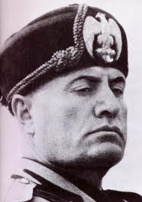
26.1 Road to War
1. Dictators are leaders who control their nations by force.
2. Benito Mussolini was the fascist leader of Italy. Fascism is extreme nationalism and racism.

Slide 3
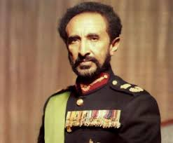
26.1 cont…
3. Ethiopian emperor Haile Selassie appealed to the League of Nations for help. “God and history will remember your judgment. It is us today. It will be you tomorrow.”

Slide 4
26.1 cont….
4. National Socialist German Workers’ Party- Nazi Party
5. Anti-Semitism is hatred of the Jews.

Slide 5
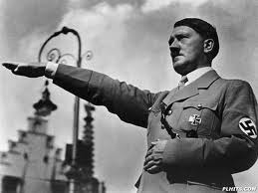
26.1 cont…..
6. In 1933 Hitler ended all democracy and established totalitarian rule in Germany. This means he had TOTAL control.

Slide 6
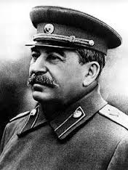
26.1 cont….
7. Joseph Stalin was the Communist leader of the Soviet Union.

Slide 7
26.1 cont….
8. Appeasement is giving in to someone’s demands.
9. The Soviet-German Non-Aggression Pact freed Hitler to invade Poland without fear of Soviet intervention.

Slide 8
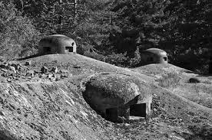
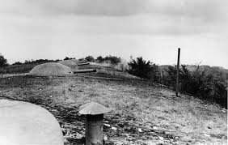
26.2 War Begins
1. Blitzkrieg means “lightning war.”
2. The Maginot Line was a string of steel and concrete bunkers along the German border from Belgium to Switzerland.

Slide 9
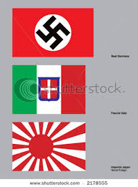
26.2 cont….
3. The Axis Powers consisted of Japan, Germany, and Italy.

Slide 10
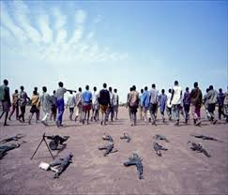
26.2 cont….
4. The Lend-Lease Act allowed America to sell, lend, or lease arms or other war supplies to any nation considered “vital to the defense of the U.S.”
5. Disarmament means to give up military weapons.

Slide 11
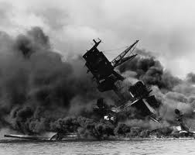
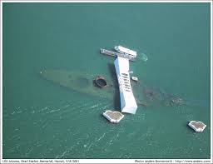
26.2 cont….
6. Pearl Harbor was the worst defeat in U.S. military history.

Slide 12
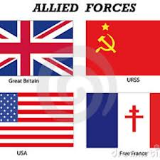
26.2 cont….
The Allied Powers consisted of Great Britain, France, China, the Soviet Union and the United States.

Slide 13
26.3 On The Home Front
1. More than 15 million people joined the armed forces during the war.
2. About 250,000 women served in the WACs ( Womens Army Corp) WAVES ( Women Appointed for Volunteer Emergency Service) in the Navy.

Slide 14
26.3 cont…..
3. Military and civilian preparations for war is called mobilization.
4. The National War Labor Board helped resolve labor disputes that might slow down war production.

Slide 15
26.3 cont….
5. The Revenue Act of 1942 raised corporate taxes and required nearly all Americans to pay income taxes.
6. To ration goods meant that consumers were only allowed to purchase a limited number of them.

Slide 16
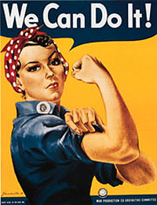
26.3 cont..
7. Women helped the war effort by taking jobs that were once held by men. A character called Rosie the Riveter encouraged women to take factory jobs.

Slide 17
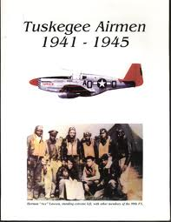
26.3 cont……
8. About one million African American men and women served in WWII. The 332nd Fighter Group, known as the Tuskegee Airmen shot down more than 200 enemy planes.

Slide 18
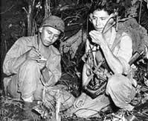
26.3 cont….
9. Native Americans also helped the war effort. A special group of Navajo formed the “code talkers.”

Slide 19
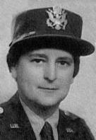
26.3 cont……
10. More than 250,000 Hispanic Americans served the armed forces. Mercedes Cubria of Cuba became the first Hispanic women officer in the Women’s Army Corps. Twelve Mexican Americans won the Medal of Honor.

Slide 20
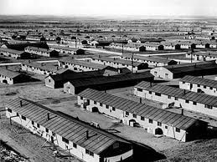
26.3 cont….
11. About 100,000 Japanese Americans were sent to detention centers called internment camps.

Slide 21
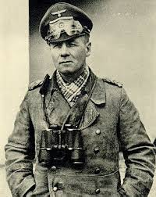
26.4 War in Europe and Africa
1. The German General in charge of forces in North Africa was Erwin Rommel. “ The Desert Fox”

Slide 22
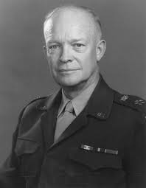
26.4 cont…..
2. Dwight D. Eisenhower was in command of Allied Forces in Europe.

Slide 23
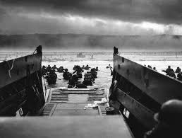
26.4 cont….
3. On June 6, 1944 – D-Day- the Allied ships landed on the coast of Normandy, France.
“ All southern England was one vast military camp crowded with soldiers awaiting final word to go.”

Slide 24
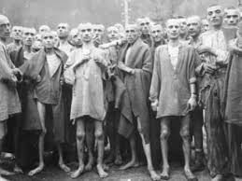
26.4 cont…..
4. As many as 6 million Jews died in what has become known as the Holocaust.
Quote page 776

Slide 25
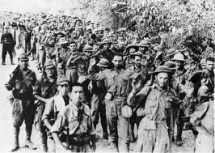
26.5 War in the Pacific
1. About 76,000 prisoners started out, but only about 54,000 of those on the Bataan Death March reached the camp.

Slide 26
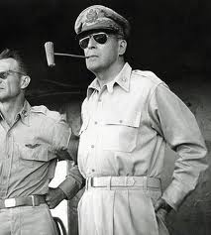
26.5 cont….
2. General Douglas MacArthur was in command of Allied forces in the Pacific.

Slide 27
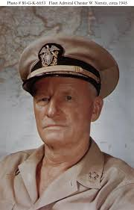
26.5 cont…..
3. Admiral Chester Nimitz adopted a strategy known as island hopping.

Slide 28
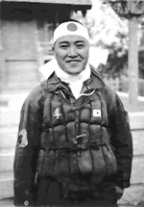
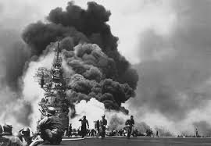
26.5 cont…
4. Japanese suicide pilots known as kamikazes crashed planes loaded with explosives into American ships.

Slide 29
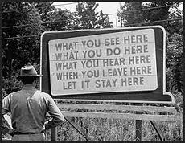
26.5 cont…
5. The Manhattan Project was a top secret program that developed the atomic bomb.

Slide 30
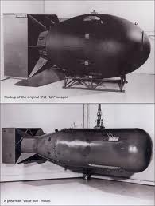
26.5 cont…..
6. On August 6, 1945, an American B-29 bomber dropped an atomic bomb on the Japanese city of Hiroshima. Three days later, a second bomb was dropped on the city of Nagasaki.

Slide 31
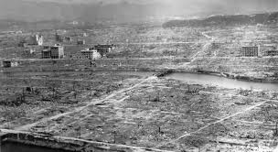
26.5 cont….
Hiroshima

Slide 32
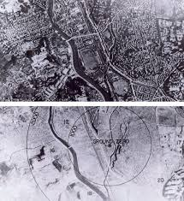
26.5
Nagasaki

Slide 33
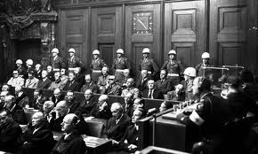
26.5 cont….
7. After the war the Allies held war crimes trials in Nuremberg, Germany.

