Slide 1
Senior Breakfast CONTACT INFORMATION
Tammi Thames
tthames@saralandboe.org
TEXT @sr21bkfast to 81010

Slide 2
SENIOR BREAKFAST
May 12th
SENIOR Class Fee MUST be Paid in order to sign up - $60

Slide 3
TABLES
3 sponsors per table
6 seats per table
3 reserved seats per table
3 seats for sign up day –
March 9th at 6:45 AM

Slide 4
SPONSORS
MUST have SIX place settings
Gift of your choice for ALL six students
Gifts may be Personalized
DO NOT bill students for table
Sponsors are financially responsible for table

Slide 5
TABLE THEME
Centerpiece
Decorations
Plate Chargers or Placemats
Clear plates, clear cups, utensils, and paper napkins will be available

Slide 6
NO confetti
NO balloons
NO candles
Tables – 60 inches Round (Tablecloths are NOT provided)
Chair covers Optional – standard size chairs

Slide 7
TABLE SET UP
Tuesday, May 11th
Time - TBA
NO SENIORS ALLOWED!! It should be a surprise for them.
6 people per table while decorating
MUST wear face mask

Slide 8
PLEASE!!!!!!
DO NOT POST ANY PICTURES OF YOUR TABLE OR ANY OTHER TABLES UNTIL AFTER BREAKFAST

Slide 9
DAY of BREAKFAST
7:30 – 8:30 AM Finish last minute decorations
Doors OPEN at 8:45 AM
Parents are NOT allowed to stay for breakfast

Slide 10
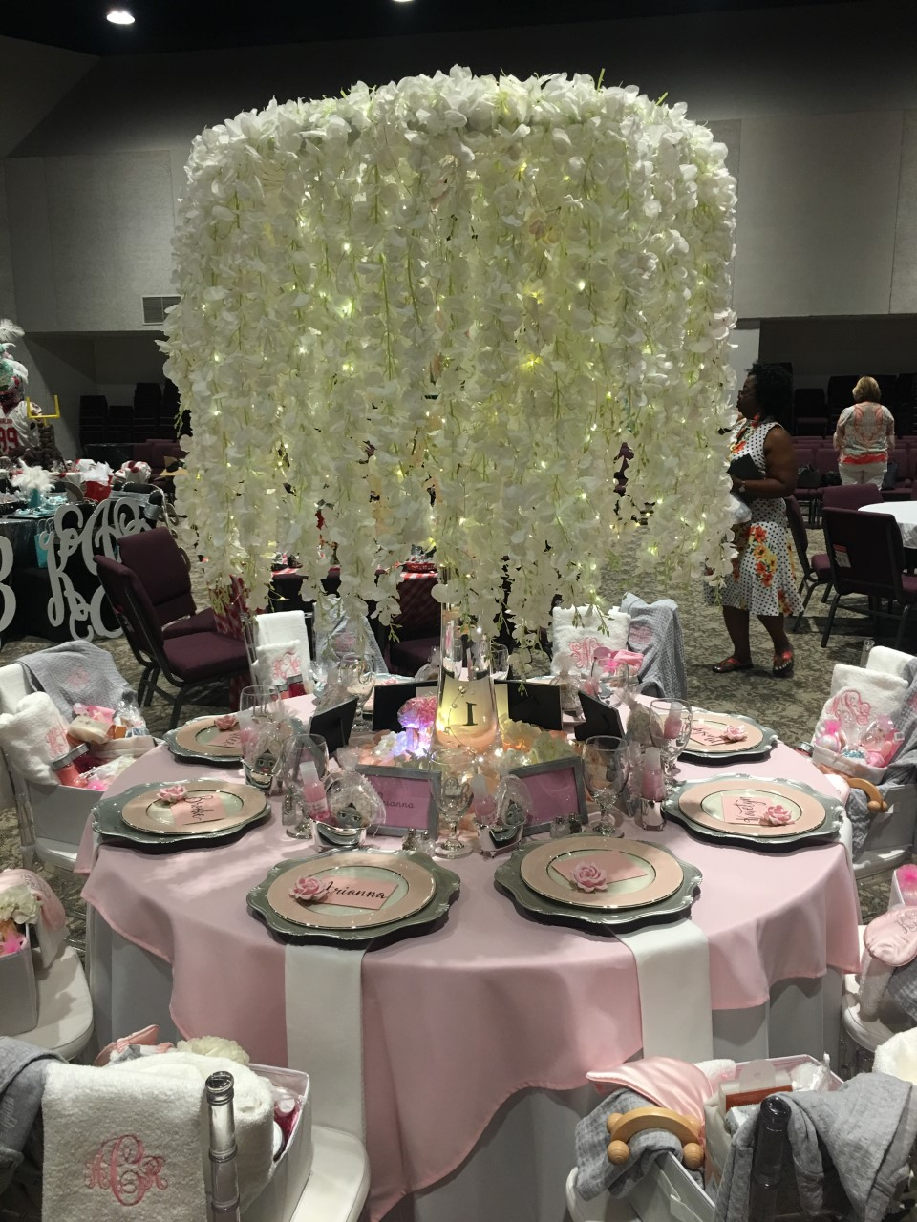

Slide 11
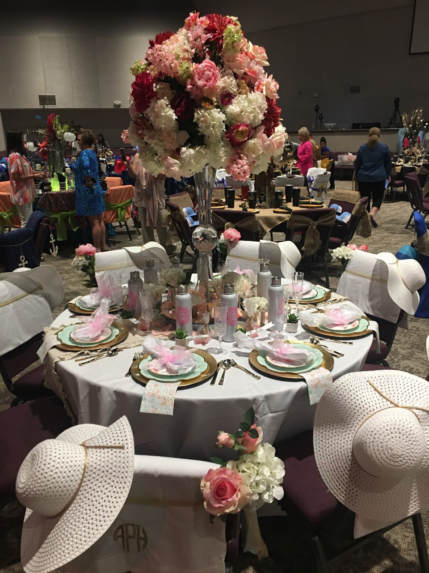

Slide 12
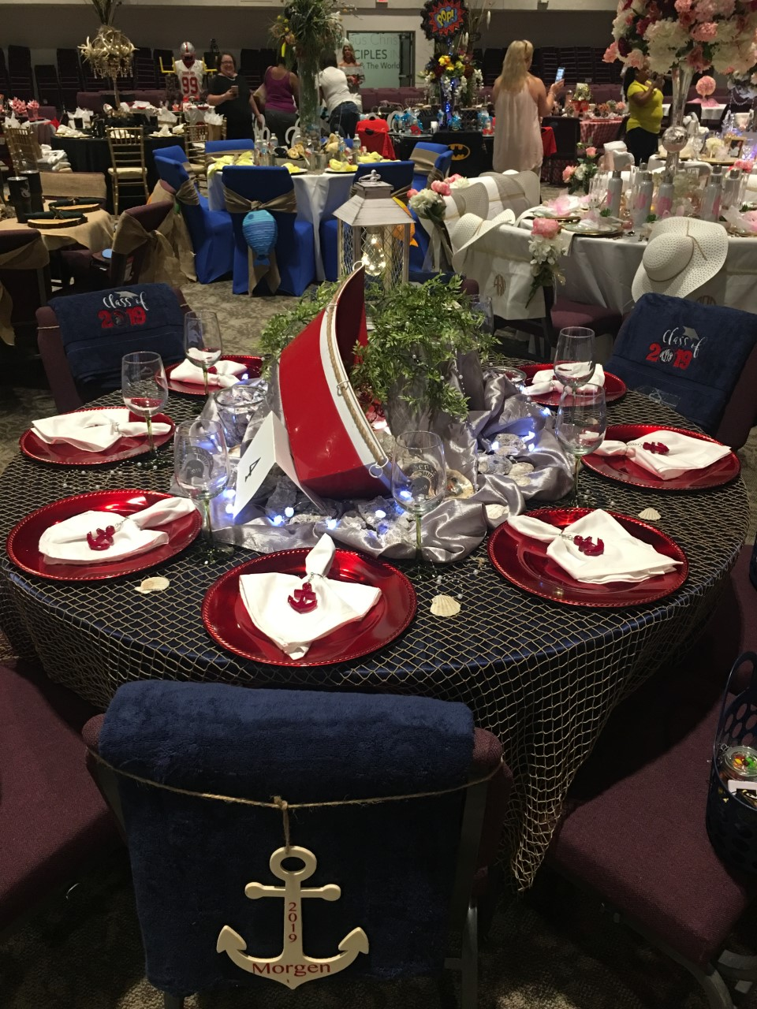

Slide 13
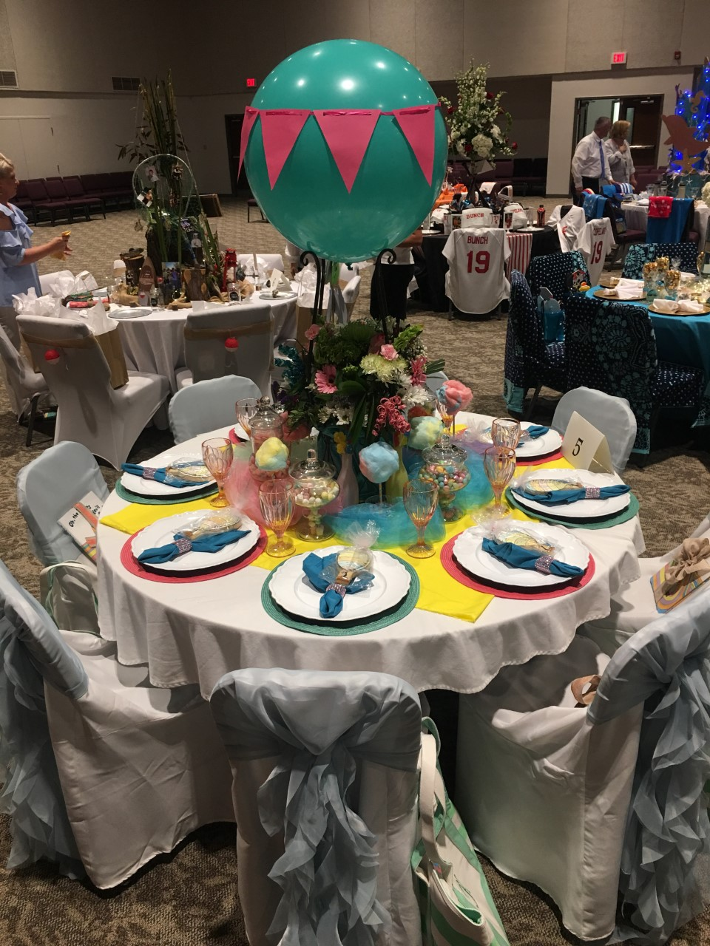

Slide 14
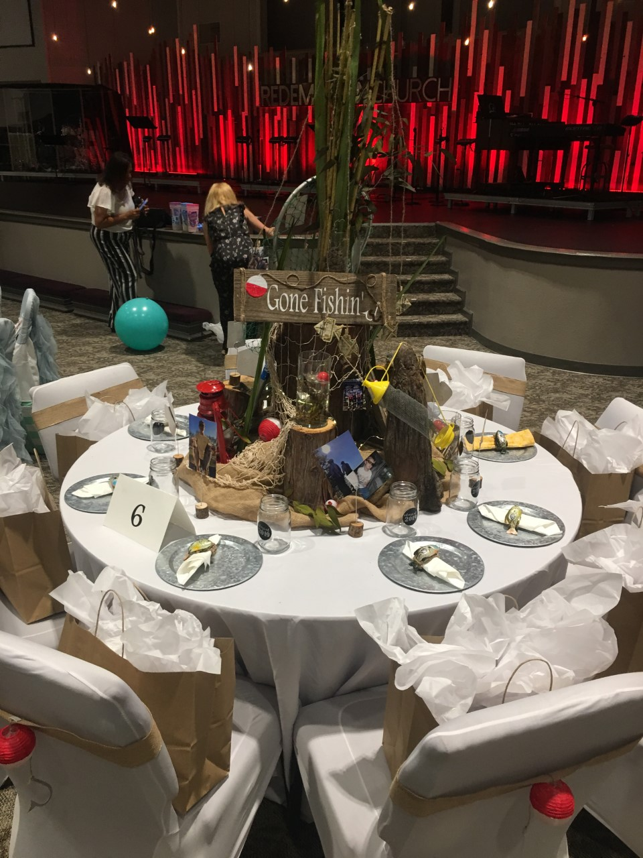

Slide 15
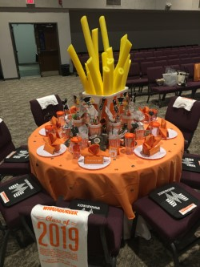

Slide 16
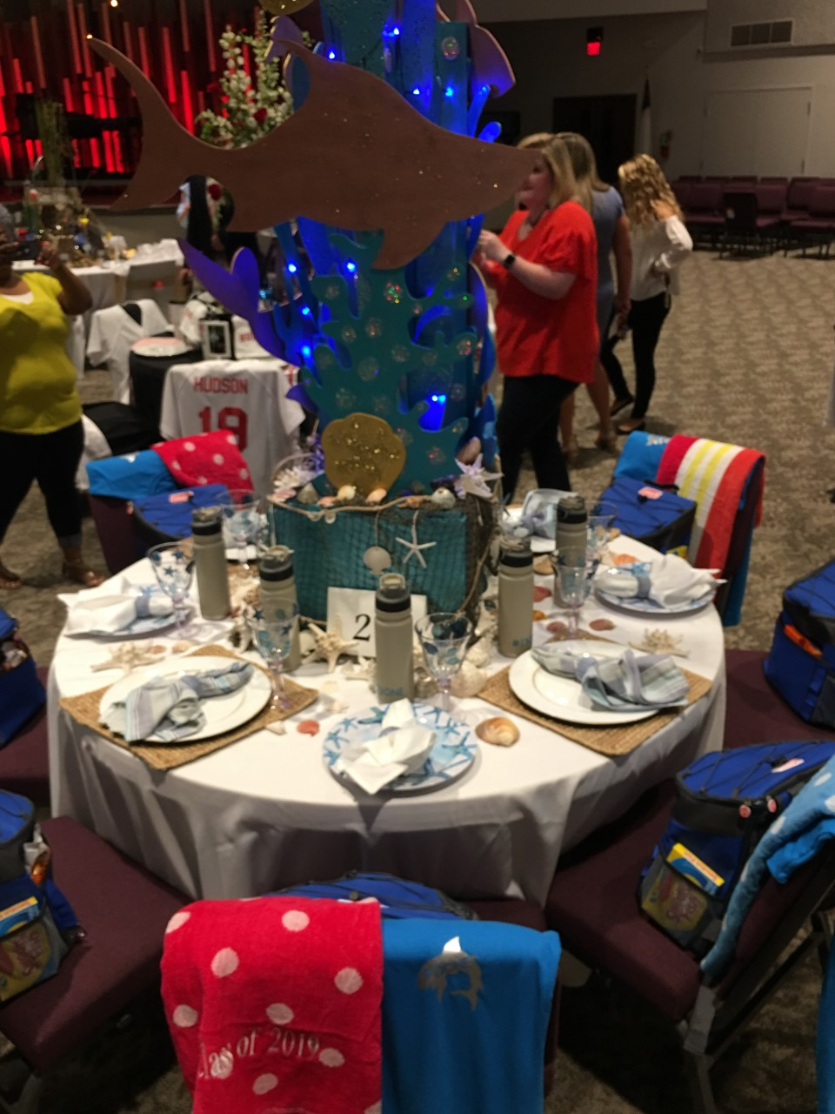

Slide 17
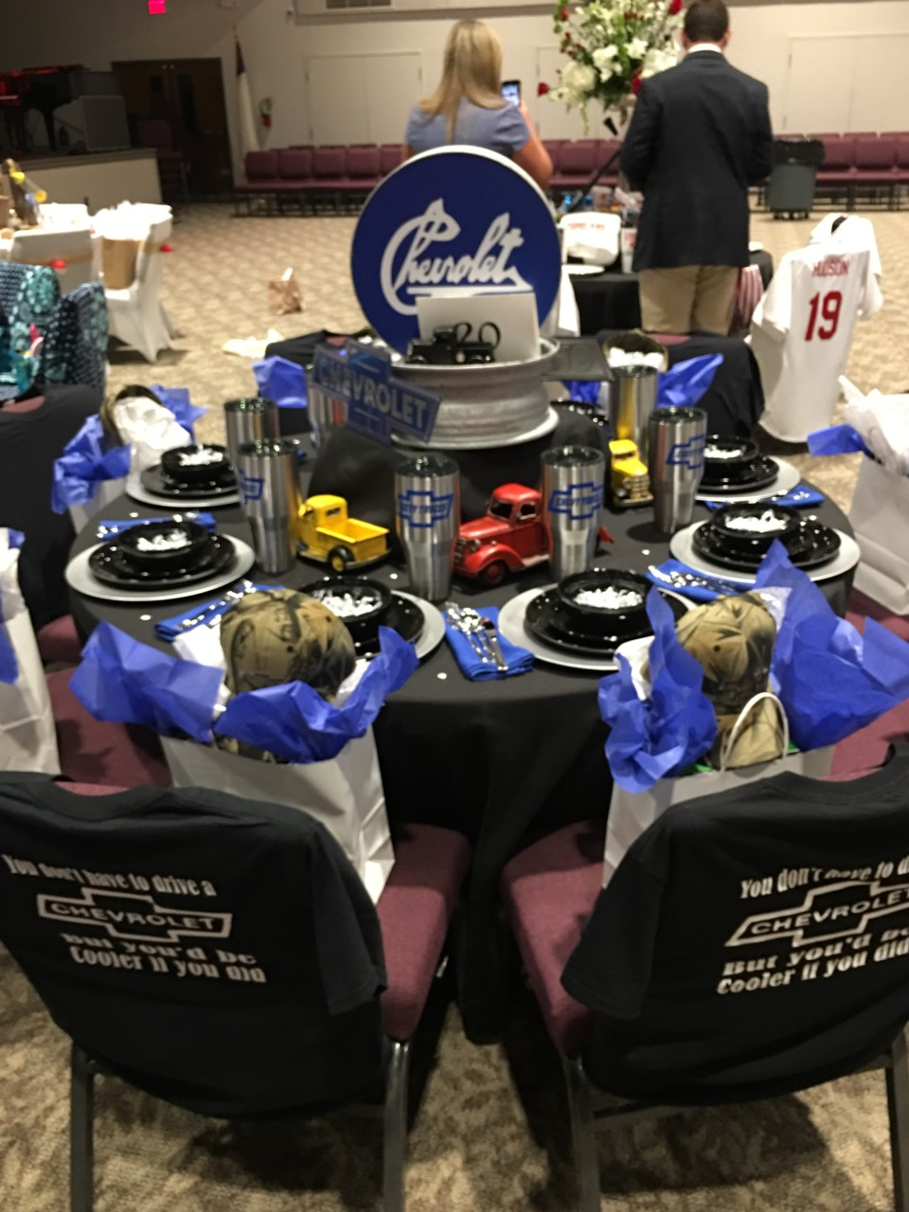

Slide 18
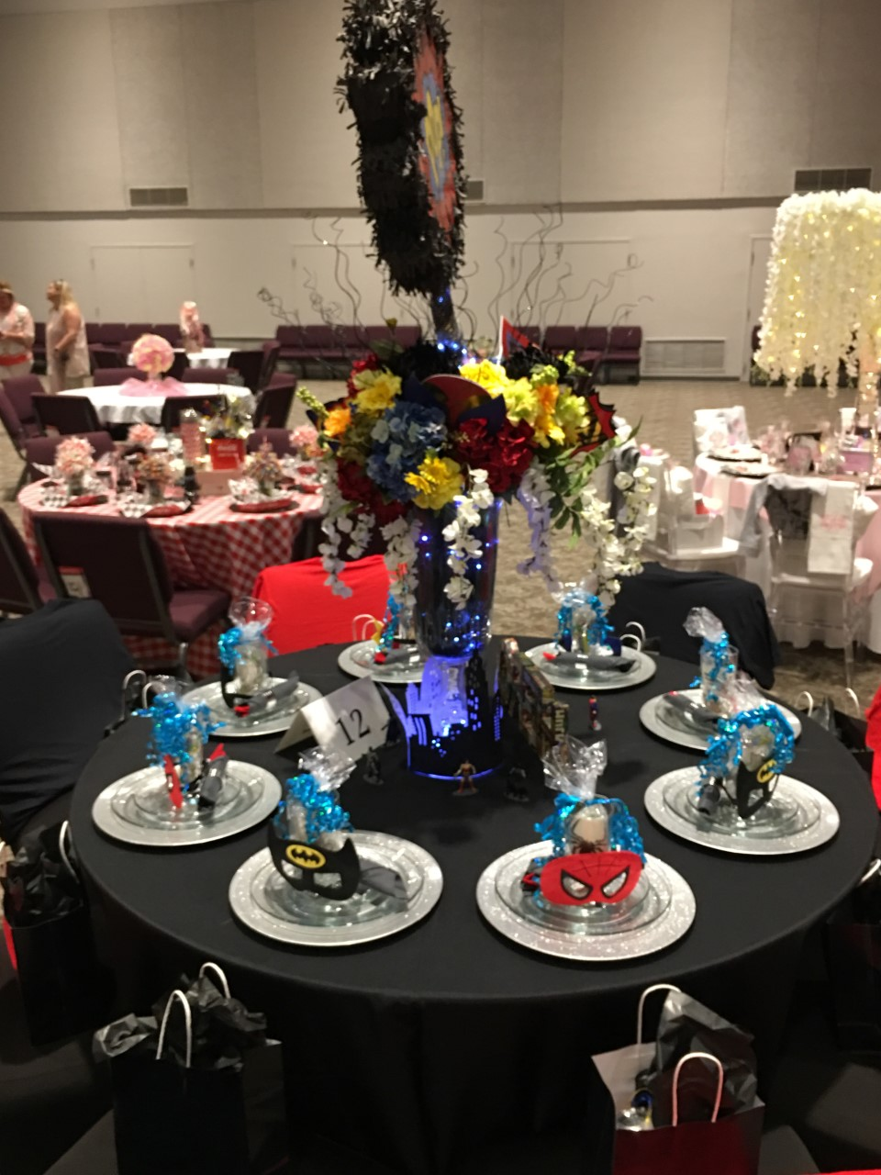

Slide 19
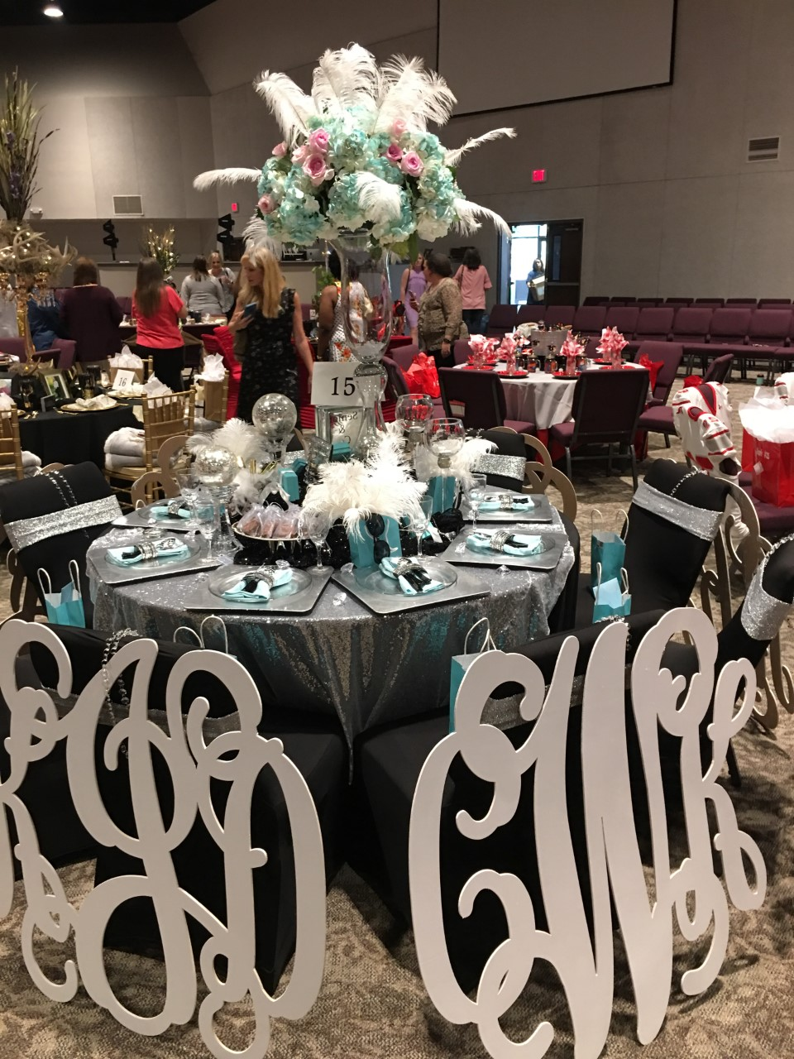
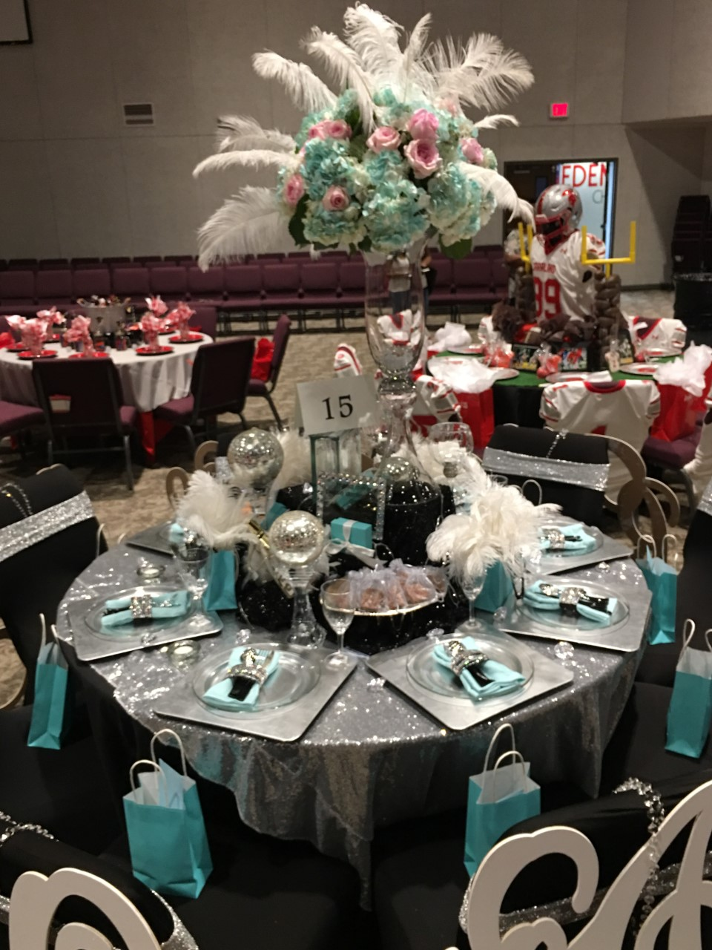

Slide 20
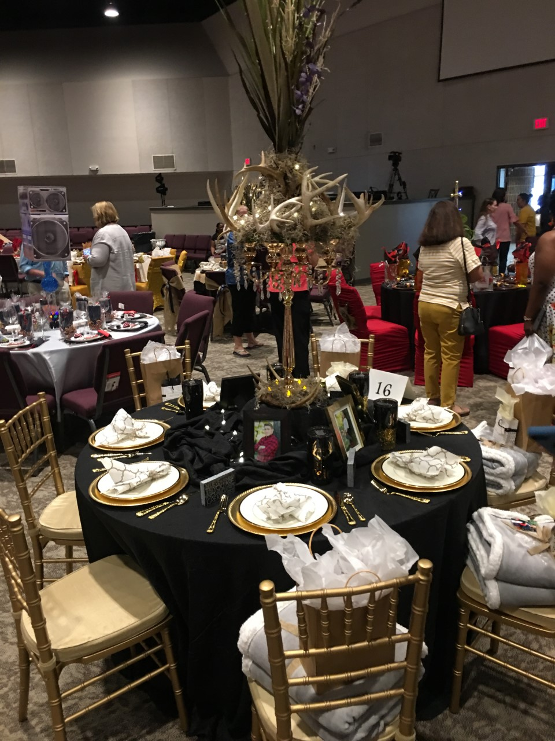

Slide 21
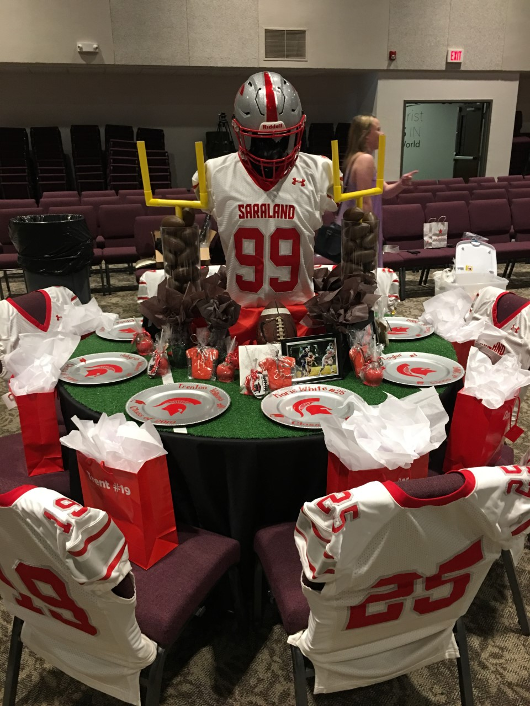

Slide 22
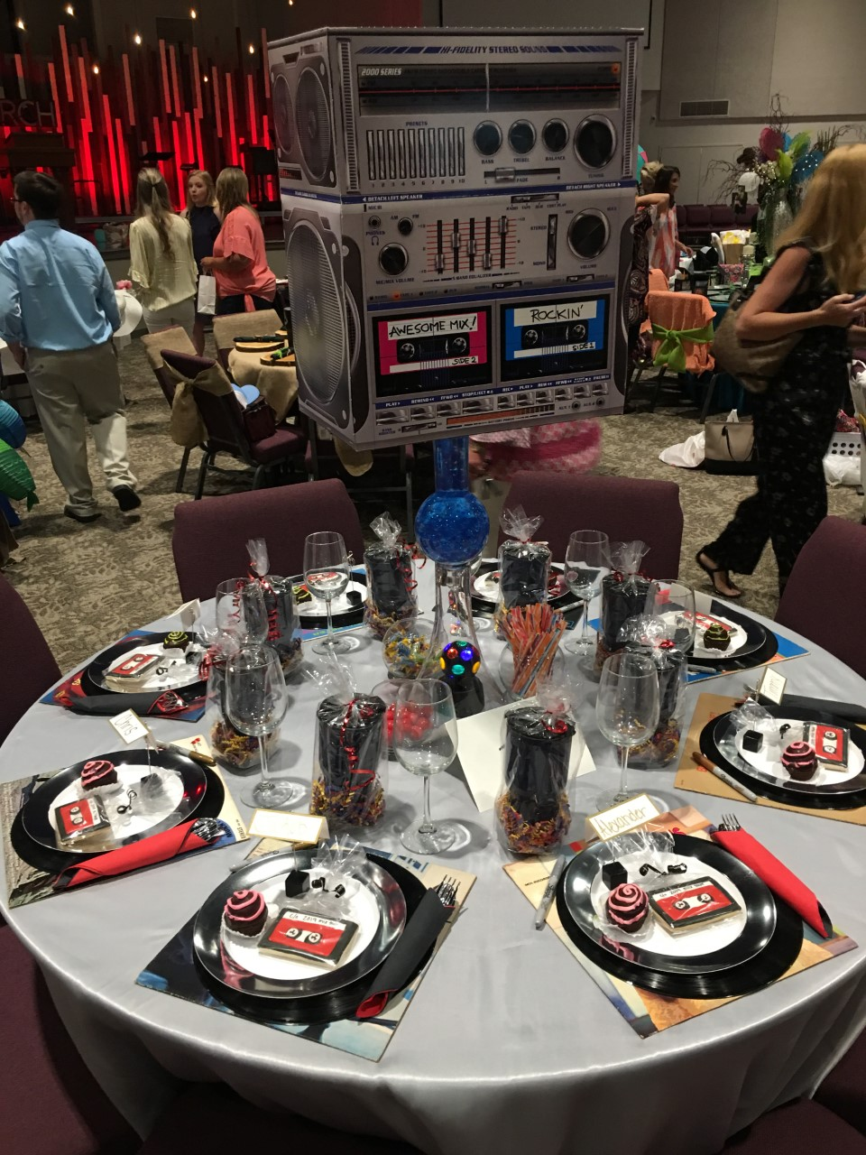

Slide 23
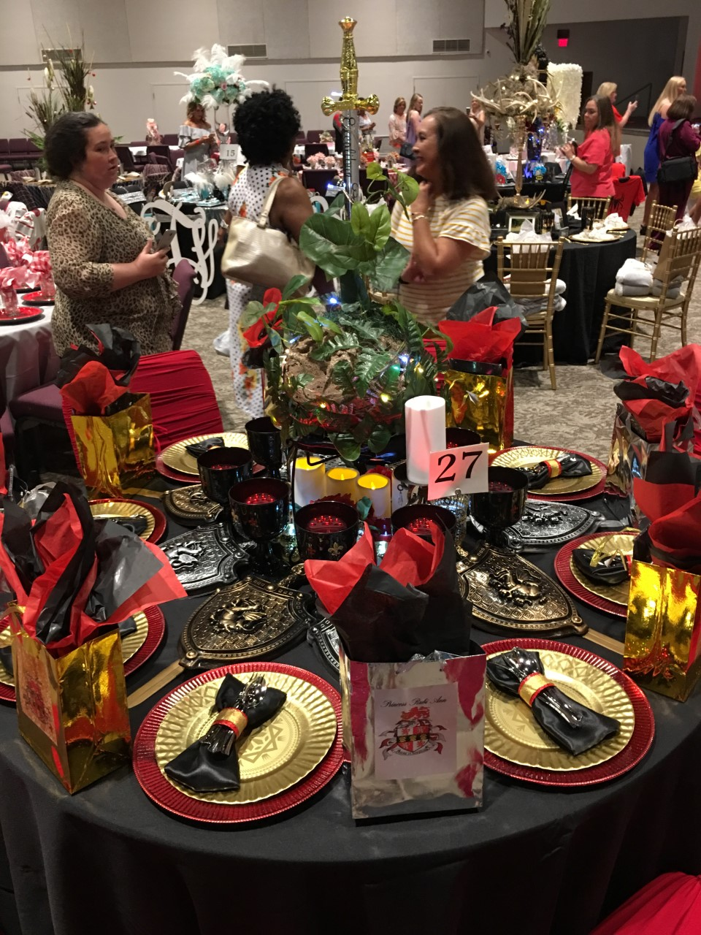

Slide 24
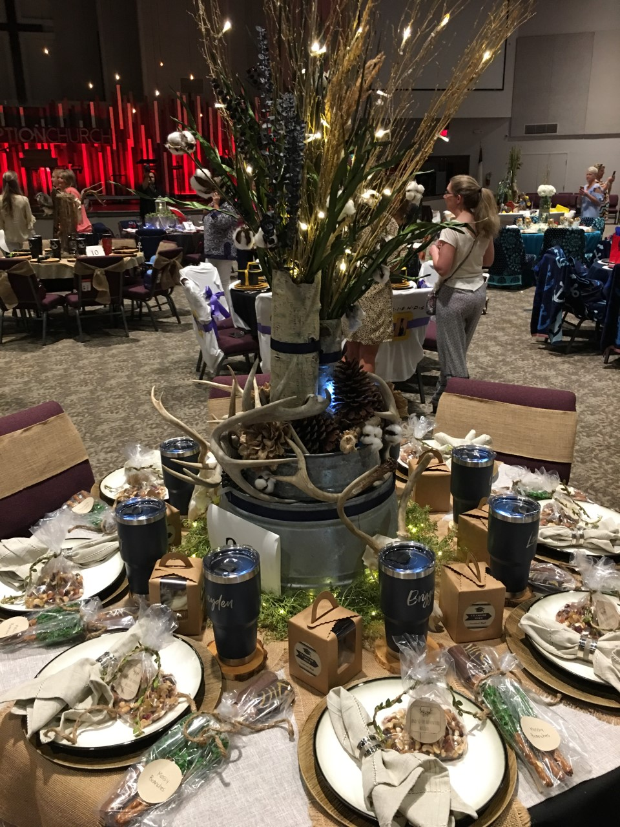

Slide 25
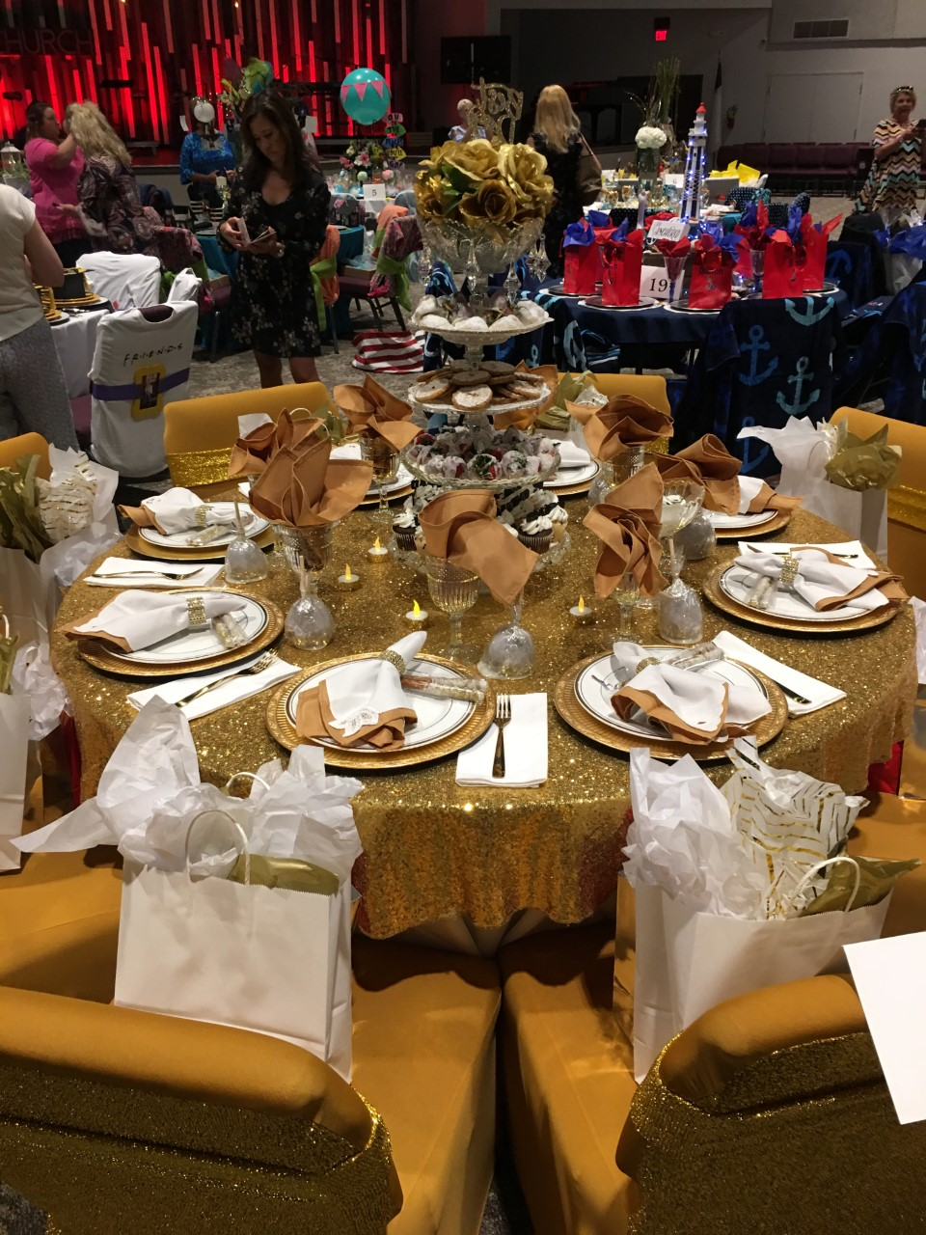

Slide 26
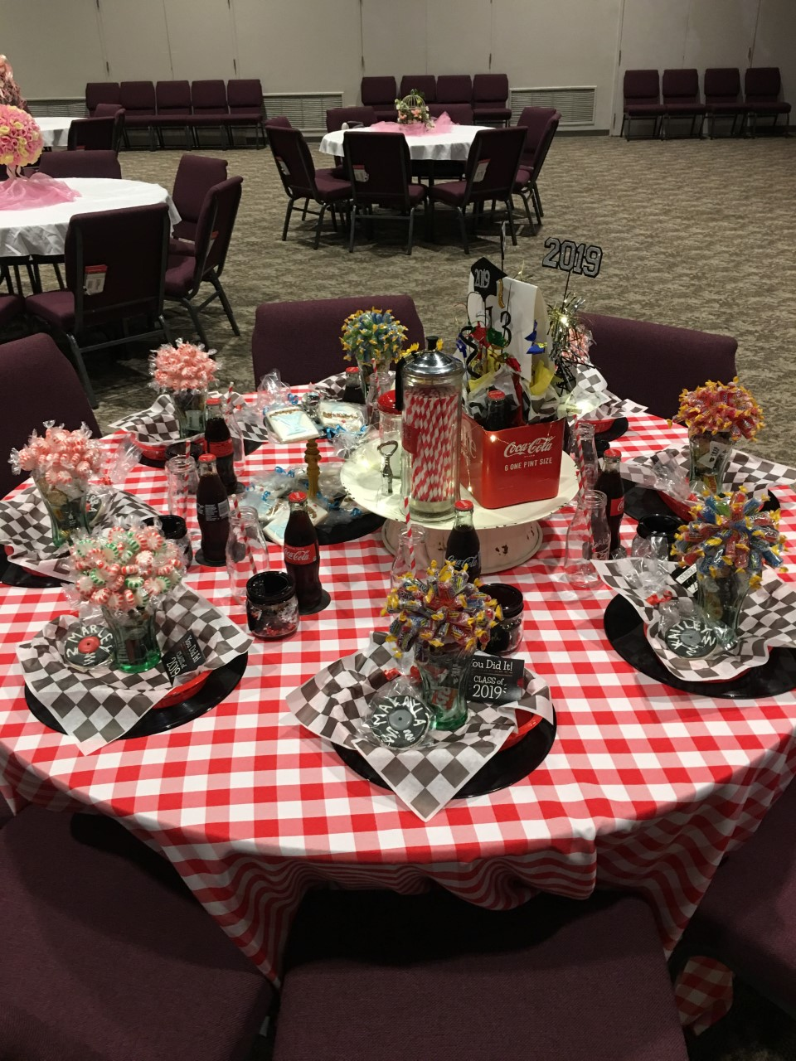

Slide 27
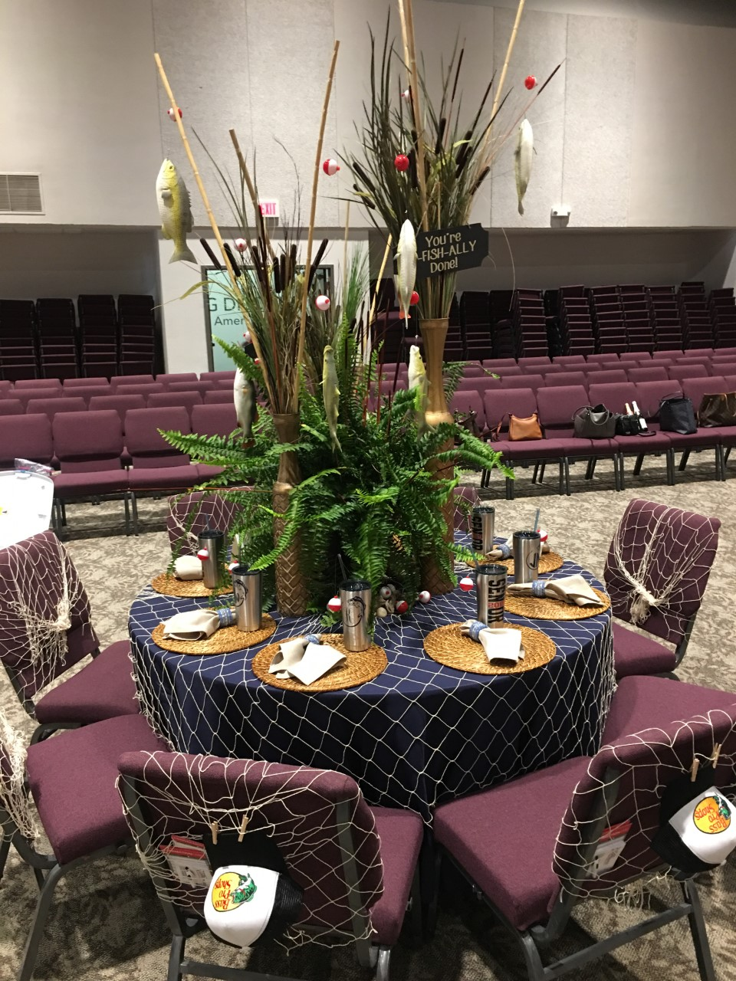

Slide 28
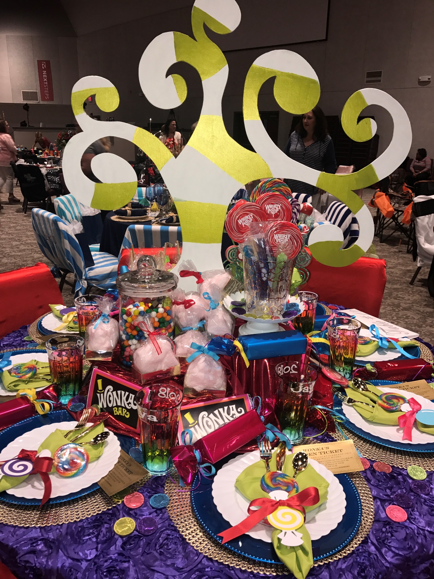

Slide 29
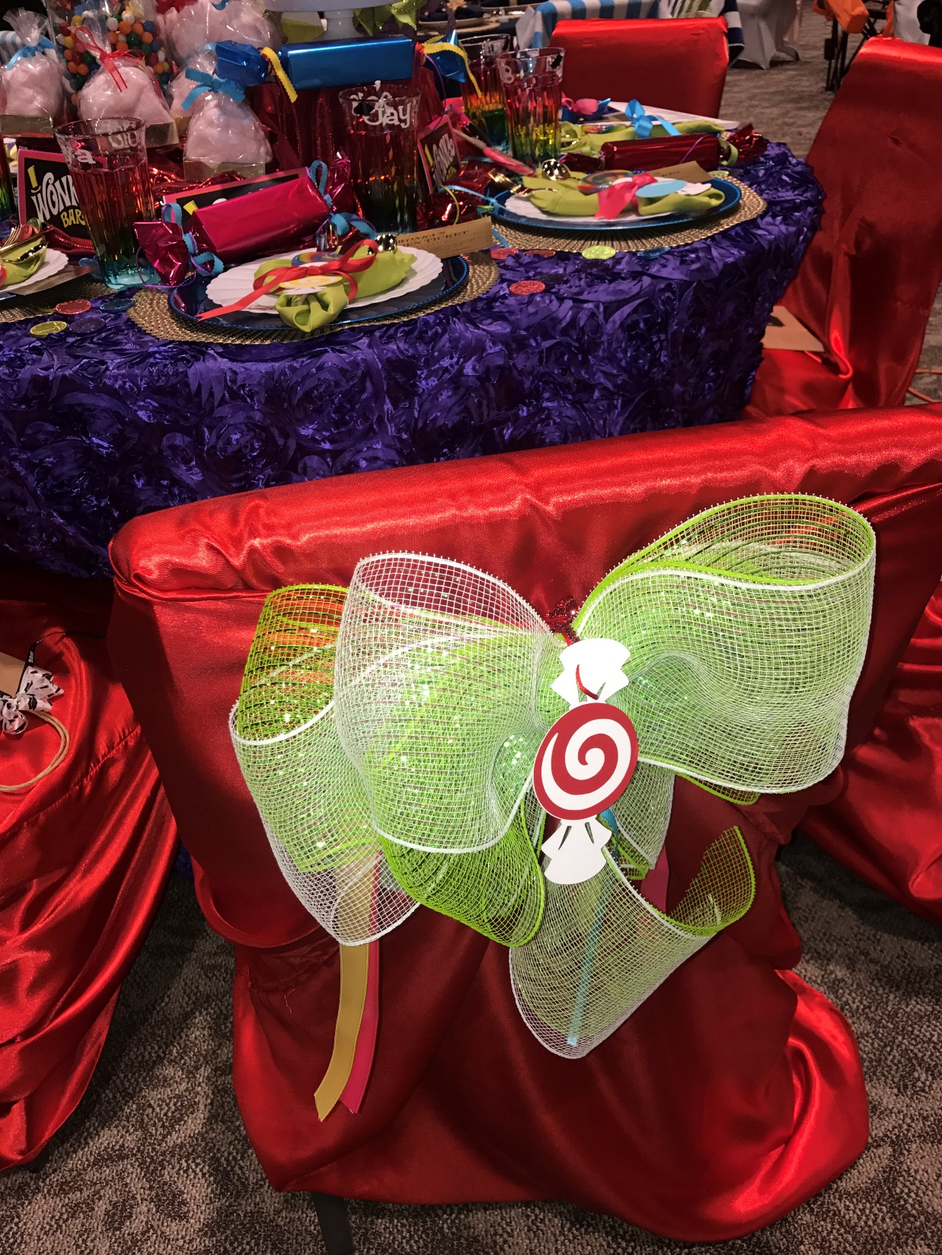

Slide 30
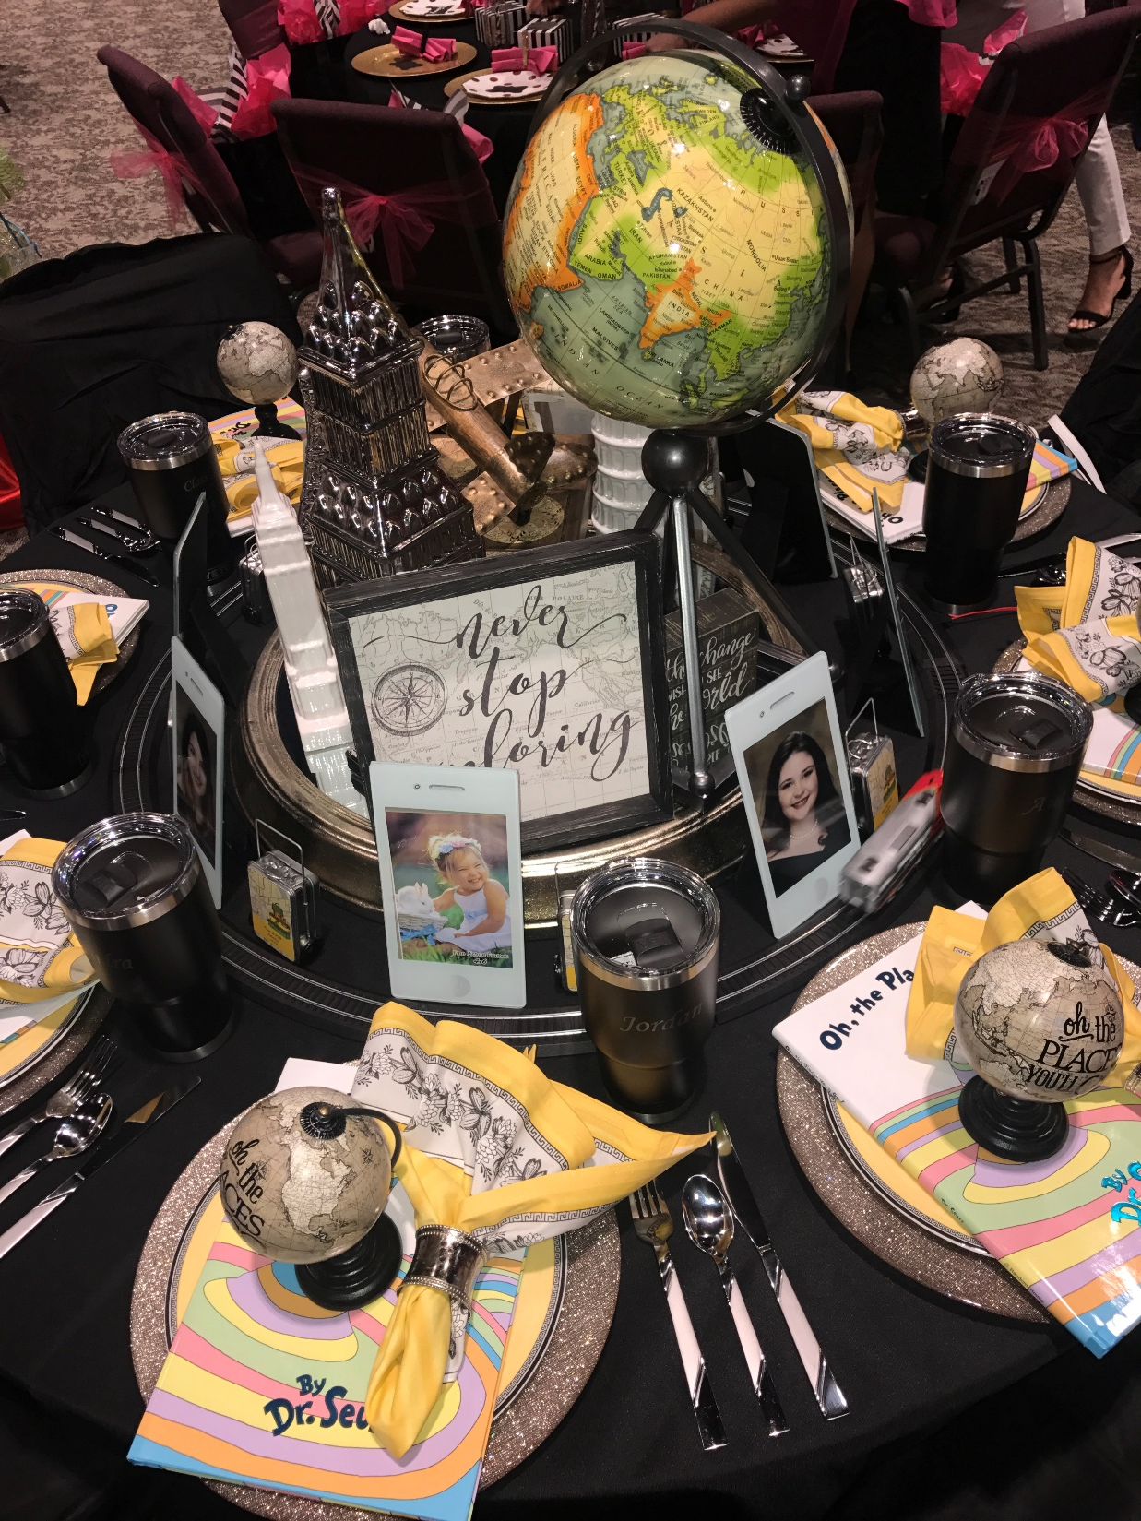

Slide 31
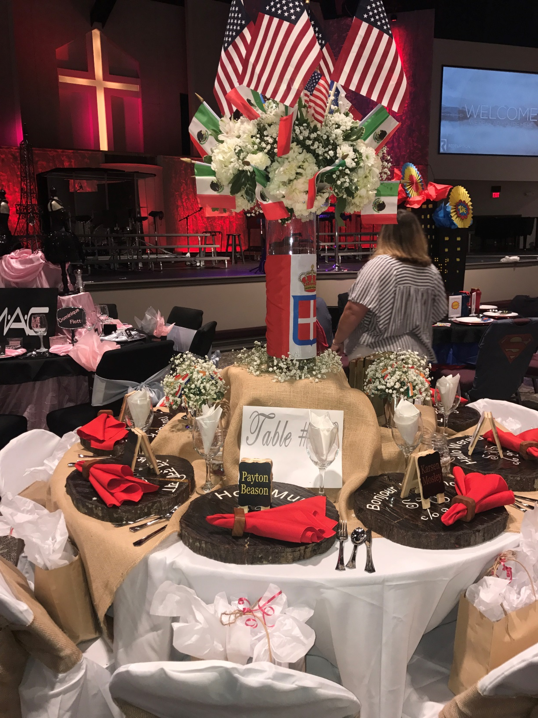

Slide 32
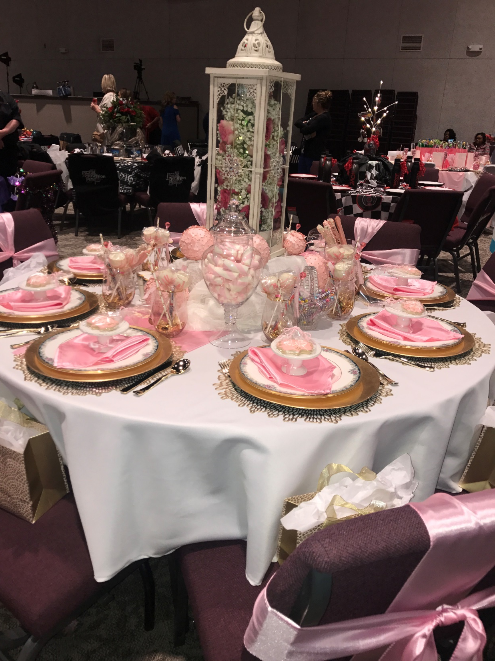

Slide 33
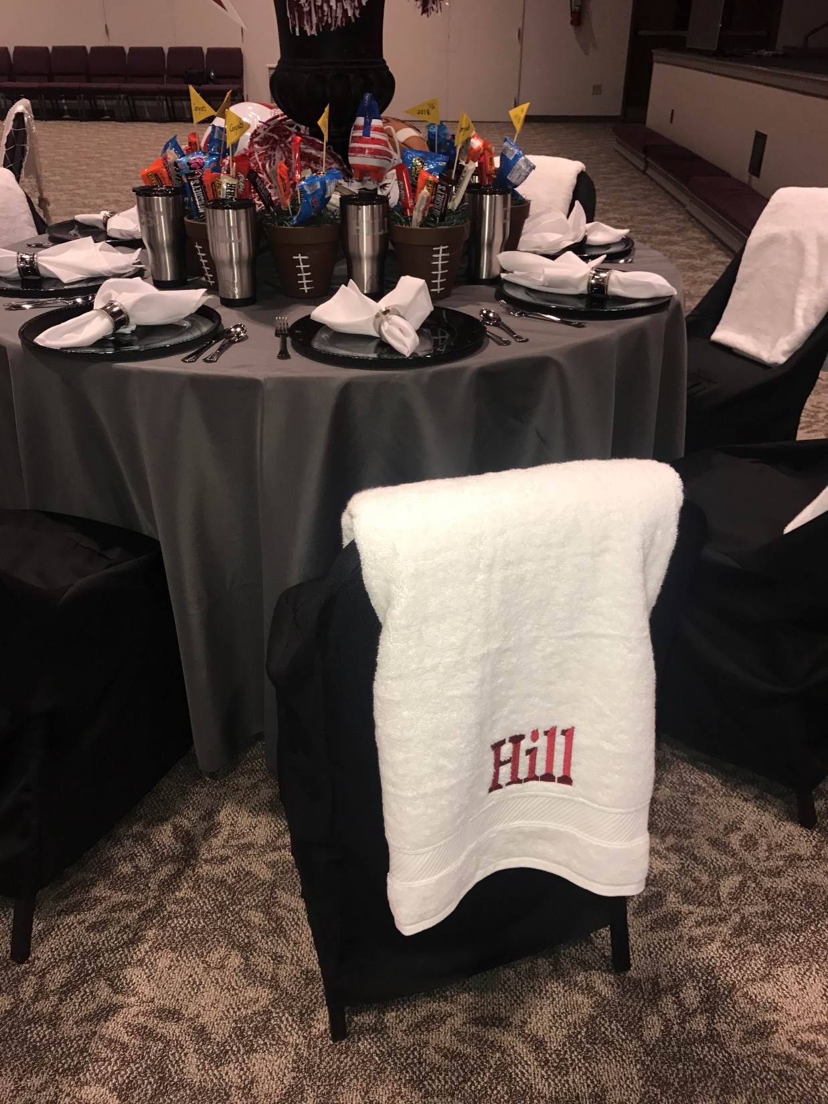

Slide 34
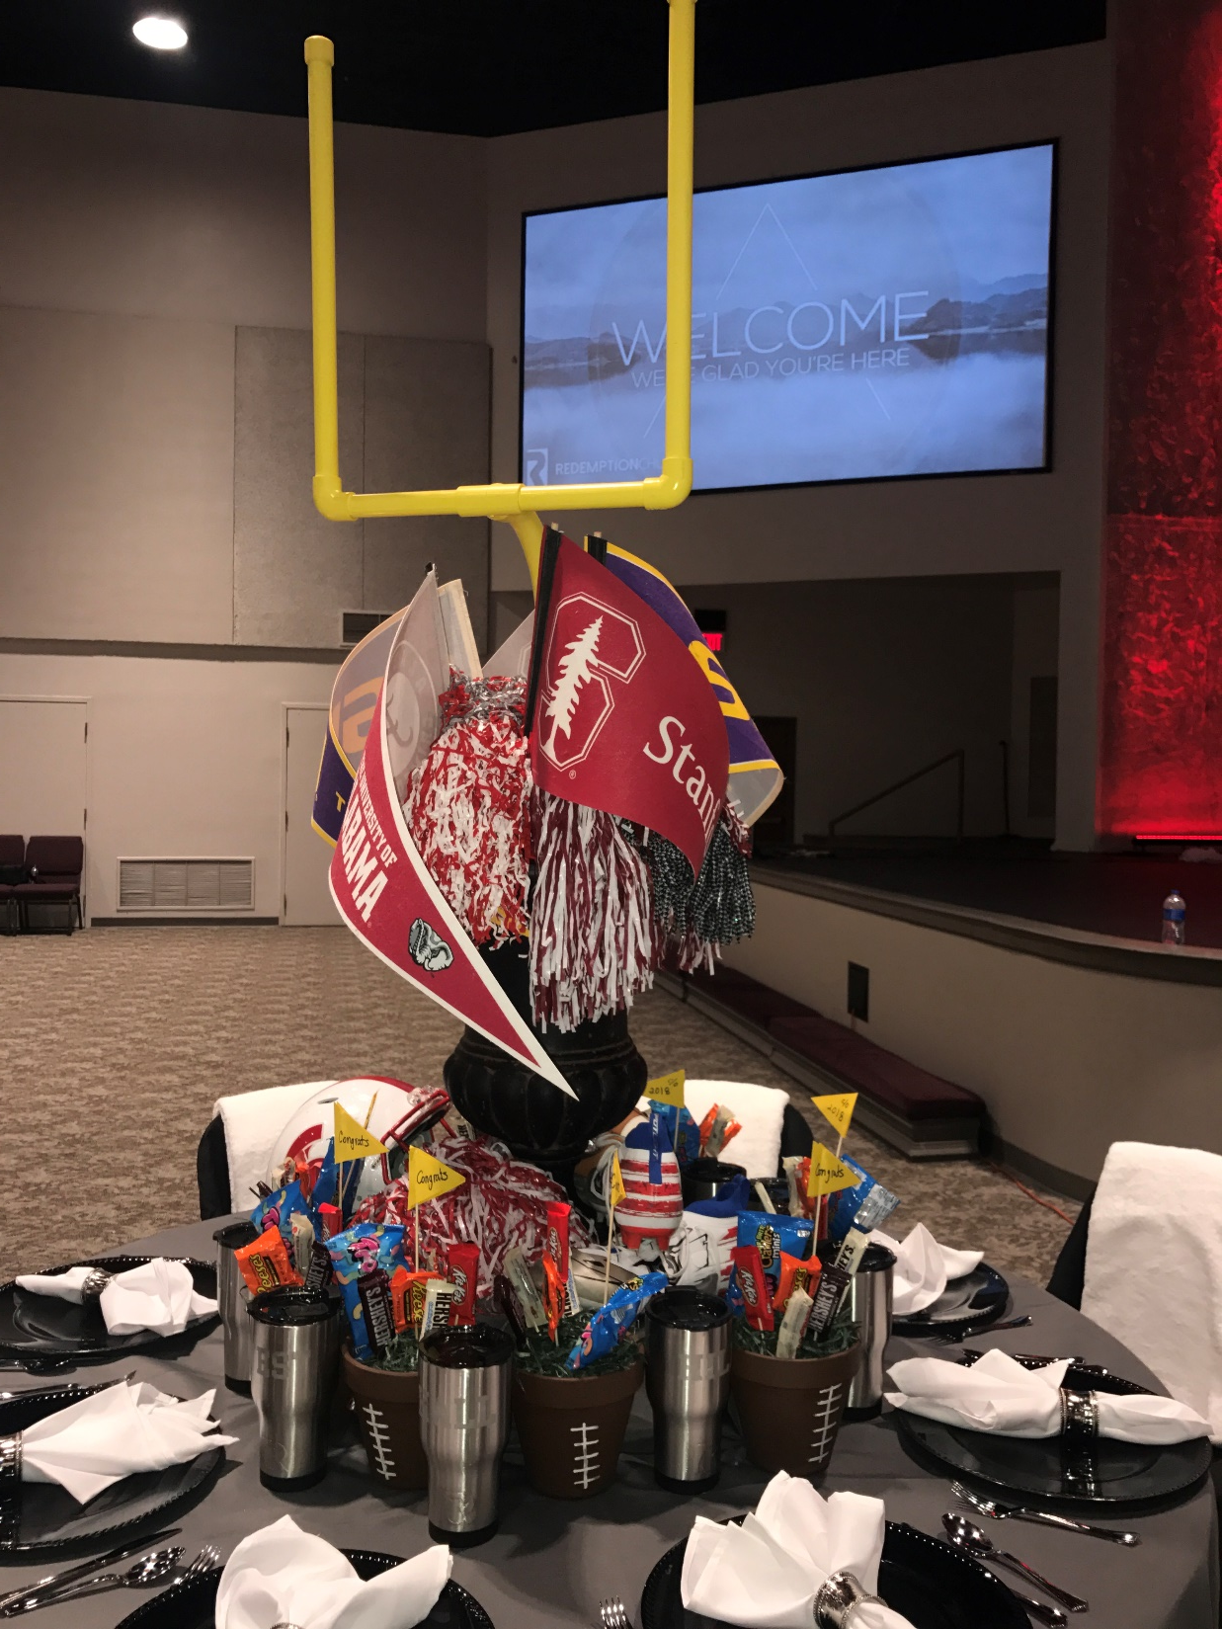

Slide 35
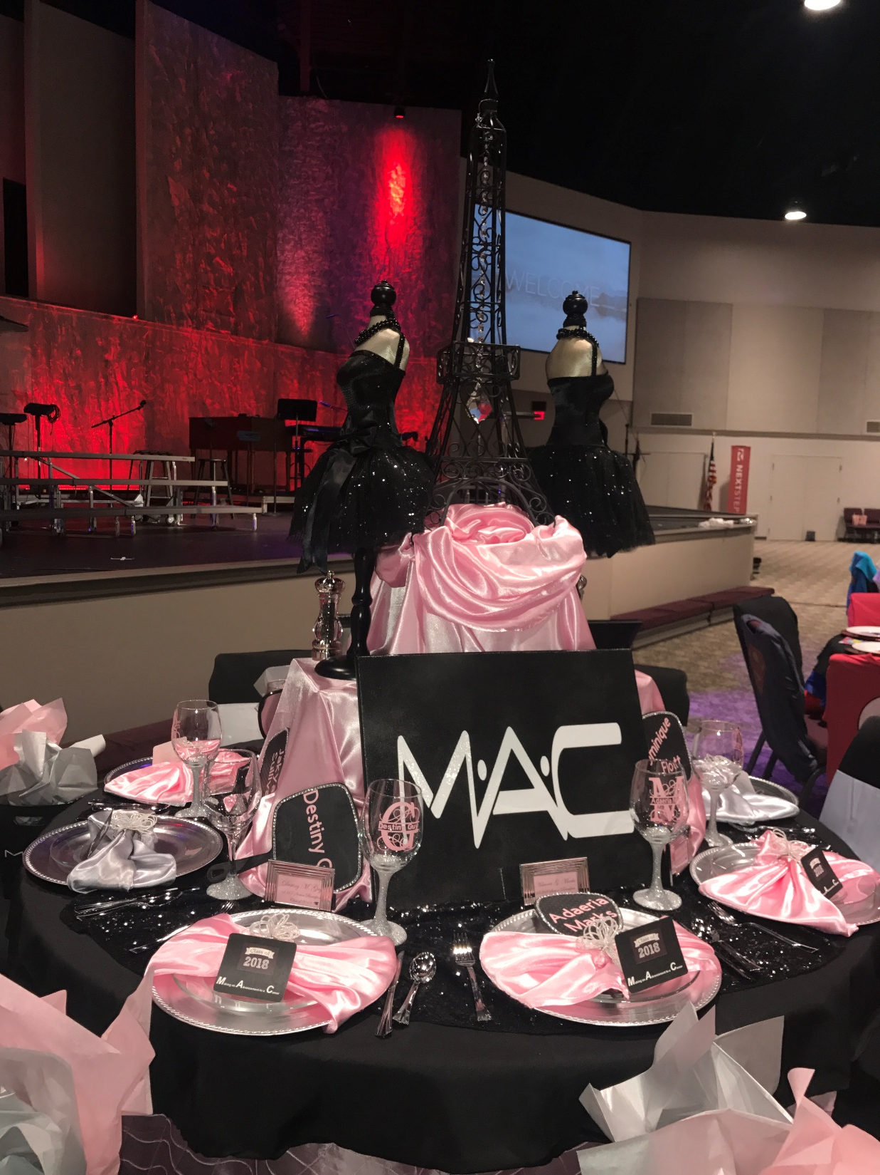

Slide 36
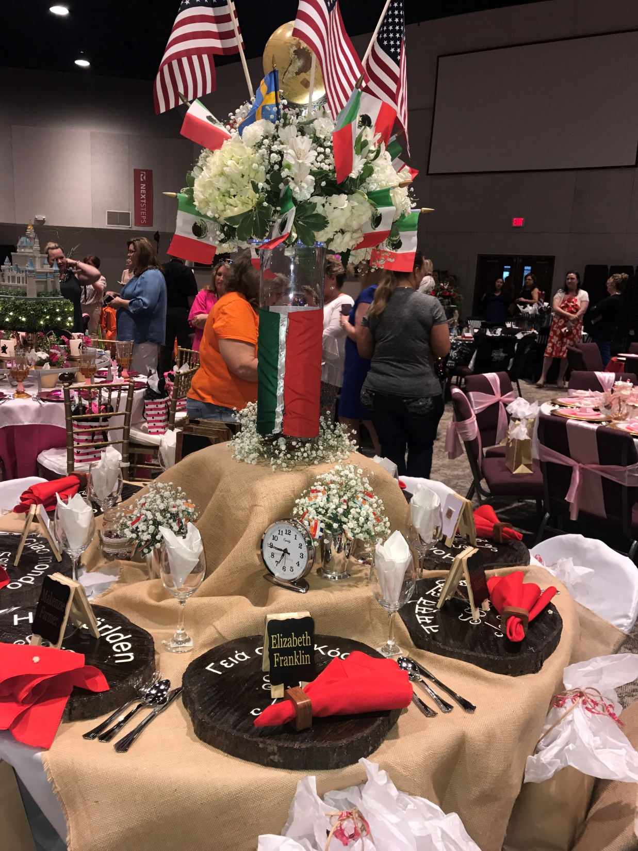

Slide 37
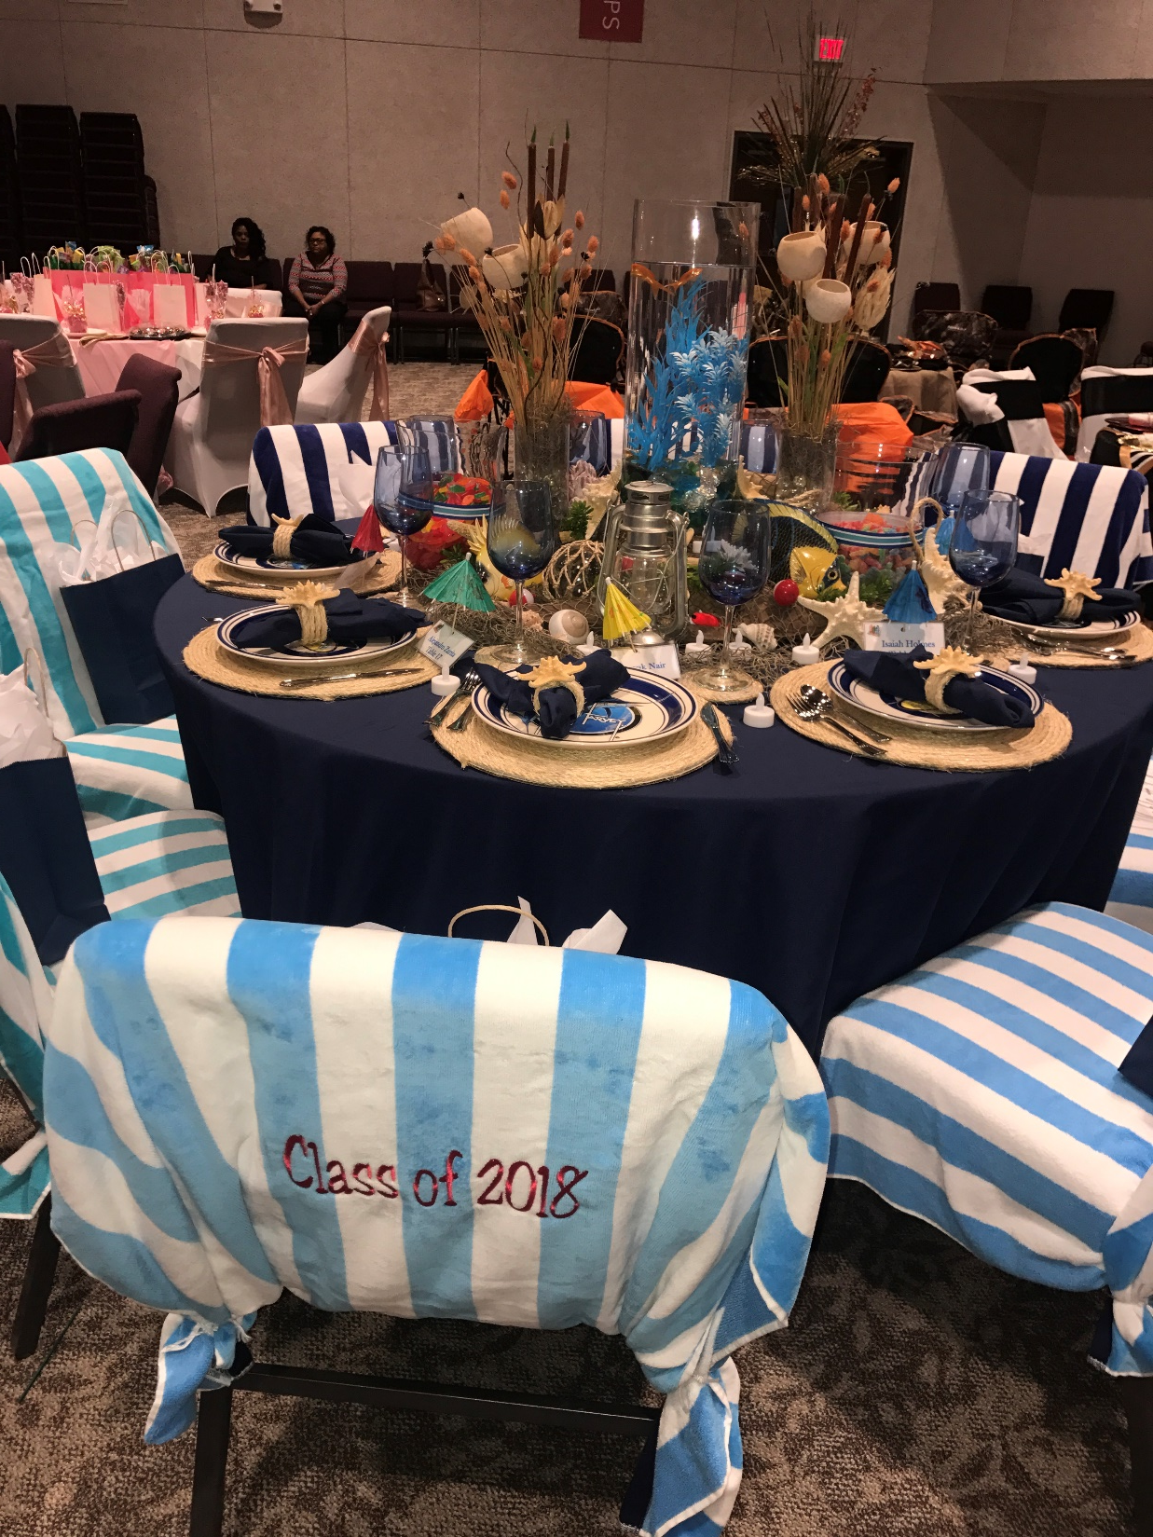

Slide 38
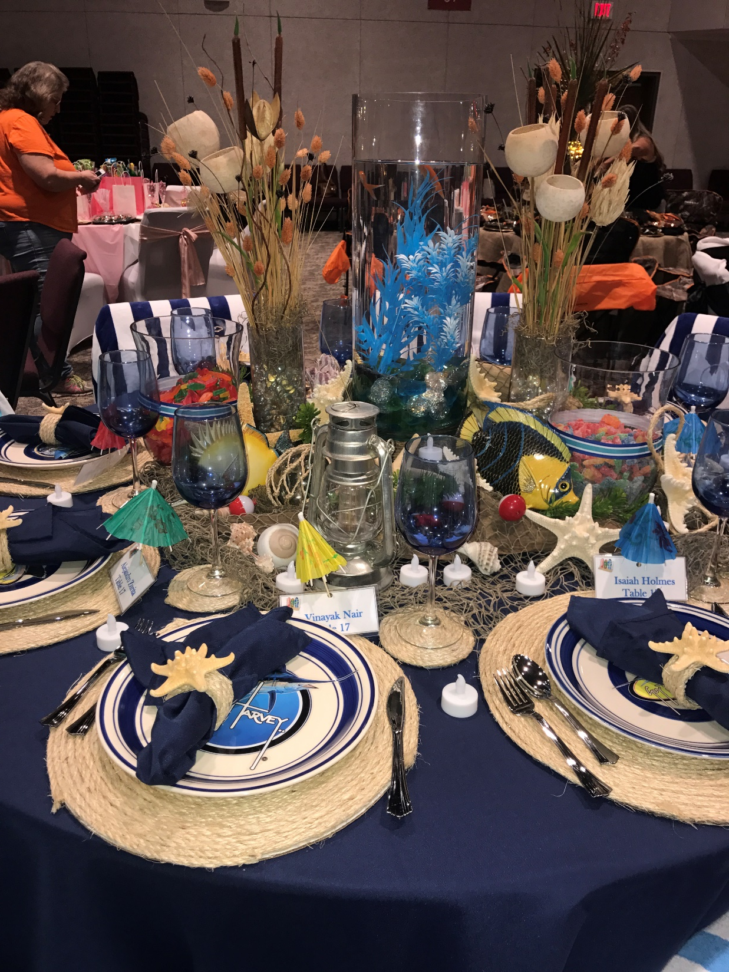

Slide 39
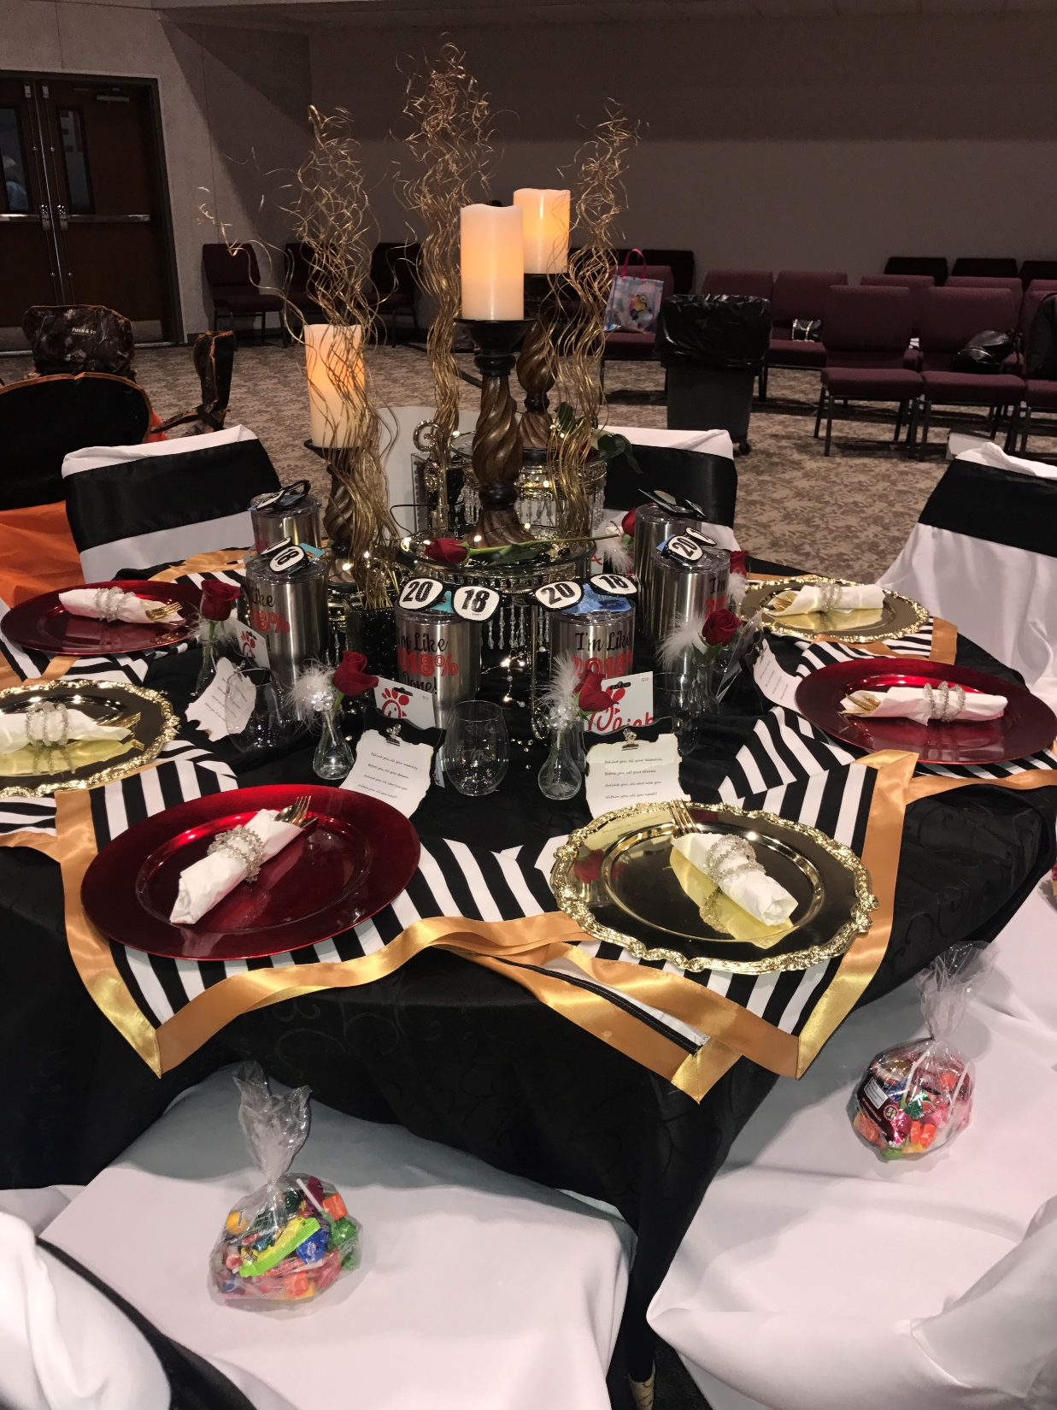

Slide 40
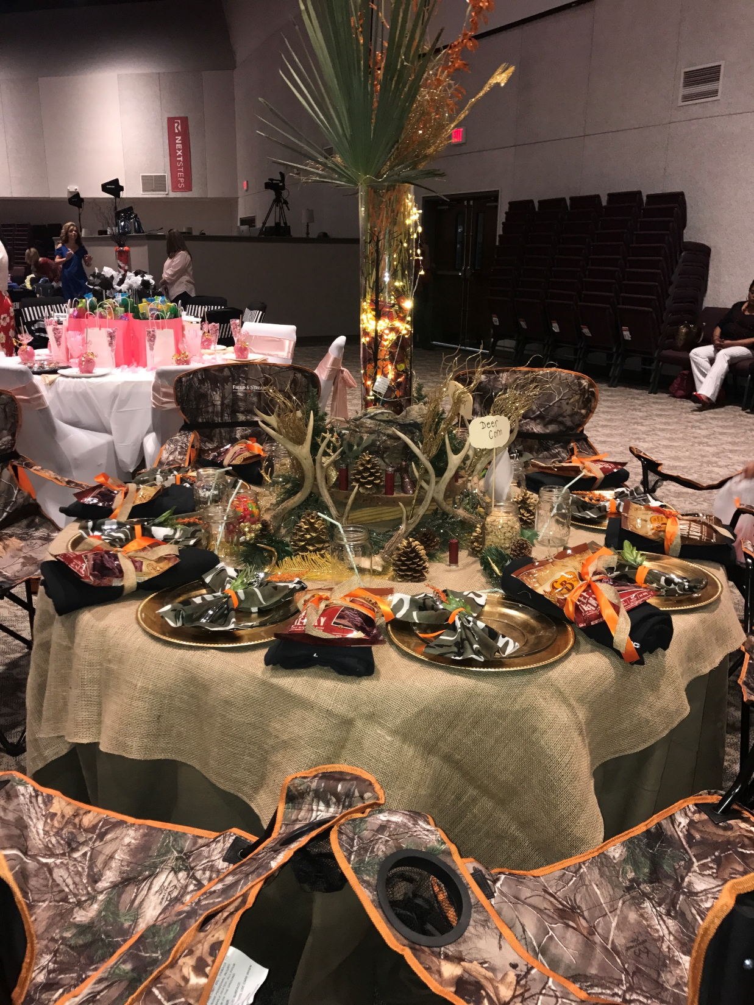

Slide 41
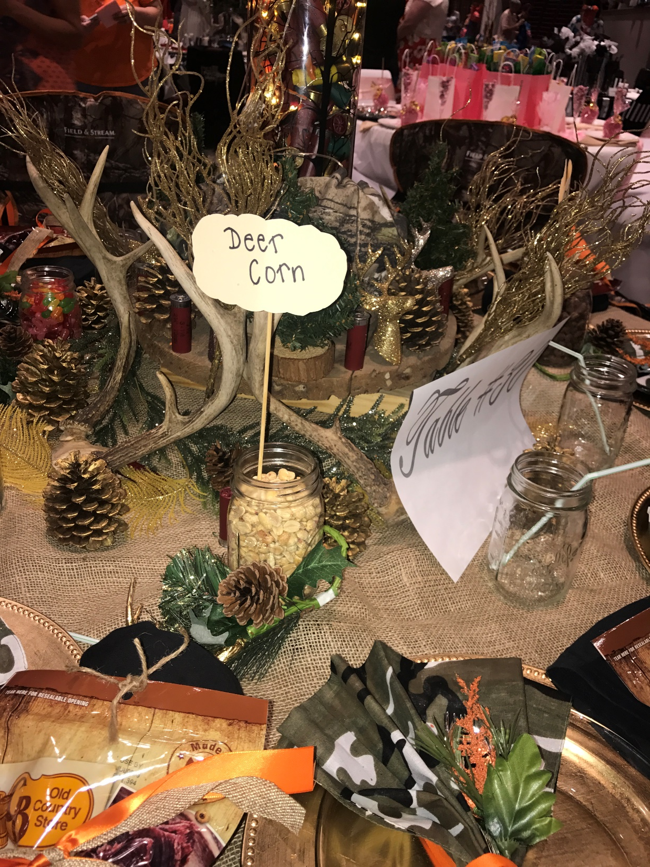

Slide 42
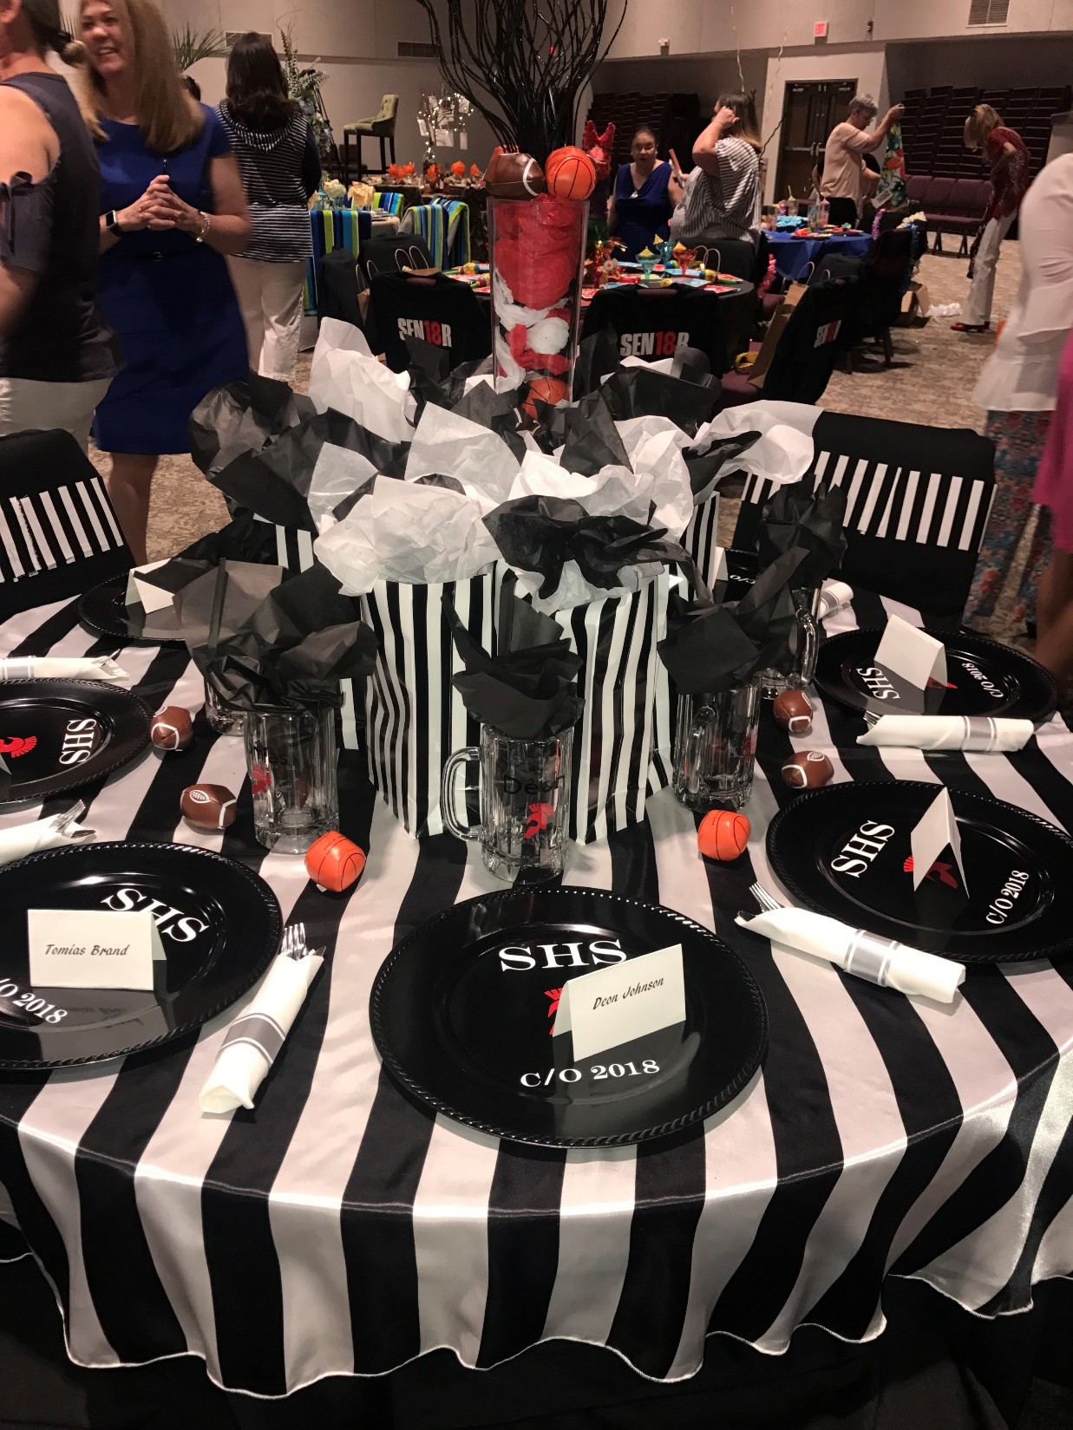

Slide 43
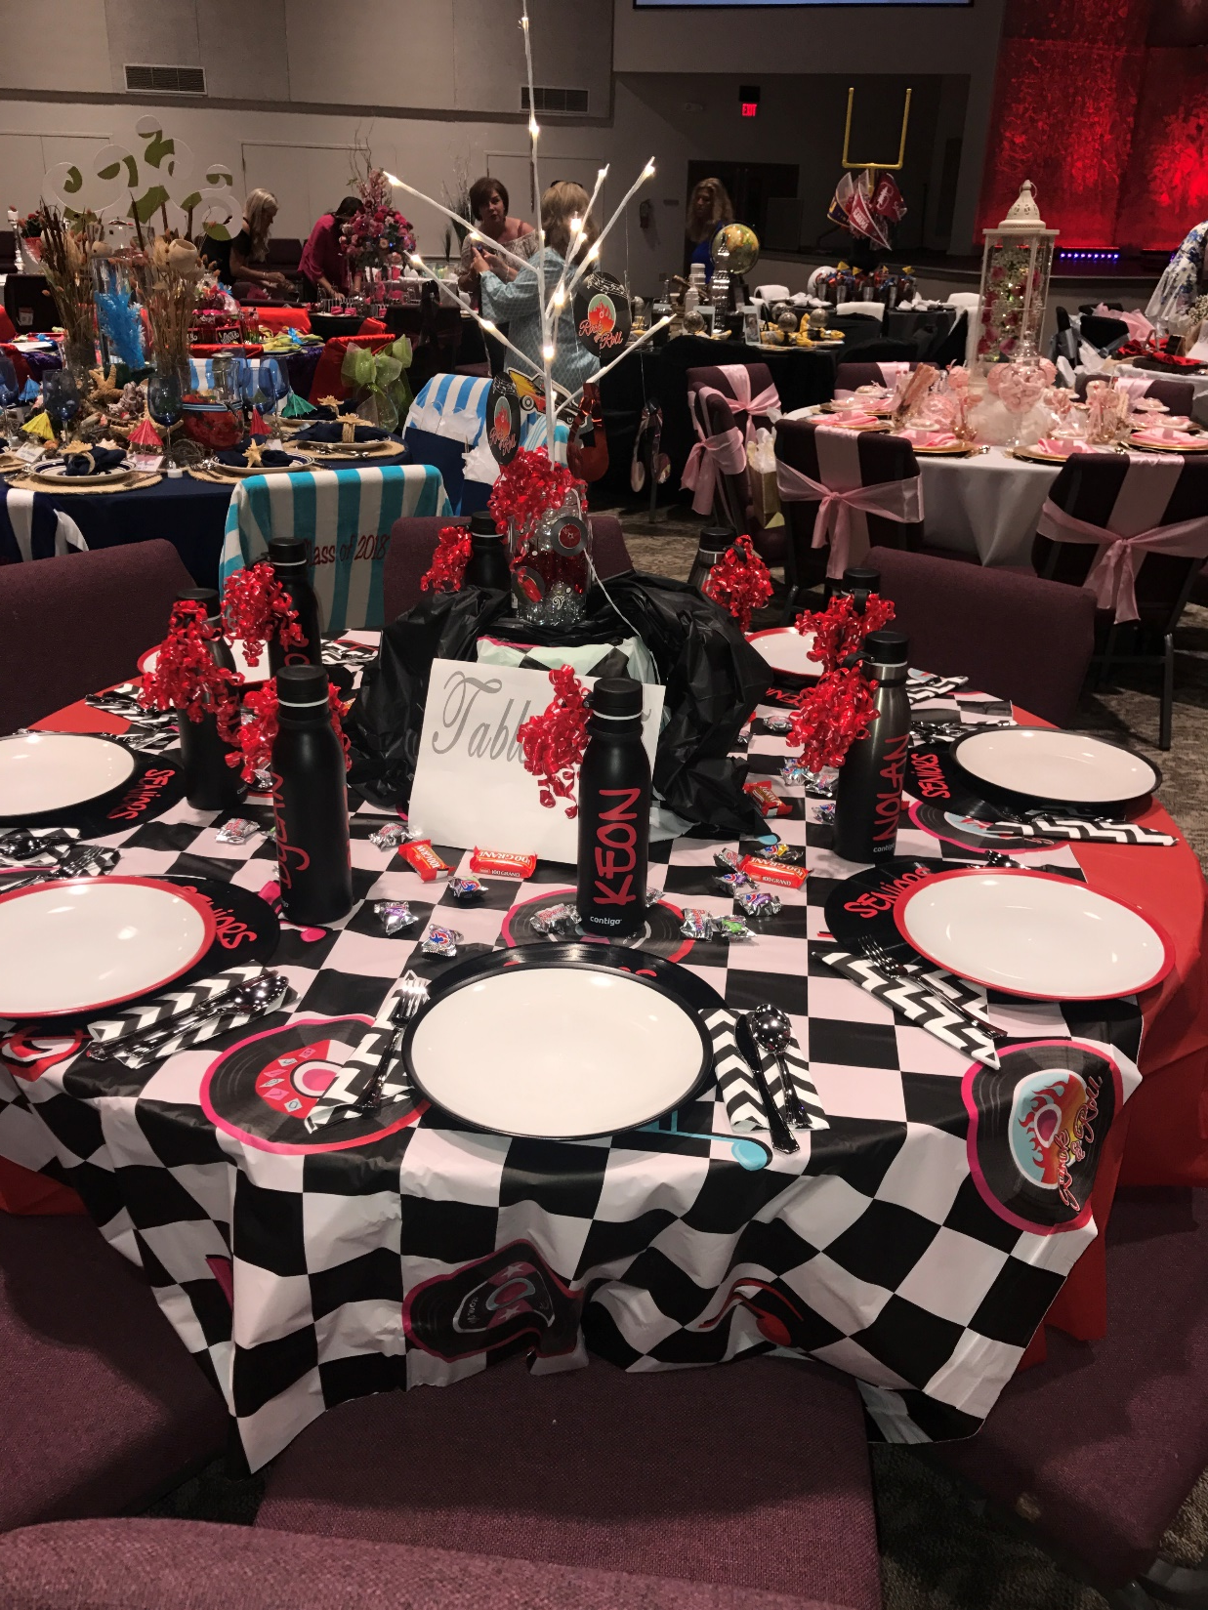

Slide 44
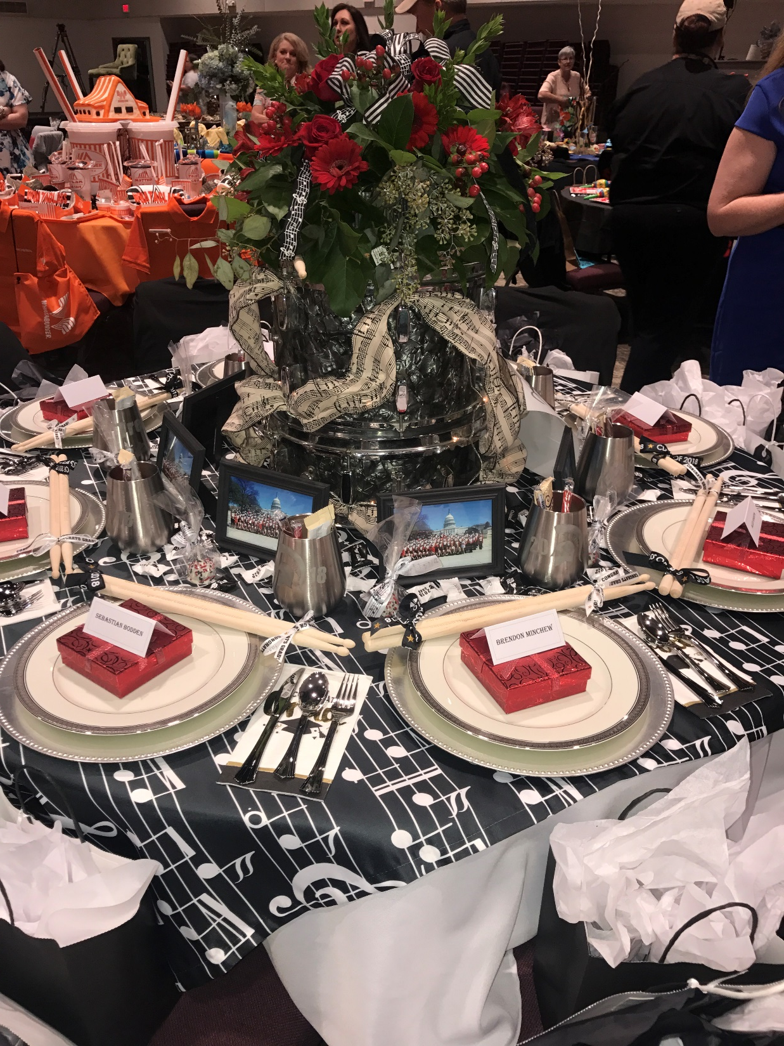

Slide 45
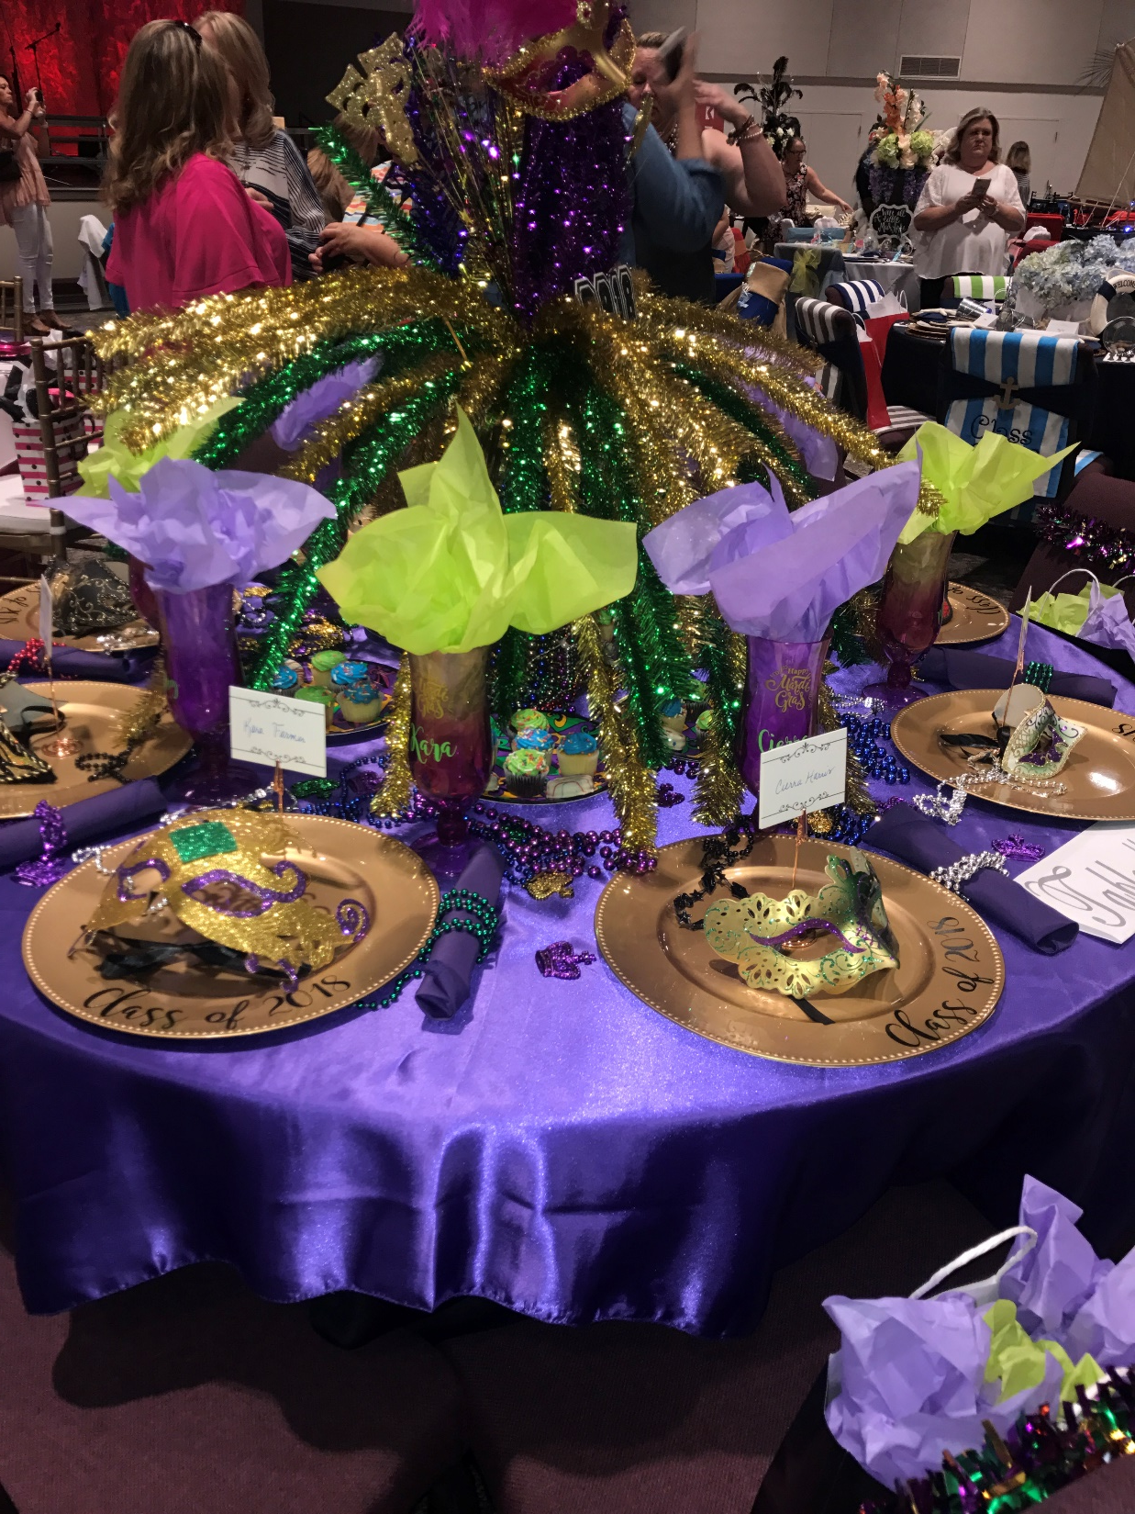

Slide 46
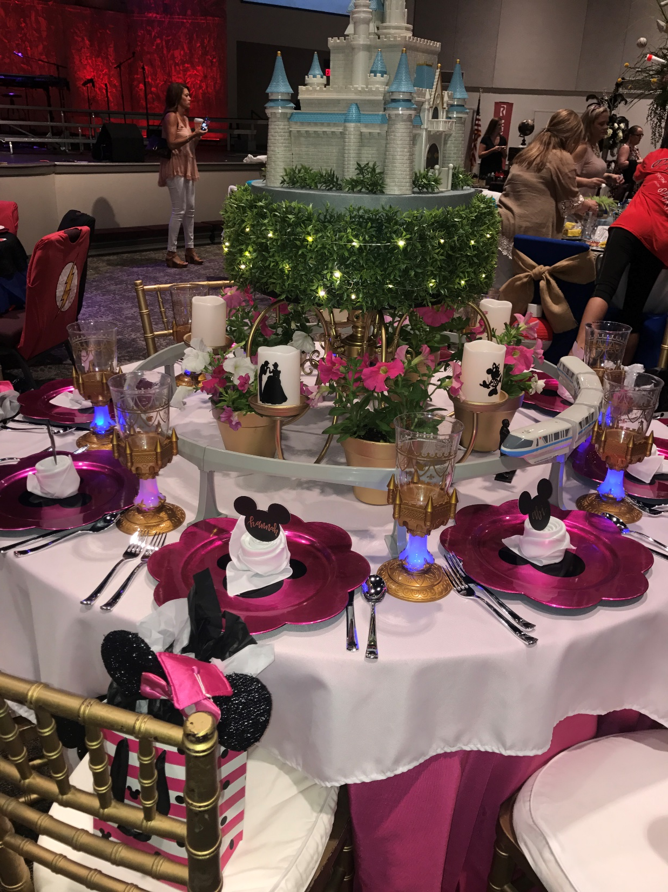

Slide 47
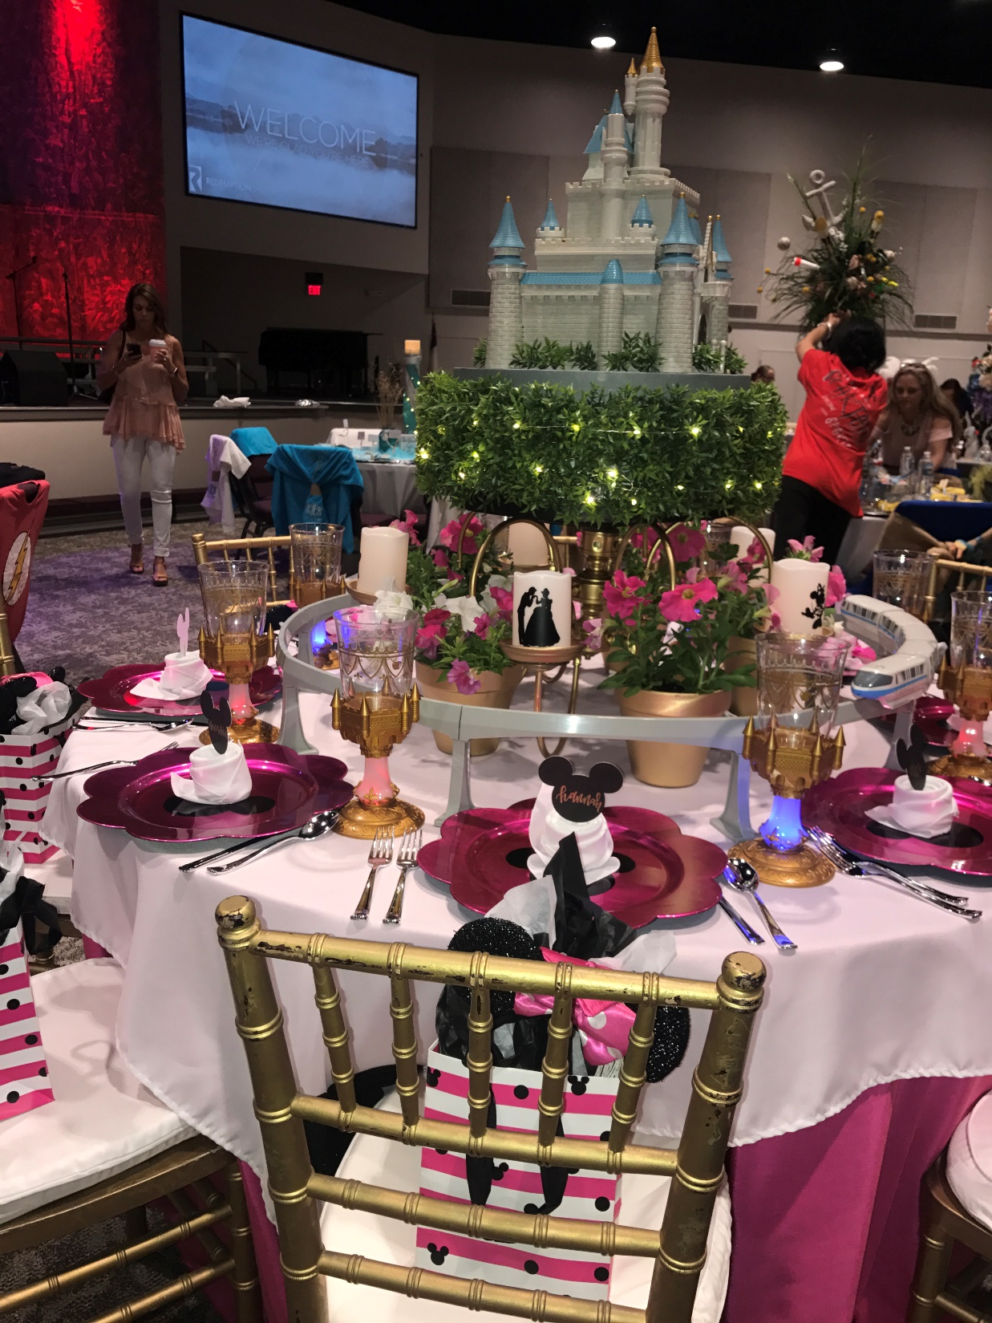

Slide 48
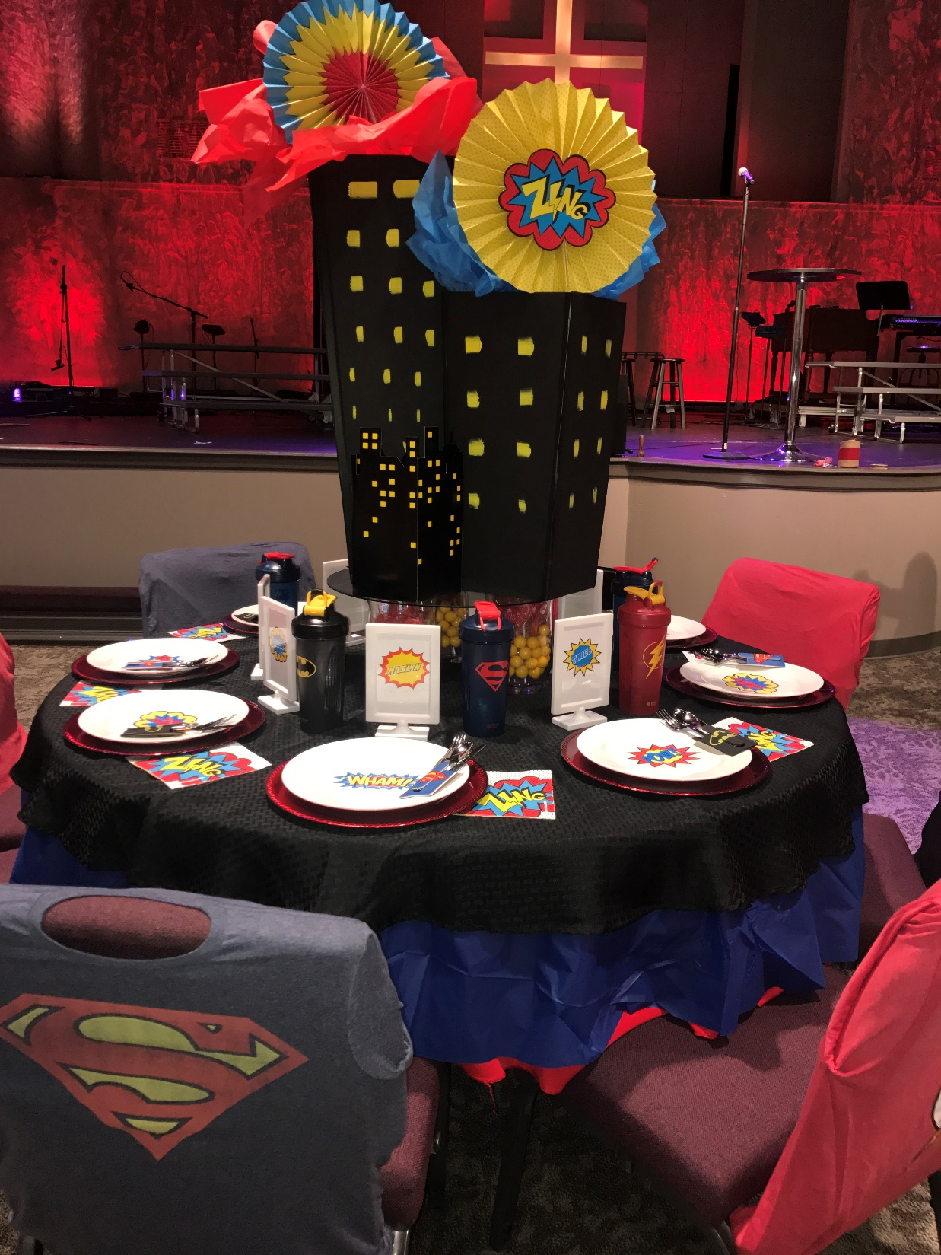

Slide 49
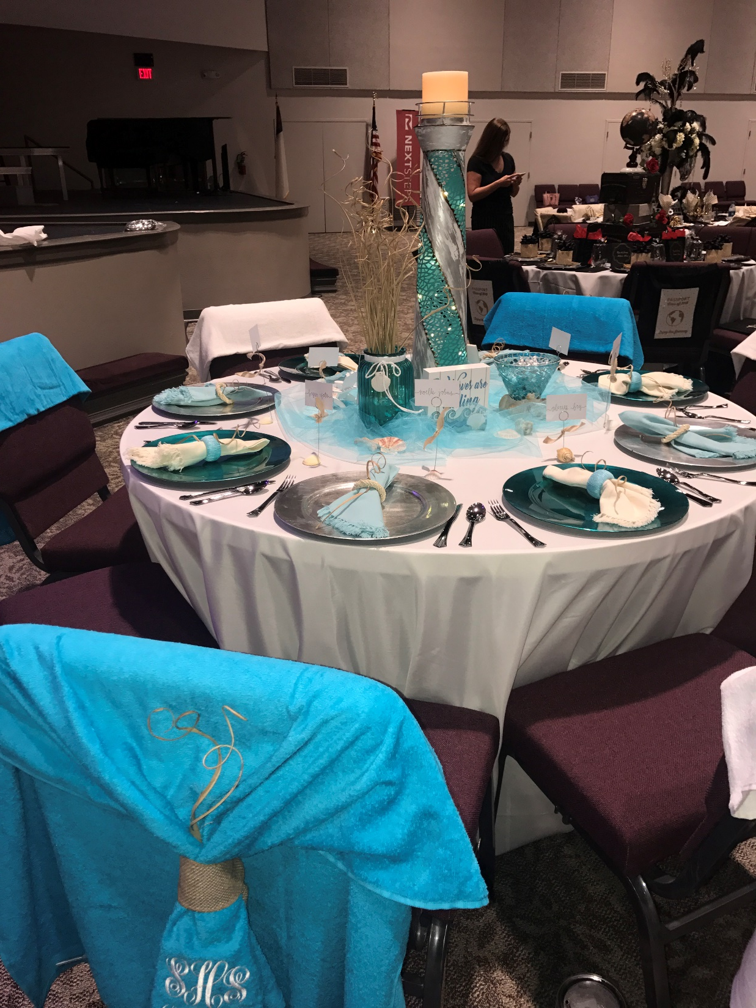

Slide 50
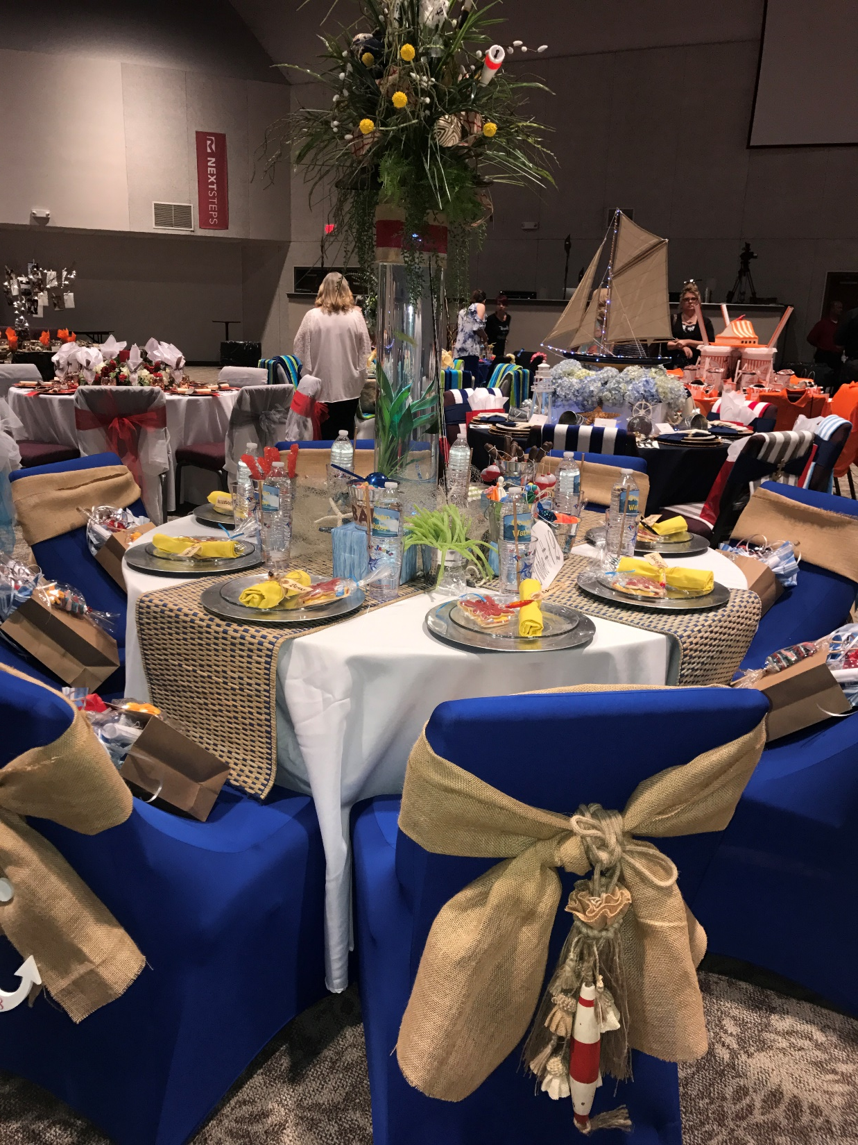

Slide 51
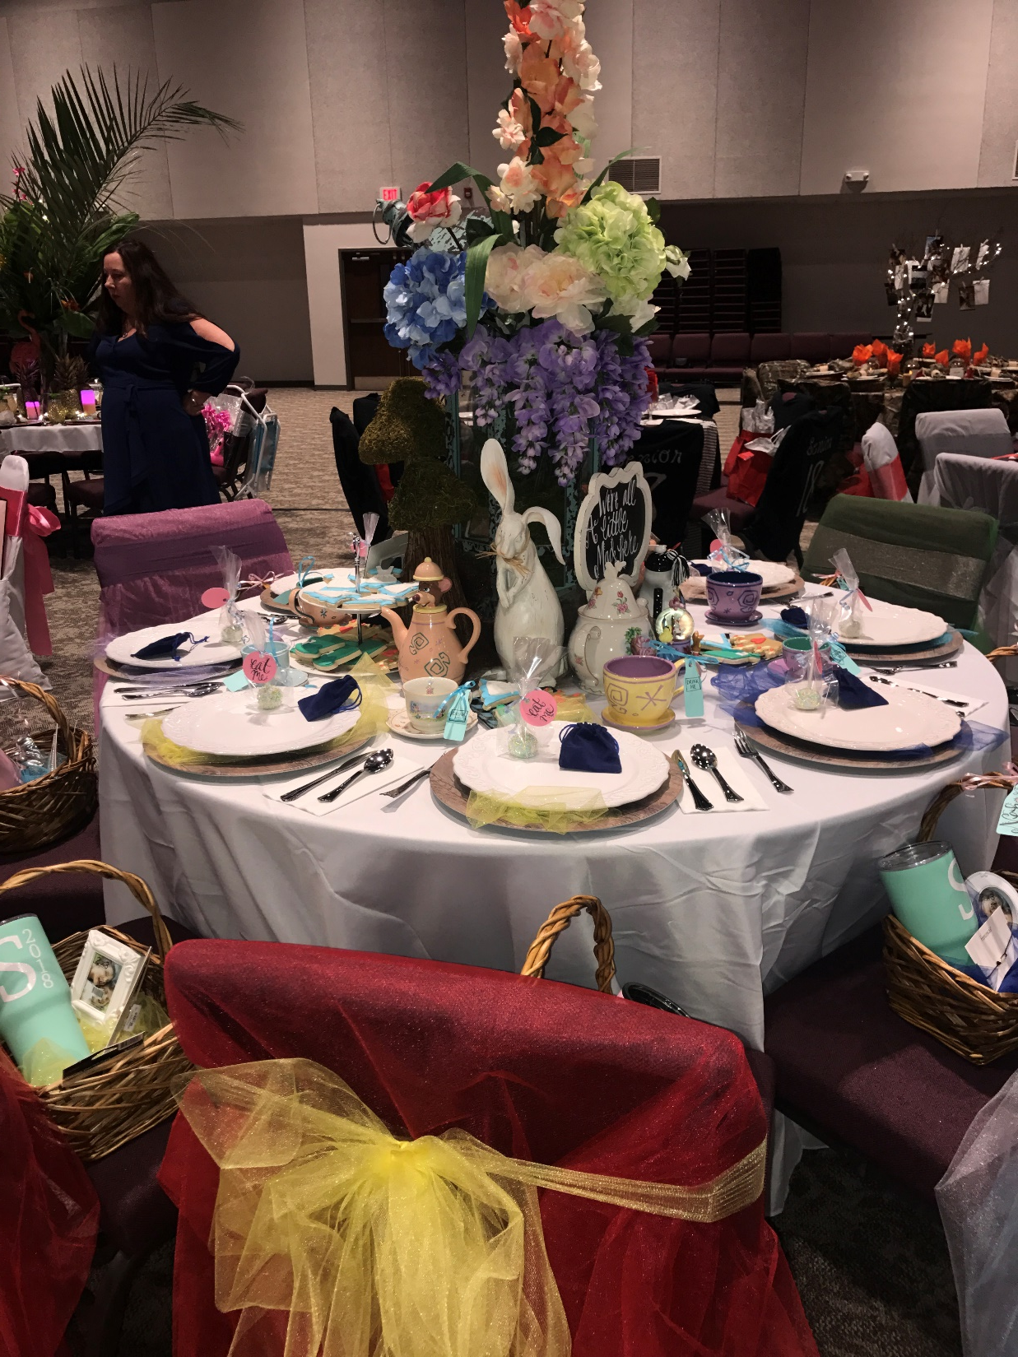

Slide 52
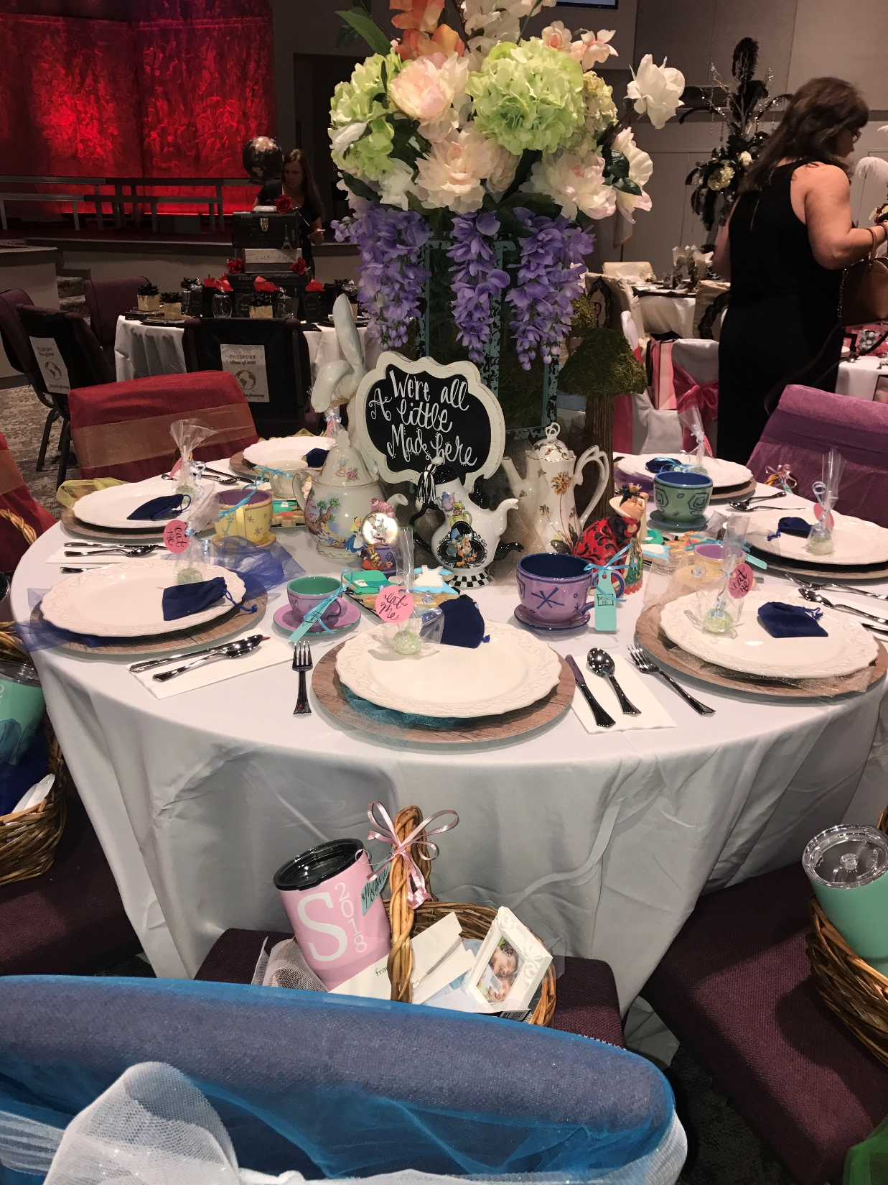

Slide 53
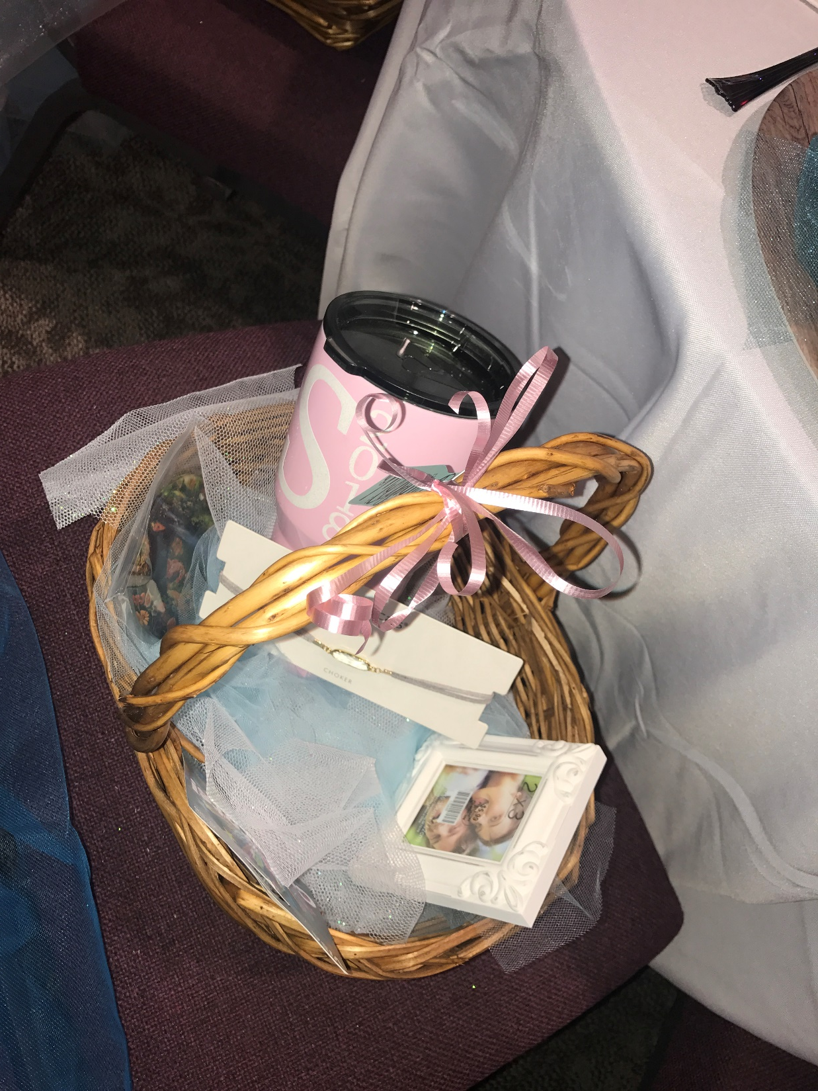

Slide 54
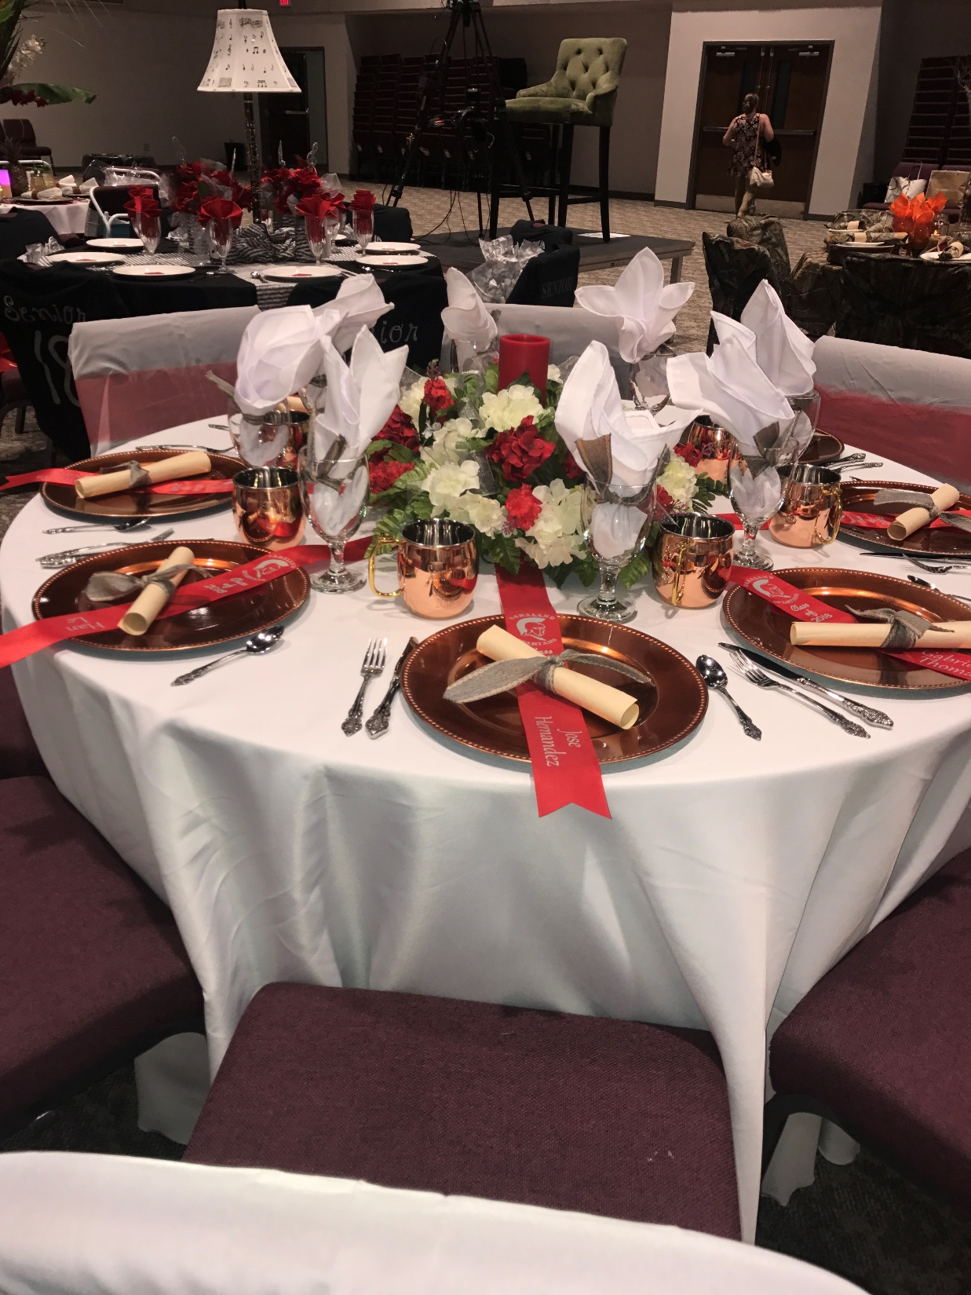

Slide 55
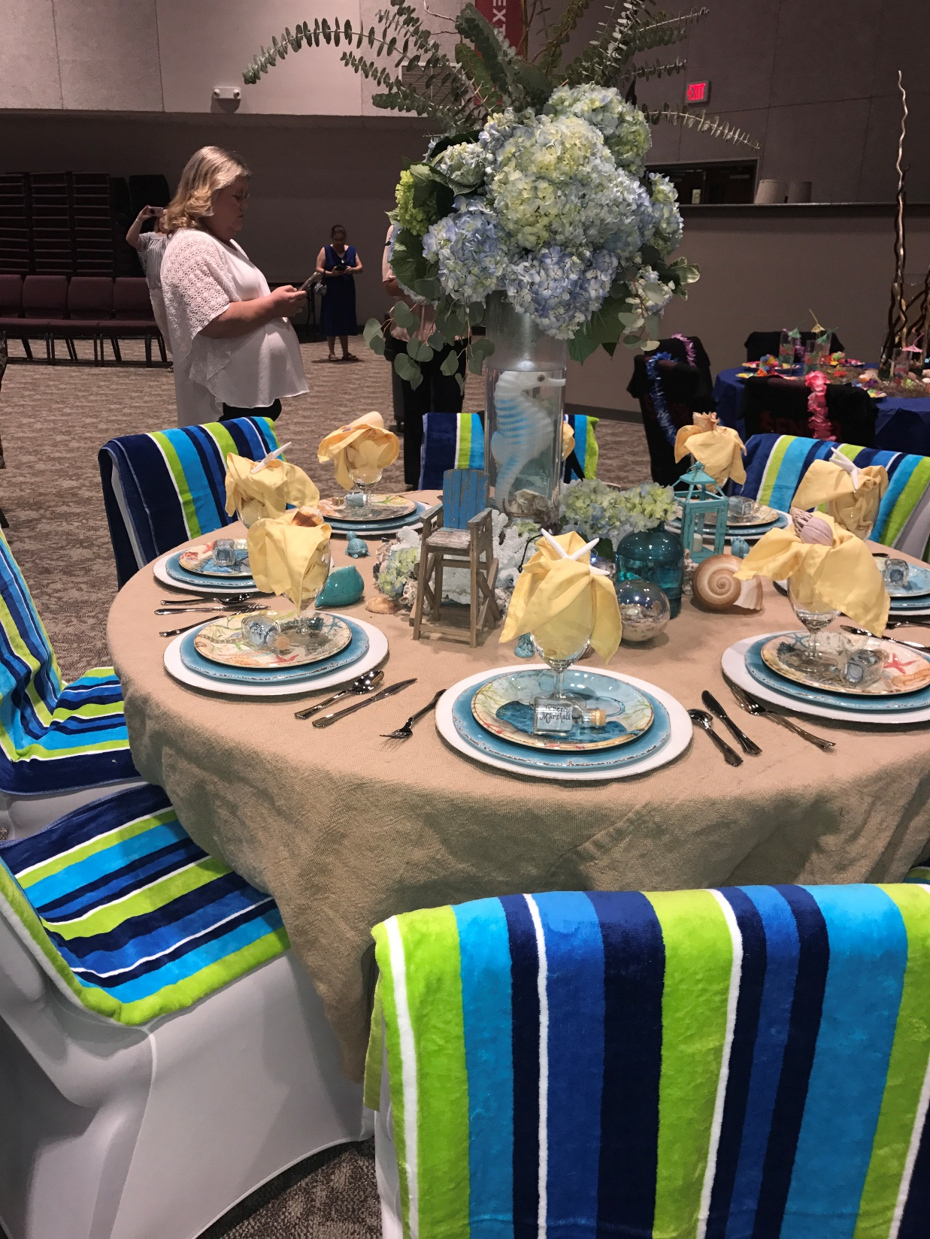

Slide 56
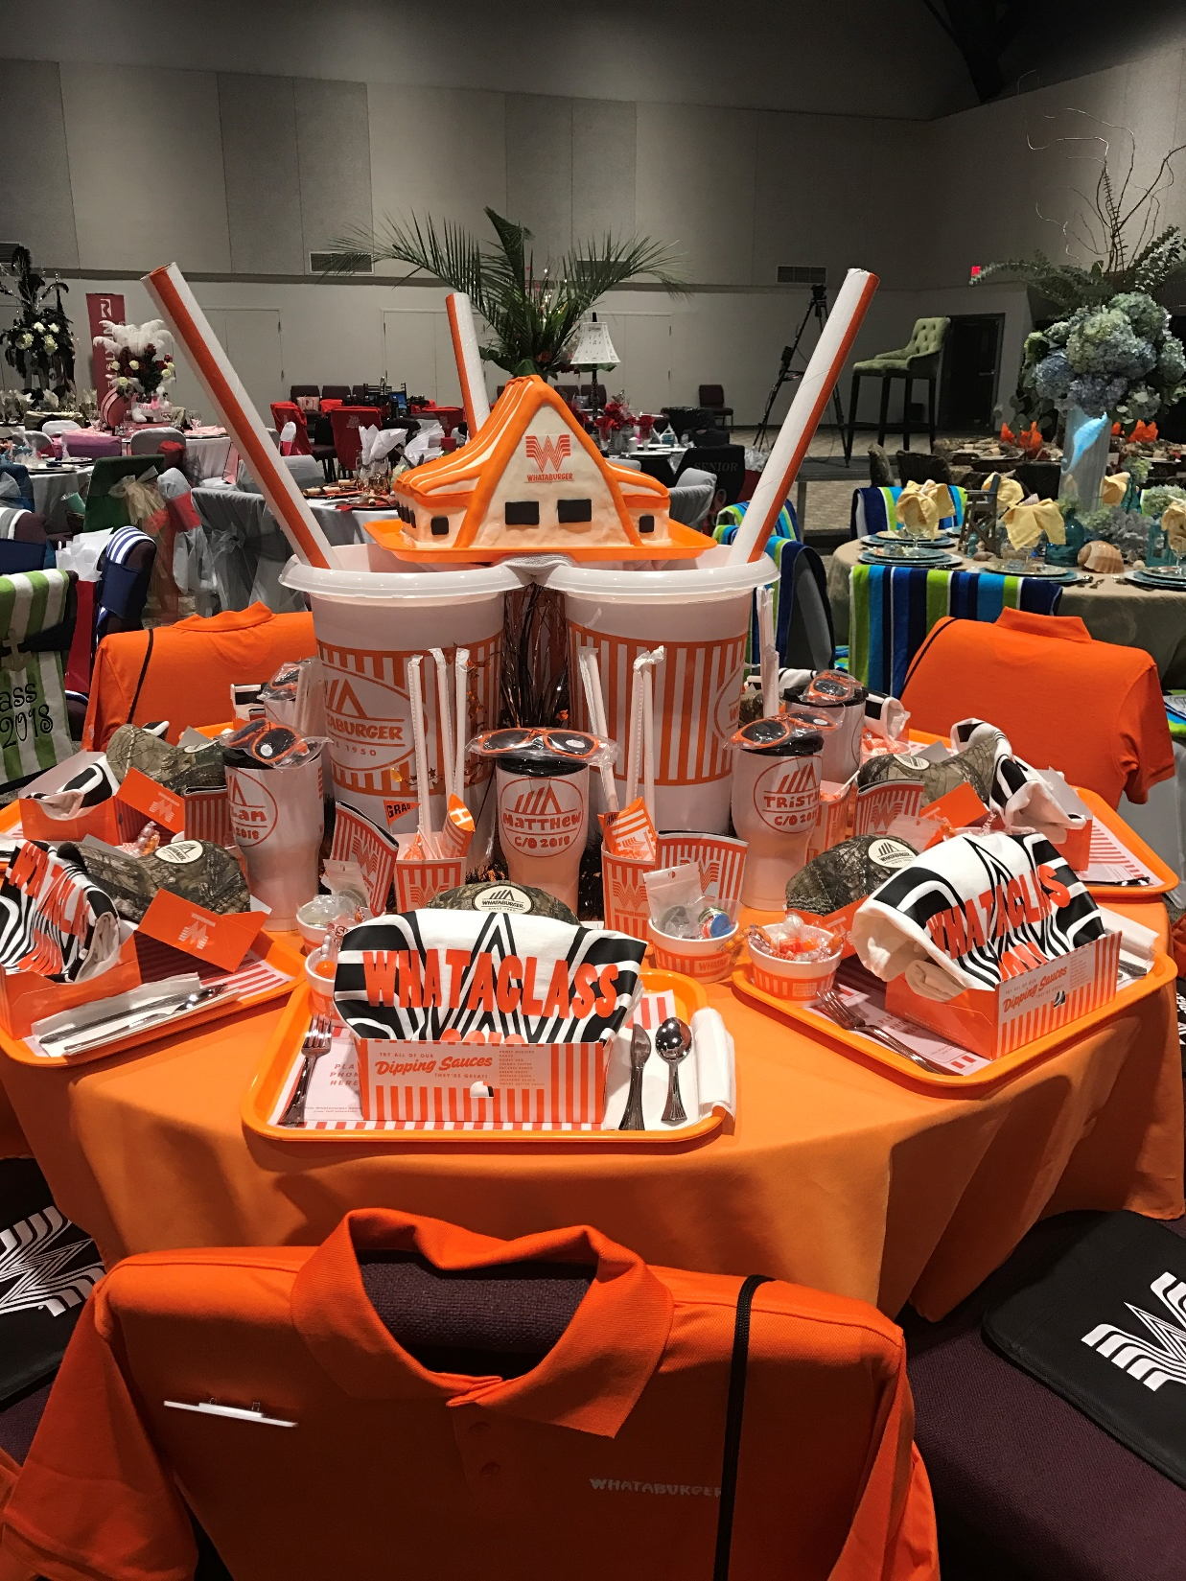

Slide 57
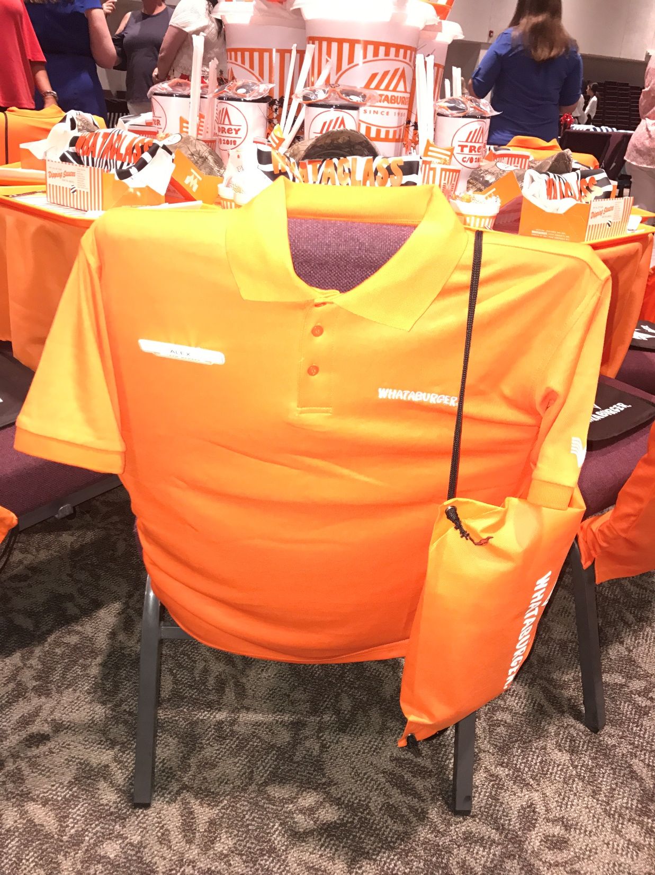

Slide 58
