Slide 1
Unit 5
Math In The Real World

Slide 2
Section 5.01
Adding & Subtracting Fractions

Slide 3
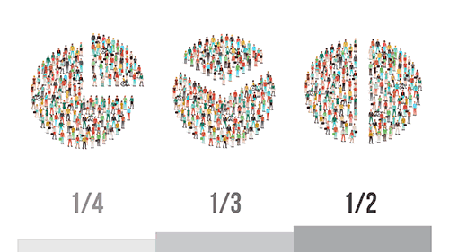
INTRODUCTION
In this section we will review some basic terminology, as well as how to add and subtract fractions.

Slide 4
Adding & Subtracting Fractions
Common Denominator in Fractions
In order to add or subtract fractions we must have a common denominator. This simply means that the denominators (the number on the bottom of the fractions) must be the same. If they are not the same, then we must find the least common multiple of all the denominators present in the problem.

Slide 5
Adding & Subtracting Fractions
Let’s look at 3/5 and 2/7.
The denominators are not the same so if we want to add or subtract these fractions, we will have to find the least common multiple of 5 and 7.
Finding the least common multiple. Make a list of multiples (the number found by multiplying one number by another) of each of the denominators.
5: 5, 10, 15, 20, 25, 30, 35, 40, 45, 50
7: 7, 14, 21, 28, 35, 42, 49, 56, 63, 70
Identify the smallest number that is common to both sets of multiples. That would be 35.
Now that we know what the least common denominator is going to be, we are ready to write equivalent fractions (different fractions that have the same value). We will be using 35 as the new denominator in each of these fractions.

Slide 6
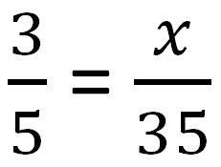
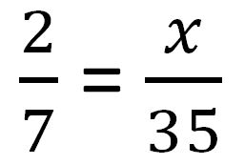
Adding & Subtracting Fractions
Step 1:
These can be solved like proportions.

Slide 7
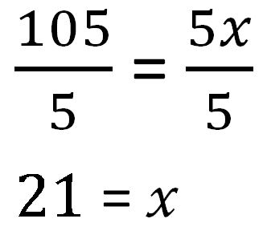
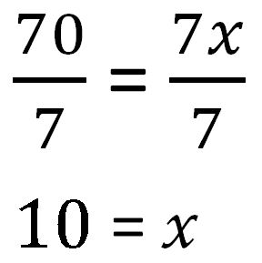
Adding & Subtracting Fractions
Step 2:
Cross multiply then divide by the number in front of 'x'.

Slide 8
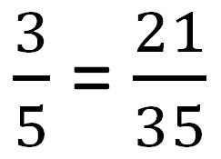
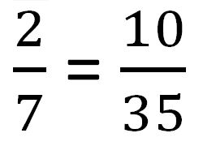
Adding & Subtracting Fractions
Step 3:
Your Answer is your new numerator (the number in the top of a fraction).

Slide 9
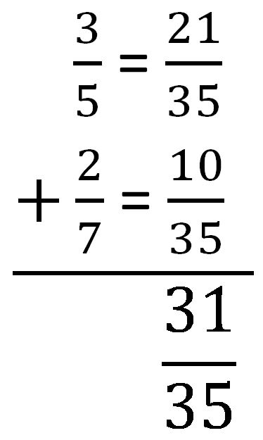
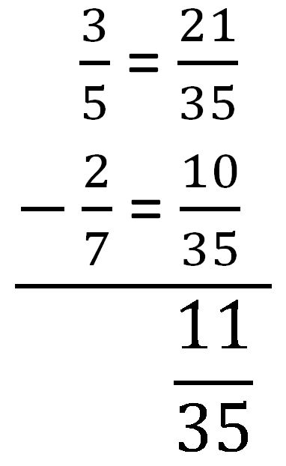
Adding & Subtracting Fractions
Step 4:
We can now add or subtract these fractions:

Slide 10
Reduce Fractions
We must always make sure that our answers are in simplest terms (that they cannot be reduced). Notice in the problem above. We divided the numerator and denominator both by 2 to reduce to simplest terms.

Slide 11
Section 5.02
Recipe Adjustments

Slide 12
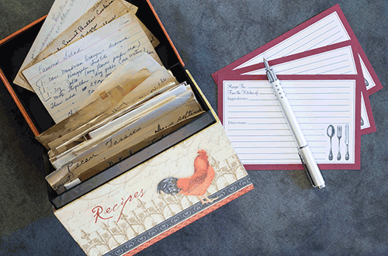
INTRODUCTION
Have you ever been guilty of asking “When will I ever use this?” in your math class. We will look at a very practical use of multiplication and division with fractions in this lesson -- recipe adjustments!

Slide 13
Recipe Adjustments
I learned to cook by working side by side with my mother in the kitchen. She had very few written recipes and was cooking for a family of four. Needless to say, I had to make some adjustments when I married. My husband has never been a fan of leftovers so we did not need five servings of anything. As my family grew, so did the need for additional servings. Now that we are part of the empty nesters, we are back down to two serving meals. You will find that there are many variables that will determine how many servings you want to prepare. You also may rarely find a recipe that is actually for the exact number of servings you will be needing.

Slide 14
Recipe Adjustments
Multiplication and Division with Fractions
We will begin by reviewing multiplication and division with fractions. Remember that to multiply, you simply multiply the numerators and place your answer in the numerator and then multiply the denominators and put your answer in the denominator. You will need to remember to simplify (reduce) your answer if possible by dividing both numerator and denominator by the same number.
Example Problem #1

Slide 15
Recipe Adjustments
Multiplication and Division with Fractions
We will begin by reviewing multiplication and division with fractions. Remember that to multiply, you simply multiply the numerators and place your answer in the numerator and then multiply the denominators and put your answer in the denominator. You will need to remember to simplify (reduce) your answer if possible by dividing both numerator and denominator by the same number.
Example Problem #1

Slide 16
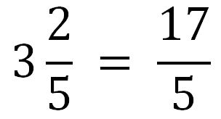
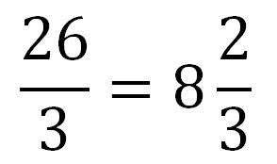
Recipe Adjustments
Multiplying Mixed Numbers
There will be times you have to multiply mixed numbers as well. In order to do this, you will need to first change them to improper fractions by multiplying the whole number times the denominator and then adding your answer to the numerator. You will put your final answer over the original denominator. Once you have changed them to improper fractions, you will multiply as before.

Slide 17
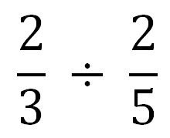
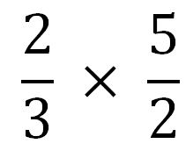
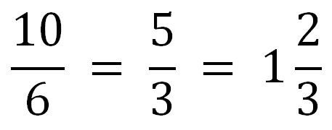
Recipe Adjustments
Dividing Fractions
You may have to divide in order to adjust the recipes. You should remember that to divide is to multiply by the reciprocal. You may have heard bring down the first fraction, change the sign to multiply, and then flip the last fraction.

Slide 18
Recipe Adjustments
Conversion Multiple
Let’s assume that you have a recipe that serves 4 people. You will just be cooking for 2. How will you need to adjust this recipe? Most of you know right off that you will only want one half of the recipe. It is not always that simple for some. You will need to find the conversion multiple:

Slide 19
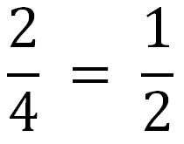
Recipe Adjustments
So, for the question above you would have:
Once you know the conversion multiple, we will multiply each ingredient in the recipe by it.

Slide 20
Example Problem
The recipe below serves 4. You are needing 30 servings for your classroom party. How much of each ingredient will you need?
Roast Beef & Horseradish Canapès
12 Frozen waffle fries
3 Ounces thinly sliced roast beef
2 tablespoons horseradish sauce

Slide 21
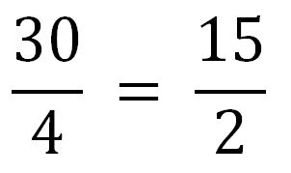
Example Problem
You will first have to find your conversion multiple:
You will then multiply each ingredient by the conversion multiple. You will then need to change any improper fractions into mixed numbers.

Slide 22
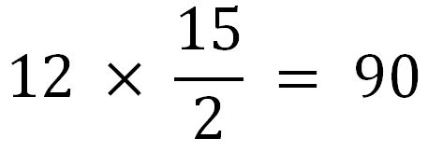
Example Problem
Roast Beef & Horseradish Canapès
12 Frozen waffle fries
For 30 servings you will need 90 frozen waffle fries.

Slide 23
Example Problem
Roast Beef & Horseradish Canapès
3 Ounces thinly sliced roast beef
For 30 servings you will need 22 ½ ounces of thinly sliced roast beef.

Slide 24
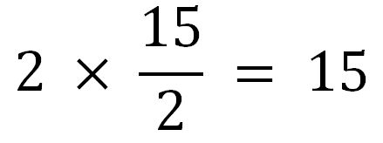
Example Problem
Roast Beef & Horseradish Canapès
2 tablespoons horseradish sauce
For 30 servings you will need 15 tablespoons of horseradish sauce.

Slide 25
Section 5.03
Percentages

Slide 26
INTRODUCTION
It is important to be able to figure the new cost of an item that is on sale for a certain percent off so that you can decide if it is a good value for the price. It is also important to be able to figure the sales tax on your purchases so that you will have enough money to pay when you get to the register.

Slide 27
Percentages
Percentages
Percent is the portion of something out of 100 parts. A dollar can be divided into 100 cents so 1% of a dollar is 1 cent and 10% of a dollar is 10 cents. When computing percents, you can use the percent sign on your calculator or you can change the percent to a decimal by moving its existing decimal two places to the left.
Example Problem # 1
3% = 0.03
300% = 3

Slide 28
Percentages
Sales Tax
Sales tax is a tax charged by most states on the selling price of a good or service. It is usually expressed as a percent. This amount in not included in the ticket price so you should take it into consideration when making purchases.
Example Problem # 2
You want to buy a pair of jeans that cost $48.98. You have $50.00. Do you have enough money to purchase these jeans if the sales tax in 7%?
Change the percent to a decimal and multiply.
48.98 × 0.07 = 3.43
Add the tax to the ticket price to find the cost.
48.97 + 3.43 = $52.40
No, you do not have enough money to buy these jeans.

Slide 29
Percentages
Discounts
Suppose the sales clerk tells you that the store will be marking the jeans down 10% the next day.
Example Problem # 3
Will you have enough money to buy the jeans then?
Change the percent of discount to a decimal and multiply.
48.98 × 0.10 = 4.90
Subtract the discount amount from the ticket price.
48.97 − 4.90 = 44.07
Multiply the discounted price by the percent of tax.
44.07 × 0.07 = 3.08
Add the tax to the discounted price.
44.07 + 3.08 = $47.15
Yes, with the 10% discount, you will have enough money to make your purchase.

Slide 30
Percentages
Profit Margin
Profit margin is figured by dividing profit by the cost. The answer will then be multiplied by 100 to change to a percent. This can be done for overall sales or by item.
Example Problem # 4
You are going to sell a shirt for $20.00. The cost of the shirt was $10.00. Your net profit is $10.00 ($20.00 − 10.00)
10 ÷ 10 = 1
1 × 100 = 100% your profit margin is 100%. This means that you will make $1 for each $1 you invest.

Slide 31
Section 5.04
Conversions

Slide 32
INTRODUCTION
This lesson is all about change! You will be changing fractions to percents, percents to decimals, and so on.

Slide 33
Converting a Decimal to a Percent
To convert a decimal to a percent, you simply multiply by 100. You have probably been told to move your decimal two places to the right. This is the same thing. You will also need to add the percent sign.
Example Problem # 1
1.4 × 100 = 140%

Slide 34
Converting a Fraction to a Percent
To convert a fraction to a percent, you will first need to convert it to a decimal by dividing the numerator by the denominator then you will convert the decimal to a percent as we did in the previous slide.
Example Problem # 2
¼ = 1 ÷ 4 = 0.25 = 25%

Slide 35
Converting a Percent to a Decimal
To convert a percent to a decimal, you will divide by 100 (or move the decimal two places to the left) and then drop the percent sign.
Example Problem # 3
100% = 1

Slide 36
Converting a Percent to a Fraction
To change a percent to a fraction, you can drop the percent sign and write the percent over 100 then reduce.
Example Problem # 4
75% = 75/100 = ¾

Slide 37
Section 5.05
Measuring

Slide 38
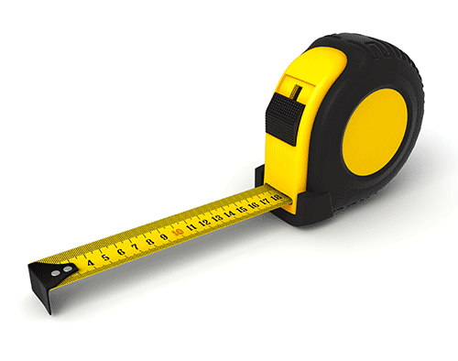
INTRODUCTION
Do you know what this it? It's a tape measure! Do you know how to use one of these?

Slide 39
Measurements
Most of you can read a ruler. At least you know that one side has inches and the other has centimeters. You can also probably measure to the nearest half-inch.
In this lesson, we will be taking a closer look at the marks on the inches side. Notice that the marks vary in length. The longest marks are for inches and the next to longest ones mark ½ inches. The longer the line, the bigger the measurement is.
What do the lines just short of the ½ inch lines mark?
Answer: ¼ inch

Slide 40
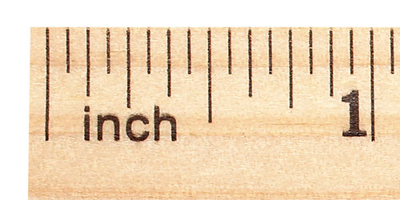
Measurements
As the lines get shorter, the measurement gets smaller. It actually is half of the previous measurement.
The measurement of the lines in order of their length is:
1 inch
½ inch
¼ inch
⅛ inch
¹⁄₁₆ inch
Actually, all of the lines are ¹⁄₁₆ of an inch apart.

Slide 41
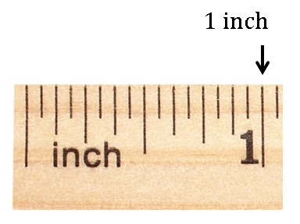
Measurements
Let's look at each measurement.
1 Inch

Slide 42
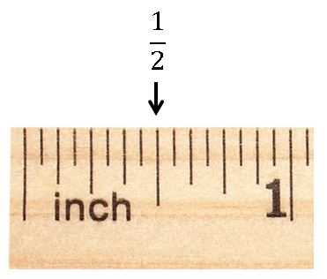
Measurements
Let's look at each measurement.
Half Inch

Slide 43
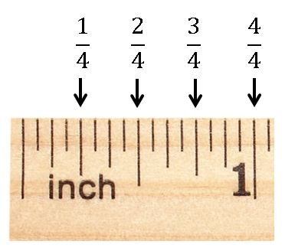
Measurements
Let's look at each measurement.
Fourth Inch

Slide 44
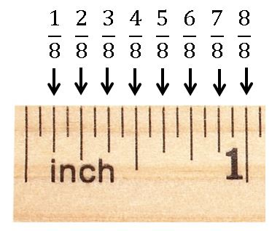
Measurements
Let's look at each measurement.
Eighth Inch

Slide 45
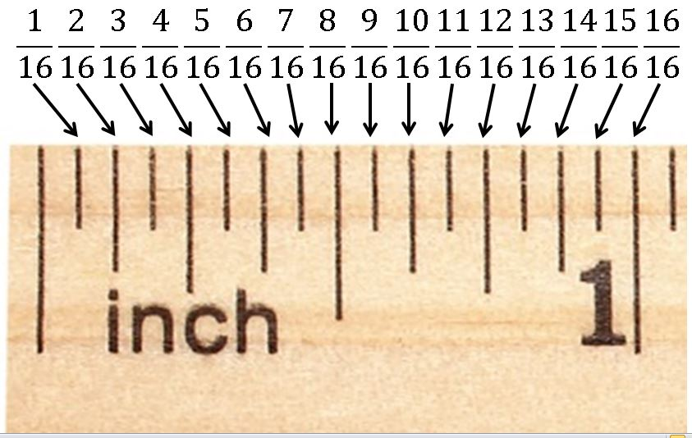
Measurements
Let's look at each measurement.
Sixteenth Inch

Slide 46
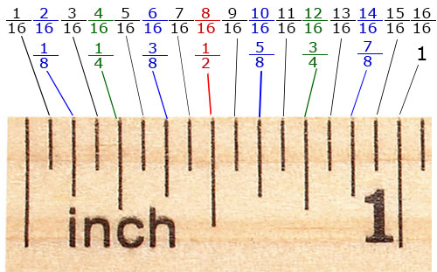
Measurements
Now, let's put it all together. This may be easier to understand if we look at it as counting by 16ths. Notice on the labeled ruler below that the bottom fraction is the top one reduced.

Slide 47
Measurements
Accuracy of Measurements
Accuracy refers to how close a measurement is to the actual measurement. You will probably never need to be more accurate than 1/16 of an inch for anything that you will be measuring around your house.
There are jobs, such as a machinist, where your accuracy will need to be within hundredths of an inch. There is much more sophisticated machinery than a simple wooden ruler to help you with those measurements though!

Slide 48
Section 5.06
Known and Unknown Information

Slide 49
INTRODUCTION
What do I know? What do I need to know? Two very important questions!

Slide 50
Identifying Known and Unknown Information
One of the biggest obstacles people face when trying to solve real-world problems is how to organize their information. When my students tell me that they do not understand, my response is "ask me specific questions about the topic". They have a difficult time doing this. It is important to ask yourself "What do I know?" and "What do I need to know?" when attempting to solve any problem. This is the first step to being a successful problem solver.

Slide 51
Section 5.07-5.08
Multi-step Problems and Equations

Slide 52
Solving Multi-Step Equations
Below are the steps to solving multi-step equations. Make sure you have these in your notes.
Steps to Solving Multi-Step Equations
Simplify each side of the equation, if possible.
Move all terms that contain a variable to one side of the equation.
Isolate the variable term.
Isolate the variable by applying the division or multiplication property.
Check your answer by applying the substitution property.

