Slide 1
Bowel Elimination
Chapter 26

Slide 2
Bellringer
What causes black and tarry stools?
What causes green stools?
Diseases and infection cause what color stools?

Slide 3
Bowel Elimination
Bowel elimination is the excretion of wastes from the gastrointestinal (GI) system.
Factors affecting bowel elimination include:
Privacy
Habits
Age
Diet and fluids
Exercise and activity
Drugs
Disability

Slide 4
Normal Bowel Elimination
Feces move through the intestines by peristalsis.
Feces move through the large intestine to the rectum.
Feces are stored in the rectum until excreted from the body.
Frequency and time of bowel movements vary from person to person.

Slide 5
Stools are normally brown, soft, formed, moist, and shaped like the rectum.
They have a normal odor
Observe and report the following:
Color
Amount
Consistency
Presence of blood or mucus
Odor
Shape
Frequency of defecation
Complaints of pain or discomfort

Slide 6
Constipation
Occurs when feces move slowly through bowel
Common causes:
Low-fiber diet
Ignoring the urge to have a BM
Decreased fluid intake
Inactivity
Drugs
Aging
Certain diseases
Treatment
Increase fluid intake and activity
Stool softeners, Laxatives, Suppositories, Enemas

Slide 7
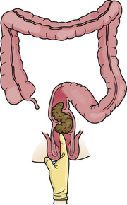
Fecal Impaction
Feces are hard or putty-like
Symptoms include:
Abdominal discomfort, abdominal distention (swelling), nausea, cramping, and rectal pain
Older persons may have poor appetite, confusion, or even a fever
Result of constipation is not relieved
Treatment:
Digital removal
Drugs, Suppositories, Enemas
Bellringer: Why is checking for and removing impactions dangerous?

Slide 8
Diarrhea
Feces move through intestines rapidly and reduces time for fluid absorption, causing fluid loss
Dehydration occurs if fluid is not replaced, which can lead to death
Causes:
Irritating foods, some drugs, and microbes in food and water
Dehydration
Bellringer: What are signs & symptoms of dehydration?

Slide 9
Spread of Infection
Preventing the spread of infection is important!!
Good hand hygiene
Standard Precautions and Bloodborne Pathogen Standard

Slide 10
Fecal Incontinence
Causes:
Intestinal diseases, Nervous system diseases, Fecal Impaction, Diarrhea, Chronic Illness, Aging, Mental Health problems or dementia, Not getting to bathroom in time, Problems removing clothes
Affects person emotionally
Person with fecal incontinence may need:
Bowel training
Help with elimination after meals and every 2 to 3 hours
Incontinence products to keep garments and linens clean
Good skin care

Slide 11
Flatulence
Causes include:
Swallowing air while eating and drinking
Bacterial action in the intestines
Gas-forming foods – onions, beans, cabbage, cauliflower, radishes, and cucumbers
Constipation
Bowel and abdominal surgeries
Drugs that decrease peristalsis
Intestines distend if flatus is not expelled, leading to abdominal cramping, shortness of breath, and swollen abdomen
Exercise, walking, moving in bed, and left side-lying position often assist with expelling flatus

Slide 12
Bowel Training
Bowel training has 2 goals:
Gain control of bowel movements (BM)
Develop a regular pattern of elimination
Fecal impaction, constipation, and fecal incontinence are prevented
Care Plan will include:
Person’s usual time for BM
Toilet, commode, or bedpan use
High-fiber diet
Increased fluids
Warm fluids
Activity
Privacy

Slide 13
Suppositories
Inserted into rectum
Bowel movement about 30 minutes later
Ordered for:
Constipation
Fecal impaction
Bowel training

Slide 14
Enemas
Doctors order enemas:
To remove feces
To relieve constipation, fecal impaction, or flatulence
To clean the bowel of feces before certain surgeries and diagnostic procedures
Doctor orders enema solution, solution determined by purpose:
Tap-water enema (obtained from a faucet)
Saline enema (solution of salt and water)
Soapsuds enema (castile soap and water)
Small-volume enema
Oil-retention enema (has mineral, olive, or cottonseed oil)

Slide 15
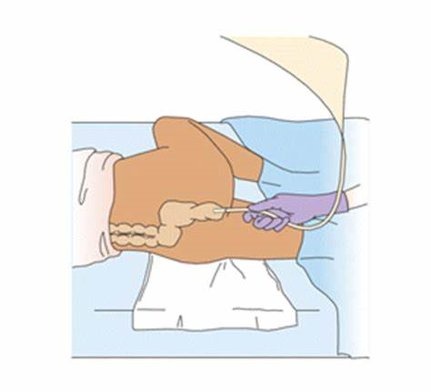
Giving Enemas
Person should void first
Give amount of solution ordered
Sims’ position or left side-lying position
Enema tubing inserted 2 to 4 inches for adults
Administer fluid slowly
Person should retain fluid based on amount and type of solution

Slide 16
Enemas
Cleansing Enemas
Relieve constipation and fecal impaction
Needed before certain surgeries and diagnostic procedures
Soapsuds enemas irritate the bowel’s mucous lining
Small-volume Enemas
Irritate and distend the rectum
Ordered for constipation and when bowel does not need complete cleansing
Oil-retention Enemas
Relieve constipation and fecal impactions

Slide 17
Ostomy
Colostomy
Permanent colostomy, diseased part of the colon is removed
Temporary colostomy, gives diseased or injured bowel time to heal
Site depends on site of disease or injury
Stool consistency depends on the colostomy site
Skin care prevents skin breakdown around the stoma

Slide 18
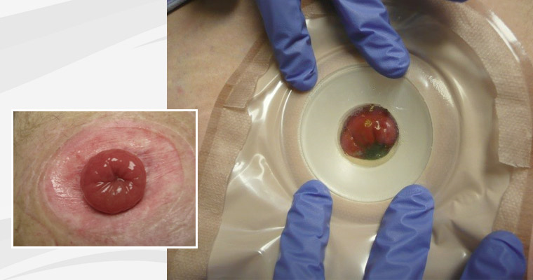
Ileostomy
Entire colon is removed
Liquid stools drain constantly
Stools must not touch the skin, digestive juices irritating to the skin

Slide 19
Ostomy Pouches
Emptied when stools are present
Pouch is opened when it balloons or bulges with flatus
Drain is wiped with toilet tissue before it is closed
Pouch is changed every 3 to 7 days and when it leaks
Frequent pouch changes can damage the skin
Person can wear normal clothes
Showers and baths are delayed 1 to 2 hours after applying new pouch
DO NOT flush pouches down the toilet

