Slide 1
URINARY ELIMINATION

Slide 2
Normal Urination
Healthy adult produces 1500 mL or 3 pints of urine/day
What affects urine production?
Age, disease, amount of fluid ingested, salt, body temperature, perspiration, medication
Urination (micturition and voiding)
process of emptying urine from the bladder

Slide 3
Rules for Normal Elimination
Help person assume a normal position for voiding
Warm bedpan or urinal
Cover person for warmth and privacy
Running water, flushing toilet, or playing music can mask voiding sounds. Voiding with others nearby embarrasses some people.
Stay nearby for weak or unsteady persons.
Call light and toilet paper within reach
Do not rush the person
Run water in sink to start stream, or place fingers in warm water

Slide 4
Normal Observations
Normal urine
Pale yellow, straw-colored, or amber
Clear with no particles
Faint odor is normal
Observe urine for:
Color
Clarity
Odor
Amount
Particles
Blood

Slide 5
Urine Observations
Red-colored urine:
Red food dyes, beets, blackberries, rhubarb
Bright yellow urine:
Carrots and sweet potatoes
Asparagus causes urine odor

Slide 6
Urinary Elimination Problems
Dysuria – painful/difficult urination
Hematuria – blood in urine
Nocturia – frequent urination at night
Oliguria – scant amount of urine; less than 500 mL/24hr
Polyuria – abnormally large amounts of urine

Slide 7
Urinary Elimination Problems
Urinary frequency – voiding at frequent intervals
Urinary incontinence – involuntary loss or leakage of urine
Urinary retention – inability to void
Urinary urgency – need to void at once

Slide 8
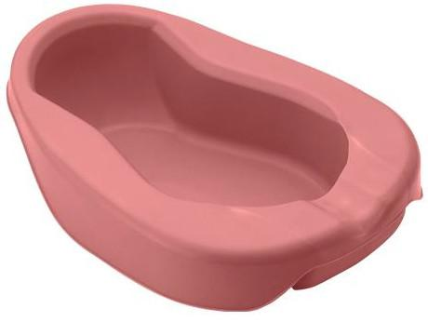
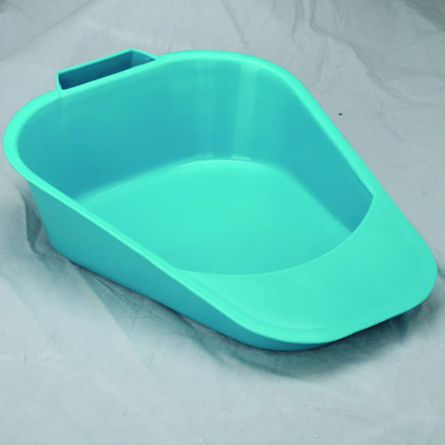
Bedpans
Used when persons cannot be out of bed
Standard bedpan
Wide rim is placed under buttocks
Fracture pan
Thin rim - ½ deep at one end
Smaller (flat) end placed under buttocks
Used for:
Persons with casts/tractions
Persons with limited back motion
Persons with osteoporosis or arthritis
After spinal cord injury, hip fracture, hip replacement, or surgery

Slide 9
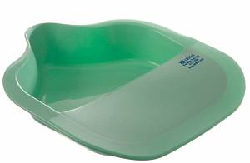
Bedpans
Bariatric bedpan
Small end is placed under buttocks
Used for obese patients
Weight capacity of 1200 pounds

Slide 10
Promoting Safety and Comfort
Raise head of bed
Lower bed before leaving the room
Do not leave person on bedpan for a long time.
Pressure ulcers occur from prolonged pressure
Position person on bedpan so urethra and anus are directly over opening.

Slide 11
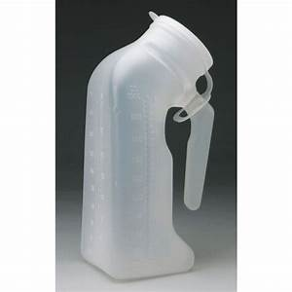
Urinals
Men use urinals to void
Urinal hooks to bedrail within man’s reach
Stands if possible to use; or he sits on side of bed or lies in bed
After voiding, urinal cap is closed – prevent spills
Do not place on over-bed table or bedside table
Empty promptly to avoid odors and spread of microbes

Slide 12
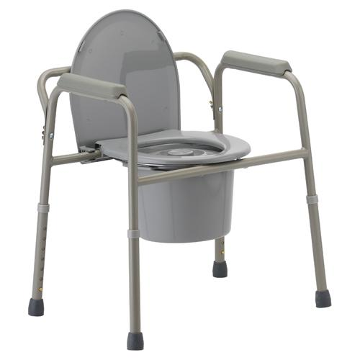
Commodes
Chair or wheelchair with opening for a container
Allows a normal position for elimination
Support provided by arm and back support
After use – clean and disinfect container

Slide 13
Incontinence
Risk Factors:
Women – pregnancy, childbirth, menopause
Men – prostate problems
Age
Over-weight
Smoking
Diabetes
Kidney disease
Immobility
Restraint use
Delays in voiding
Confusion and disorientation

Slide 14
Types of Incontinence
Stress Incontinence – urine leaks during exercise and certain movements that cause pressure on bladder
Often called dribbling, occurs with laughing sneezing, coughing, lifting
Urge Incontinence – urine lost in response to a sudden, urgent need to void
Cannot get to toilet in time
Mixed Incontinence – combination of stress and urge incontinence
Over-flow Incontinence – small amounts of urine leak from a full bladder
Feel like bladder is not empty
Dribbles often or constantly

Slide 15
Types of Incontinence
Functional Incontinence – person has bladder control but cannot use the toilet in time
Reflex Incontinence – urine is lost at predictable intervals when the bladder is full
Transient Incontinence – temporary or occasional incontinence that is reversed when the cause is treated
Transient means for a short time
May result from physical illness or drugs

Slide 16
Managing Incontinence
Goals of Incontinence:
Prevent UTIs
Restore as much normal bladder function as possible
Risks:
Skin irritation, infection, pressure ulcers
Social/Emotional Concerns:
Pride, dignity, self-esteem, social isolation, loss of independence, depression
Garments wet and odors develop

Slide 17
Managing Incontinence
Incontinence is linked to abuse, mistreatment, and neglect
Answer call lights promptly
Decrease fluid intake at bedtime
Provide good skin care
Observe for signs of skin breakdown
Protect person’s dignity
Stay calm

Slide 18
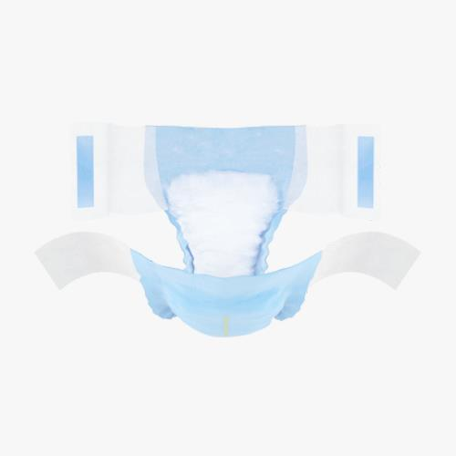
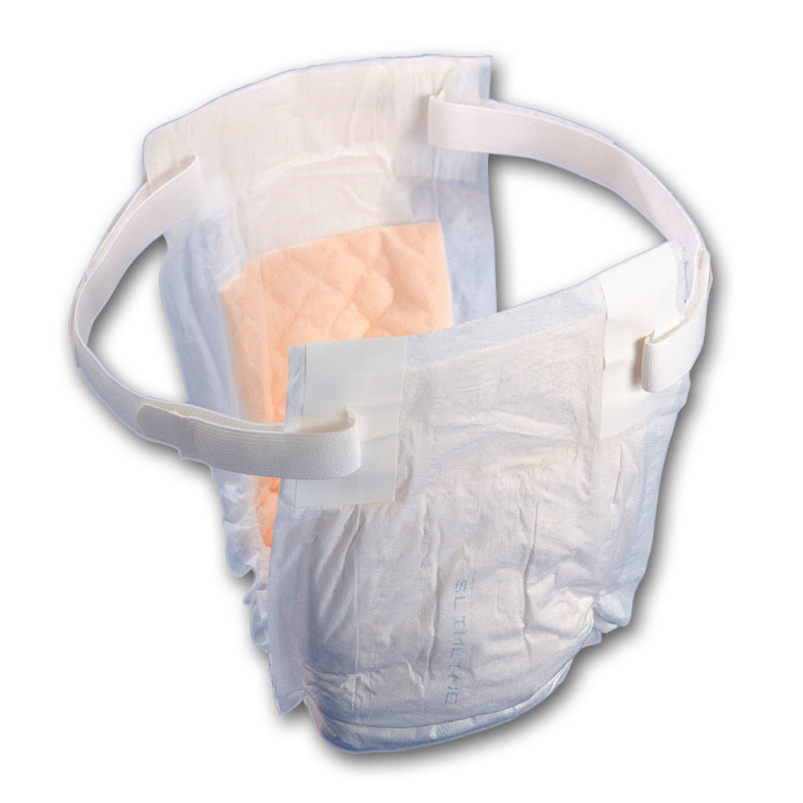
Applying Incontinence Products
Disposable products that help keep the person dry
Products:
Complete incontinence brief
Secured at the sides with Velcro or tape tabs
Pad and under-garment
Looks like regular underwear, pad is inserted in the built in pouch
Pull on underwear
Look like regular underwear
Belted under-garment
Pad is attached to a re-usable belt

Slide 19
Bladder Training
Goal – control of urination
Provides comfort and quality of life, increases self-esteem
Rules for bladder re-training (bladder rehabilitation):
Resist and ignore desire to urinate
Urinate following a schedule rather than urge (intervals increase)

