Slide 1
The Depression and FDR 1929-1941
Chapter 25

Slide 2
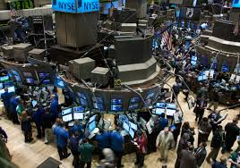
25.1 The Great Depression
1. stock exchange – an organized system for buying and selling shares in corporations.

Slide 3
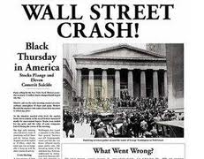
25.1 cont……
2. on margin – borrowed money to buy stocks.
3. October 24, 1929 was known as Black Thursday.

Slide 4
25.1 cont…..
4. The Great Depression was a severe economic crisis that the U.S. experienced starting in 1929 and lasting throughout the 1930s.
5. Defaulted – failed to meet loan payments.

Slide 5
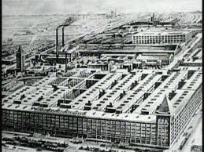
25.1 cont……
6. Industrial cities were the hardest hit during the Great Depression.

Slide 6
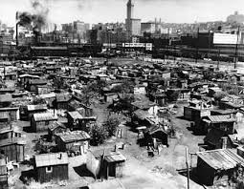
25.1 cont…..
7. “ a feeling of worthlessness and loneliness; I began to think of myself as a freak and a misfit”
8. Shelters that were built out of boxes and other debris were called Hoovervilles.

Slide 7
25.1 cont…..
9. Hoover believed that “prosperity was just around the corner”.
10. Charities, churches and volunteers provided relief – aid for the needy.
11. Public Works – projects such as building highways, parks, and libraries.

Slide 8
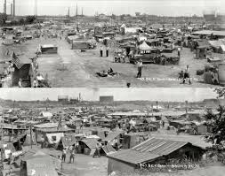
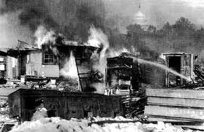
25.1 cont…..
•12. Bonus Army – World War I veterans that had been promised by the government a $1000 bonus for their service to the country.

Slide 9
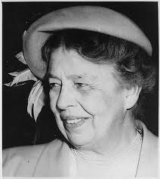
25.2 Roosevelt’s New Deal
1. Eleanor Roosevelt became FDR’s eyes and ears.

Slide 10
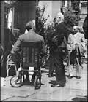
25.2 cont……
2. Franklin D. Roosevelt was struck with polio in both legs in 1921.
3. Roosevelt got advice from a group of lawyers, economists, and social workers. He called this group the Brain Trust.

Slide 11
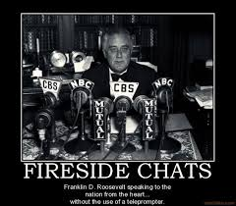
25.2 cont…..
4. During the 1932 presidential campaign, Roosevelt said that “ the country needs and demands bold, persistent experimentation.”
5. FDR’s weekly radio broadcasts were called fireside chats.

Slide 12
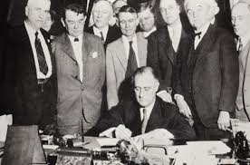
25.2 cont….
6. In Roosevelt’s first 100 days in office he sent 15 proposals to congress and all 15 were passed.

Slide 13
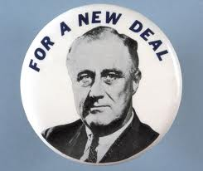
25.2 cont…..
7. The New Deal was Roosevelt’s set of programs and laws to help the country out of the Great Depression.

Slide 14
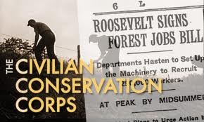
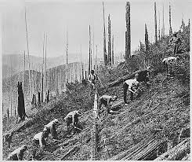
25.2 cont…..
8. Civilian Conservation Corps (CCC) The CCC employed men to work on projects that benefited the public.

Slide 15
25.2 cont…..
9. The Federal Emergency Relief Administration (FERA) gave money to states for use in helping people in need.

Slide 16
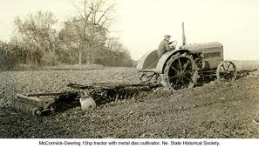
25.2 cont…..
10. The Agricultural Adjustment Act (AAA) was to raise farm prices quickly and to control production so that farm prices would stay up over the long term.

Slide 17
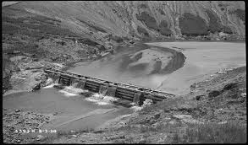
25.2 cont…..
11. The Tennessee Valley Authority (TVA), by building dams and improving others brought electricity to rural areas along the Tennessee River and helped to control disastrous flooding.

Slide 18
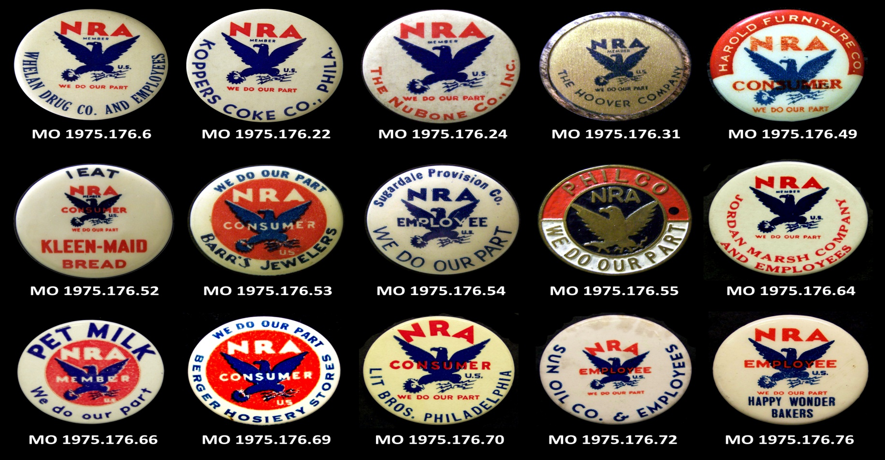
25.2 cont….
12. The National Recovery Administration (NRA) encouraged businesses to set a minimum wage and abolish child labor.

Slide 19
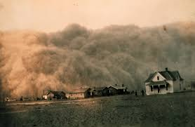
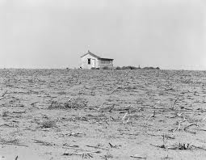
25.3 Life During the Depression
1. The Dust Bowl was caused by over farming and years of drought.

Slide 20
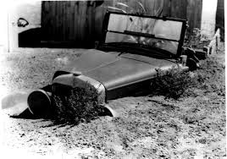
25.3 cont….

Slide 21
25.3 cont…..
2. About 400,000 farmers migrated to California and became migrant workers.
3. John Collier, the head of the Bureau of Indian Affairs, introduced a set of reforms known as the Indian New Deal.

Slide 22
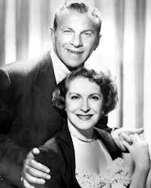
25.3 cont….
4. Variety shows featured comedians like George Burns and Gracie Allen.

Slide 23
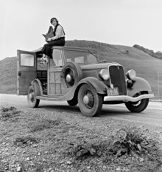
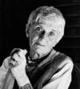
25.3 cont…..
5. Dorothea Lange took photos of migrant workers during the Great Depression.

Slide 24
25.3 cont….
6. Socialist and Communist saw the Depression as the death of a failed system.

Slide 25
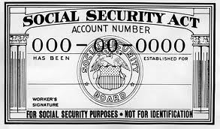
25.4 Effects of the New Deal
1. The Social Security Act created a tax on workers and employers. That money provided monthly pensions for retired people.

Slide 26
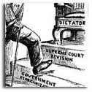
25.4
2. FDR took and unpopular action to prevent the Supreme Court from undoing the New Deal. This was called Roosevelt’s “ court-packing plan.”

Slide 27
25.4 cont……
3. The disaster that was reversed by government spending on public works was known as the Roosevelt Recession.

