Slide 1
Defensive Driving
There are many different techniques that we can use to help minimize our risks while driving on the roadways.
There are two that are the backbone of safe driving. They are: Smith System and SIPDE.

Slide 2
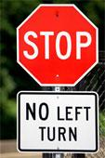
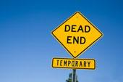
S.I.P.D.E.
The SIPDE process is an easy-to-use system for dealing with the driving challenge.
S.I.P.D.E. is an acronym for a 5 step process for defensive driving.

Slide 3
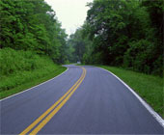
SIPDE
“S”- Search the roadway and the off-road areas 20 to 30 seconds ahead for information that can help you with a safe path of travel.
“I” – Identify objects or conditions within 12 to 15 seconds ahead that could interfere with your planned path of travel.

Slide 4
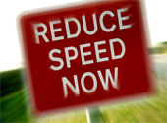
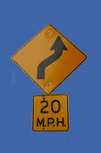
SIPDE
“P”- Predict what actions or changes in conditions on or near the roadway could increase possible danger.
“D” – Decide what action or actions you should take to help minimize risks.
Ex. Steer right or left, brake, increase speed, reduce speed, etc.

Slide 5
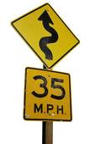
SIPDE
“E” – Execute the decision you have made. Executing a decision in most cases is making a routine maneuver. You might have to take some kind of emergency action.

Slide 6
Smith System & SIPDE
Almost all of the procedures that make up these two processes, we do everyday.
We should practice these procedures over and over again until we can perform them automatically.
Following these will help us to minimize risks on the roadway.

Slide 7
REMEMBER!!
The SIPDE and Smith System are ongoing processes. You will be reacting to one situation while gathering information about a new one.
Notes:
7

