Slide 1
Chapter 29
The Civil Rights Era
1954-1973

Slide 2
29.1 The Civil Rights Movement
1. Segregation- the separation of people of different races. (p.838)
2. NAACP (National Association for the Advancement of Colored People) worked to end segregation. (p.839)

Slide 3
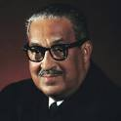
29.1 cont….
3. Thurgood Marshall – chief lawyer for the NAACP, challenged the idea of separate but equal. (p.839)

Slide 4
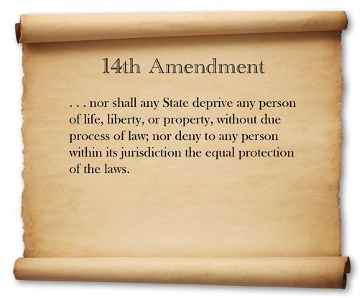
29.1 cont……
4. Marshall argued segregated schools violated the Fourteenth Amendment. (p.839)

Slide 5
29.1 cont….
(p.841) 5. Rosa Parks’ arrest lead to the Montgomery Bus Boycott.

Slide 6
29.1 cont….
6. Martin Luther King was the leader of the Southern Christian Leadership Conference (SCLC) which emphasized nonviolent protests. (p.842)

Slide 7
Section 29.2 – Kennedy and Johnson
1. “ And so , my fellow Americans: ask not what your country can do for you—ask what you can do for your country.” (p.846)
John F. Kennedy
http://www.wkyc.com/video/2854144525001/1/JFK-Ask-not-what-your-country-can-do-for-you

Slide 8
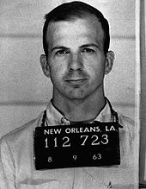
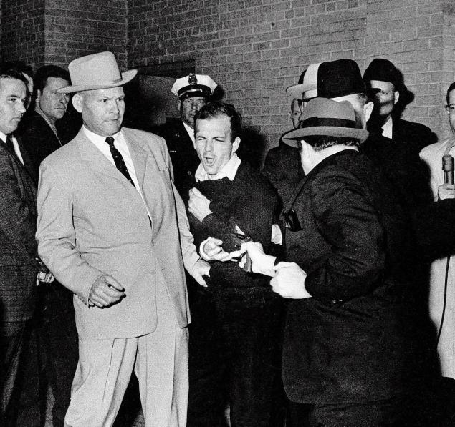
29.2 cont….
2. Lee Harvey Oswald – charged with killing President Kennedy. (p.846)

Slide 9
29.2 cont…..
3. Warren Commission – group that investigated John F. Kennedy’s assassination. (p.846)
4. In January 1964, President Johnson declared an unconditional war on poverty. (p.847)
5. Medicare – helps pay for medical care for senior citizens. (p.847)
6. Department of Housing and Urban Development (HUD) helped fund public housing projects. (p.847)

Slide 10
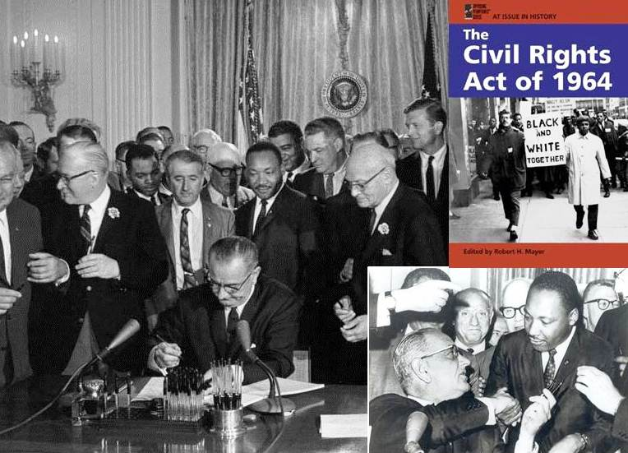
29.2 cont….
7. The Civil Rights Act of 1964 – prohibited discrimination against African Americans in employment, voting, and public accommodations.

Slide 11
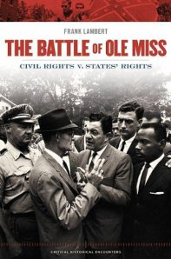
Section 29.3 The Movement Grows
1. Ross Barnett – Governor of Mississippi who prevented James Meredith from registering at the University of Mississippi.

Slide 12
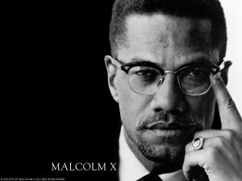
29.3 cont….
2. Malcolm X – leader of the Nation of Islam. (Black Muslims)

Slide 13
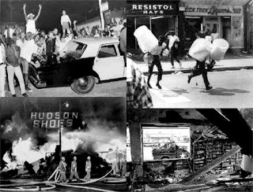
29.3 cont……..
• 3.Watts Riots – Riots that took place in the Watts area of Los Angeles, California in 1965. In a week of rioting, 34 people were killed and much of Watts was burned to the ground.

Slide 14
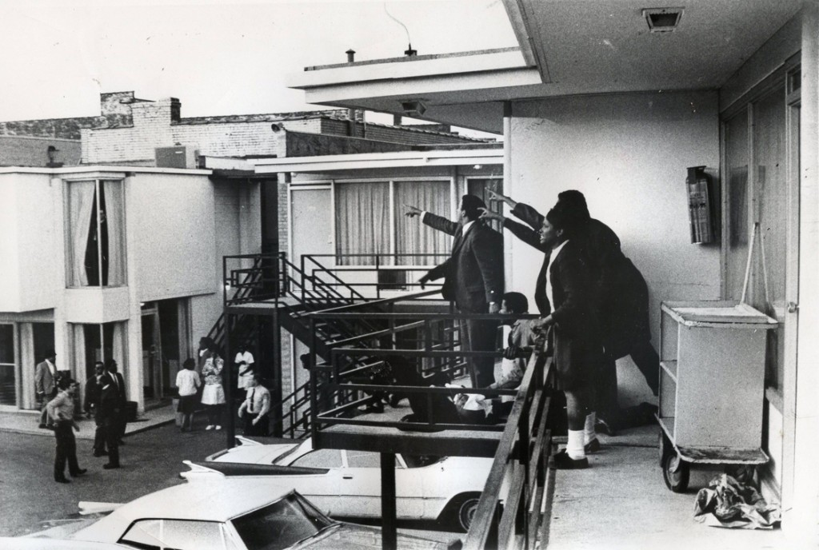
29.3 cont….
• 4. On April 4, 1968 Dr. Martin Luther King, Jr. was assassinated.

Slide 15
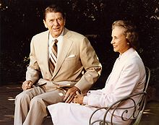
Section 29.4 Women’s Rights
1. Equal Rights Amendment – was never ratified.
2. In 1981 President Ronald Reagan appointed Sandra Day O’Connor as the first female justice of the Supreme Court.

Slide 16
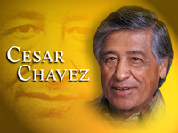
29.4 cont…….
3. Cesar Chavez organized thousands of farm workers into the United Farm Workers. (UFW)

Slide 17
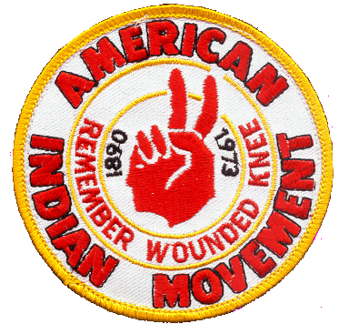
29.4 cont….
4. American Indian Movement (AIM) protested civil rights violations.

