Slide 1
The Jazz Age 1919-1929
Chapter 24

Slide 2
24.1 Time of Turmoil
1. Capitalism – an economic system based on private property and free enterprise.
2. Communism – a form of government where the government itself controls business and production of goods.

Slide 3
24.1 cont….
3. A fear of communism led to the “Red Scare.” This was a time when the government went after communists as well as other radicals.

Slide 4
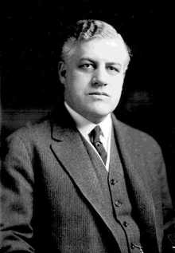
24.1 cont…..
4. In 1919 and early 1920, Attorney General A. Mitchell Palmer ordered the arrest of people suspected of being communists.

Slide 5
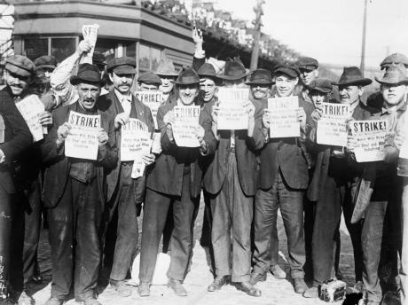
24.1 cont…..
5. The largest strike in U.S. history occurred in the steel industry. Eighteen strikers died in a riot in Gary, Indiana as a result of the strike.

Slide 6
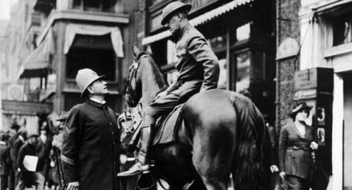
24.1 cont….
6. In September 1919, police officers in Boston went on strike, demanding the right to form a union. The strike collapsed and officials fired the entire force.

Slide 7
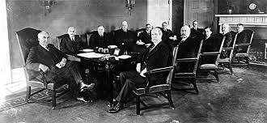
24.2 Desire for Normalcy
1. President Harding was a friend to big business.
2. President Harding gave jobs to many of his friends and political allies. This group became known as the Ohio gang.

Slide 8
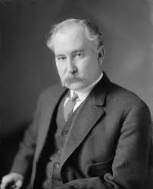
24.2 cont….
3. The biggest scandal of the Harding administration involved Albert Fall.

Slide 9
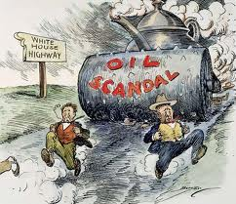
24.2 cont….
4. Teapot Dome became a symbol of the corruption in the Harding administration and of government corruption and scandal in general.

Slide 10
24.2 cont…..
5. Calvin Coolidge was also a friend to big business. “ The man who builds a factory builds a temple” (p. 706)
6. The Kellogg-Briand Pact called for outlawing war. It lacked any means of enforcing peace.

Slide 11
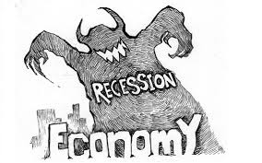
24.3 A Booming Economy
1. An economic downturn is called a recession.

Slide 12
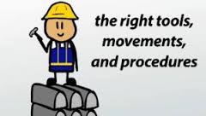
24.3 cont….
2. Gross National Product is the total value of all goods and services produced.
3. Many employers used scientific management - hiring experts to study how goods could be produced more quickly.

Slide 13
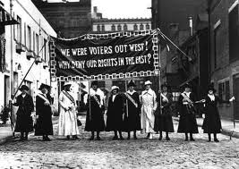
24.4 The Roaring Twenties
1. The nineteenth amendment guaranteed women in all states the right to vote.

Slide 14
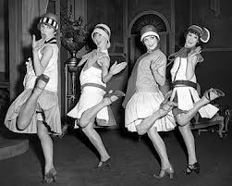
24.4 cont….
2. Flappers were a symbol of a new more liberated woman.

Slide 15
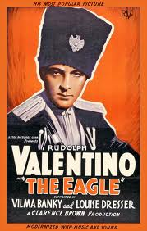
24.4 cont….
3. In the 1920s the motion picture industry in Hollywood, California, became one of the countries leading businesses. The movies offered entertainment and escape for millions of Americans.

Slide 16
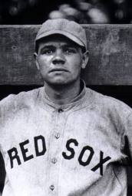
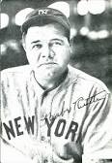
24.4 cont….
4. Many people idolized Babe Ruth, the great outfielder for the New York Yankees, who hit 60 homeruns in 1927.

Slide 17
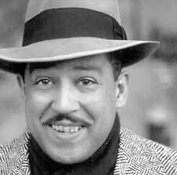
24.4 cont….
5. Langston Hughes was an African American writer and poet during the 1920s.

Slide 18
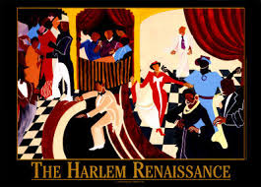
24.4 cont…..
6. The Harlem Renaissance was a flowering of African American culture and a movement that instilled an interest in African culture and pride in being African American.

Slide 19
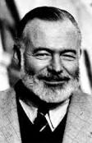
24.4 cont…..
7. Expatriates were people who choose to live in another country. Ernest Hemingway was a famous American writer and expatriate.

Slide 20
24.4 cont…..
8. The Eighteenth Amendment was known as the Prohibition Amendment.
9. Bootlegging was the making and selling of illegal alcohol.
10. The Emergency Quota Act established a quota system in 1921.

Slide 21
24.4 cont…..
11. In 1924 the National Origins Act reduced the annual country quota from 3 to 2 percent.
12. Herbert Hoover became president in 1928.

