Slide 1
The Vietnam Era
1960-1975

Slide 2
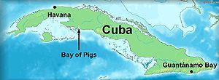
30.1 Kennedy’s Foreign Policy
President Kennedy tried to convince the Soviets to agree to a ban on nuclear testing.
President Kennedy’s first foreign policy crisis was in Cuba. It was known as the Bay of Pigs.

Slide 3
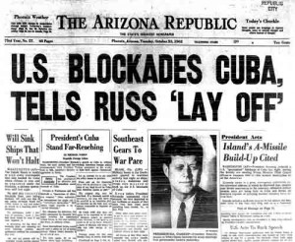
30.1 cont…..
3. In response to a Russian missile buildup in Cuba, President Kennedy ordered a blockade of the country.

Slide 4
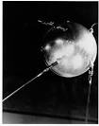
30.1 cont…..
4) The world’s first successful satellite, Sputnik, was launched by the Soviet Union in 1957.

Slide 5
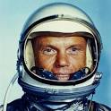
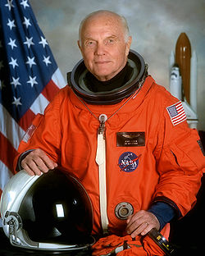
30.1 cont….
5) The first American to orbit the earth was John Glenn in1962.

Slide 6
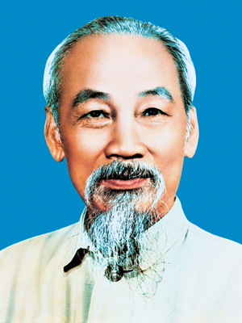
30.2 War in Vietnam
Ho Chi Minh – Leader of communist forces in North Vietnam.

Slide 7
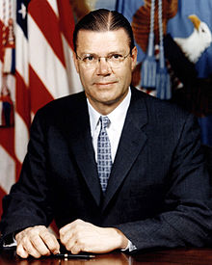
30.2 cont…..
2) Robert McNamara – Secretary of Defense sent to Vietnam on a fact finding mission.

Slide 8
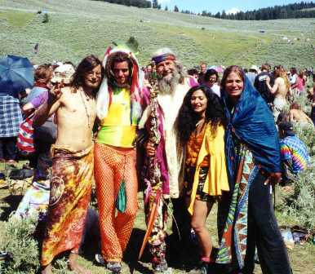
30.3 The Vietnam Years at Home
1) Counterculture – People who opposed the war and started a movement that rejected traditional American Values.

Slide 9
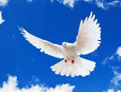
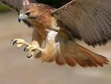
30.3 cont….
2) Doves – Opponents of the Vietnam War.
Dove – Symbol of Peace
3) Hawks – Supporters of the Vietnam War.
Hawk- Bird of Prey. Hunter

Slide 10
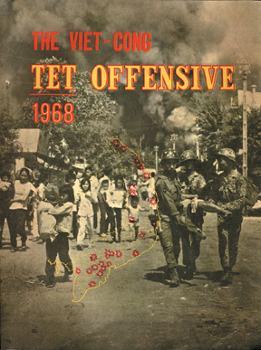
30.3 cont…..
4) The Tet offensive marked the turning point in the Vietnam War. http://www.youtube.com/watch?v=q1vJqTN-qVI

Slide 11
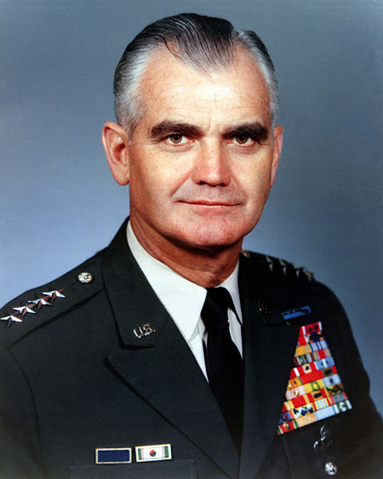
30.3 cont….
5) General William Westmorland – American commander in Vietnam.

Slide 12
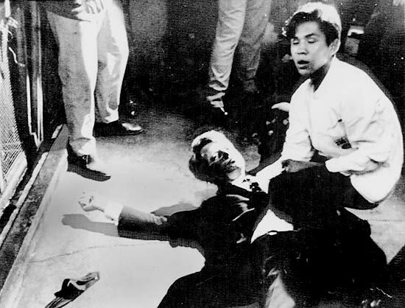
30.3 cont…….
6) Robert Kennedy was assassinated after winning the California Primary.

Slide 13
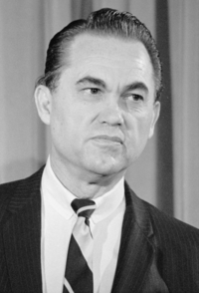
30.3 cont….
7) George C. Wallace ran as a third party candidate in the 1968 presidential race.

Slide 14
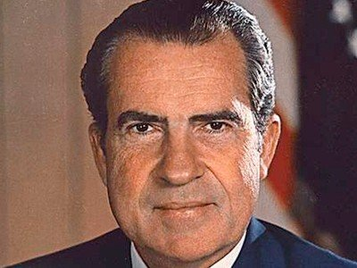
30.3 cont….
8) Richard M. Nixon – The 1968 “silent majority’s” presidential candidate.

Slide 15
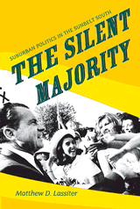
30.3 cont….
9) Silent Majority – The phrase used by Nixon to describe the majority of Americans, those who did not protest or demonstrate.

Slide 16
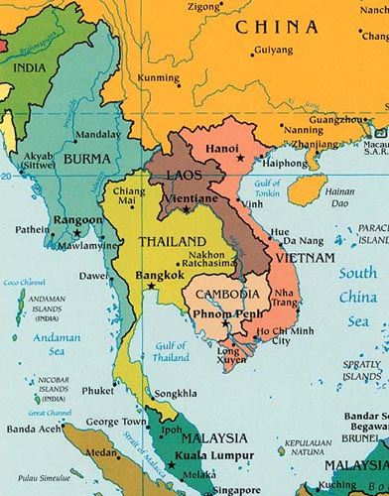
30.4 Nixon and Vietnam
President Nixon ordered the bombing of enemy supply routes in Laos and Cambodia.

Slide 17
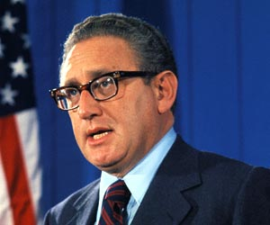
2) Henry Kissinger – the president’s national security adviser who represented the United States in the Paris Peace talks.

Slide 18
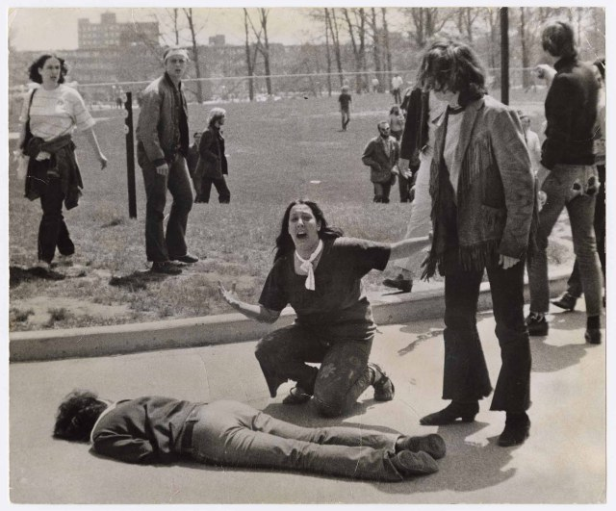
30.4 cont…
3) Four students were killed during protests at Kent State University.

