Slide 1
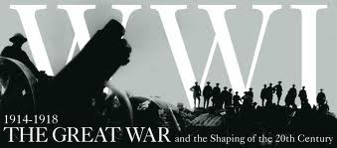
Chapter 23

Slide 2
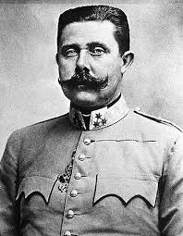
23.1 War in Europe
1. Archduke Franz Ferdinand, the heir to the throne of the Austro-Hungarian Empire, along with his wife, was assassinated in Bosnia on June 28, 1914.

Slide 3
23.1 cont……
2. Nationalism is a feeling of intense loyalty to one’s country.
3. Ethnic groups are people who share a common language and traditions.
4. Militarism is a buildup of the military within a country.

Slide 4
23.1 cont….
5. Alliance systems are defense agreements among nations.
6. An entente is an understanding among nations.
7. As a response to Germany invading Belgium, Great Britain declared war on Germany.

Slide 5
23.1 cont….
8. Allied Powers – Great Britain, France, Russia, Japan, and Italy
9. Central Powers – Germany, Austria-Hungary, and the Ottoman Empire

Slide 6
23.1 cont…..

Slide 7
23.1 cont….
10. The Ottoman Empire joined the Central Powers because it had fought Russia in the past.
11. Japan joined the Allies because it was a rival of Germany.

Slide 8
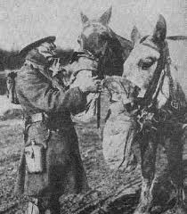
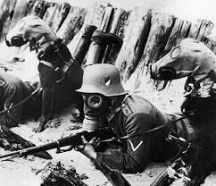
23.1 cont…..
12. Poison gas was first used by the Germans over Allied lines in April 1915.

Slide 9
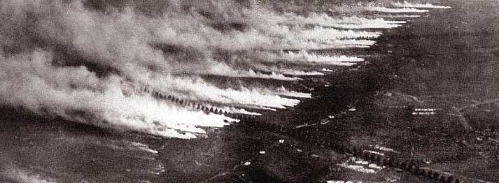
23.1 cont…..
Poison Gas Attack WWI

Slide 10
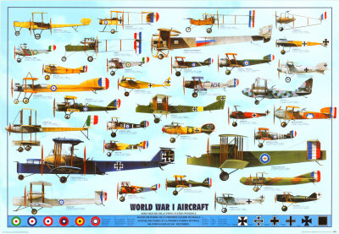
23.1 cont….
13. The most dramatic new weapon of WWI was the airplane.

Slide 11
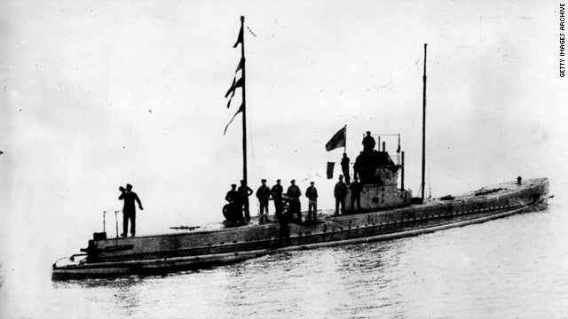
23.1 cont…..
14. German U-boat attacks changed the course of the war.

Slide 12
23.2 America’s Road to War
1. Propaganda is information used to influence opinion. Both the Allies and the Central Powers used propaganda.
2. On May 7, 1915 a German U-boat torpedoed the British passenger liner Lusitania off the coast of Ireland.

Slide 13
23.2 cont….

Slide 14
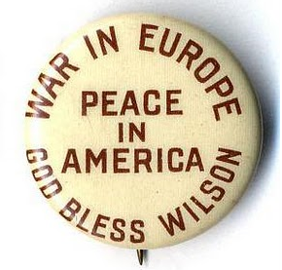
23.2 cont….
3. “ He Kept Us Out of War” was the Democratic slogan during Woodrow Wilson’s second run for presidency in 1916.

Slide 15
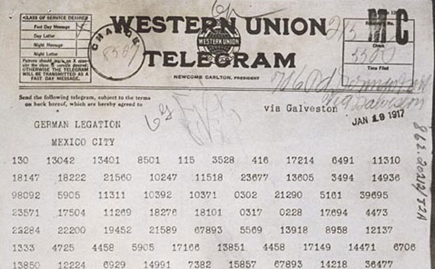
23.2 cont….
4. In March of 1917 American newspapers published the Zimmermann telegram.

Slide 16
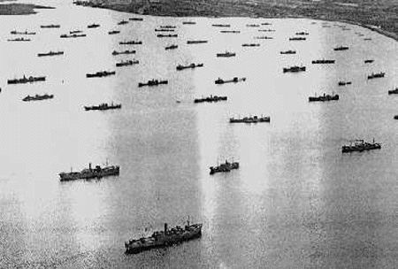
23.3 Americans Join the Allies
1. To ensure needed supplies got to Britain the U.S. used convoys to protect supply ships.

Slide 17
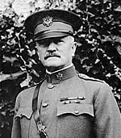
23.3 cont…..
2. General John J. Pershing led the American Expeditionary Force in Europe.

Slide 18
23.3 cont….
3. On October 4, 1918 Germany asked for and received an armistice.

Slide 19
23.4 The War at Home
1. After declaring war on Germany in 1917, Americans began mobilization.
2. To ensure production of vital war materials, the government created the National War Labor Board in April 1918.
3. World War I cost the U.S. about $32 billion.

Slide 20
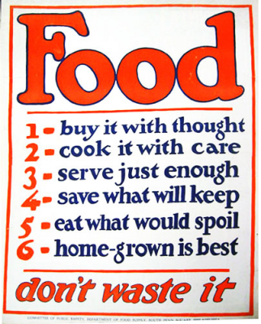
23.4 cont….
4. The Food Administration encouraged farmers to produce more and people to eat less.
Wheatless Mondays – Meatless Tuesdays – Porkless Thursdays Victory Gardens

Slide 21
23.4 cont…..
5. Socialists believe industries should be publicly owned.
6. Pacifists oppose the use of violence.
7. People gave patriotic names like liberty cabbage and liberty sausage to German words such as sauerkraut and frankfurter.

Slide 22
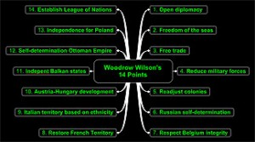
23.5 Searching For Peace
1. President Wilson’s plan for peace was known as the Fourteen Points.

Slide 23
23.5
2. President Woodrow Wilson believed in national self-determination. The right of the people to decide how they should be governed.

Slide 24
23.5 cont….
3. The Treaty of Versailles was signed on June 28, 1919. The Germans were shocked by the harsh terms of the treaty.
4. The treaty carved up the Austro-Hungarian and Russian Empires to create new nations or restore old ones. This fulfilled part of Wilson’s vision of “national self-determination.”

Slide 25
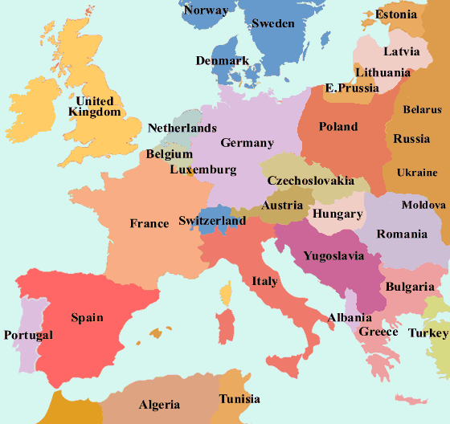
23.5 cont….
Europe After WWI

Slide 26
23.5 cont….
5. The United States did not sign the Treaty of Versailles. The United States signed separate treaties with each of the Central Powers and never joined the League of Nations.

