Slide 1
The Cold War Era 1945-1954
Chapter 27

Slide 2
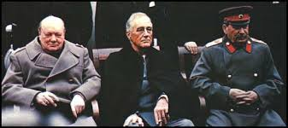
27.1 Cold War Origins
1. In Feb. 1945, the “Big Three” Allied leaders- Franklin D. Roosevelt, Winston Churchill, and Joseph Stalin met at Yalta, a Soviet port on the Black Sea. (Yalta Conference)

Slide 3
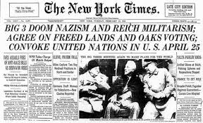
27.1 cont…
2. At the Yalta Conference, the Soviet Union agreed to enter the war against Japan in exchange for some territories in Asia.

Slide 4
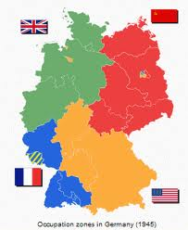
27.1 cont….
3. After WWII the Allies agreed to divide Germany into four zones. The U.S., Britain, France, and Russia would each control a zone.

Slide 5
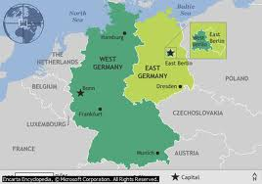
27.1 cont….
Germany becomes two separate countries.

Slide 6
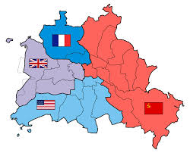
27.1 cont….
Berlin divided into 4 parts

Slide 7
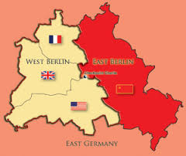
27.1 cont….
Berlin becomes a divided city.

Slide 8
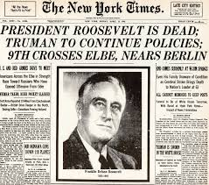
27.1 cont…
4. President Roosevelt died suddenly on April 12, 1945. Vice president Harry S. Truman succeeded him. (Quote p.790)

Slide 9
27.1 cont….
5. On June 26, 1945 , in San Francisco, California, 50 nations – including the Soviet Union – signed the charter creating the United Nations. (U.N.)

Slide 10
27.1 cont….
6. In 1946, Winston Churchill declared in a speech in Fulton, Missouri, that an “iron curtain” had descended on Europe. He meant that the Soviets had cut off Eastern Europe from the West. (map p.789)

Slide 11
27.1 cont….

Slide 12
27.1 cont…..
7. The policy of containment meant that the U.S. would try to prevent the Soviet Union from spreading communism to other parts of the world.
8. The Truman Doctrine was a commitment to help nations threatened by communism and Soviet expansion.

Slide 13
27.1 cont…..
9. The Marshall Plan helped rebuild the countries of Western Europe.
10. The Berlin Airlift continued day and night for more than 10 months, delivering tons of supplies to West Berlin.

Slide 14
27.1 cont….

Slide 15
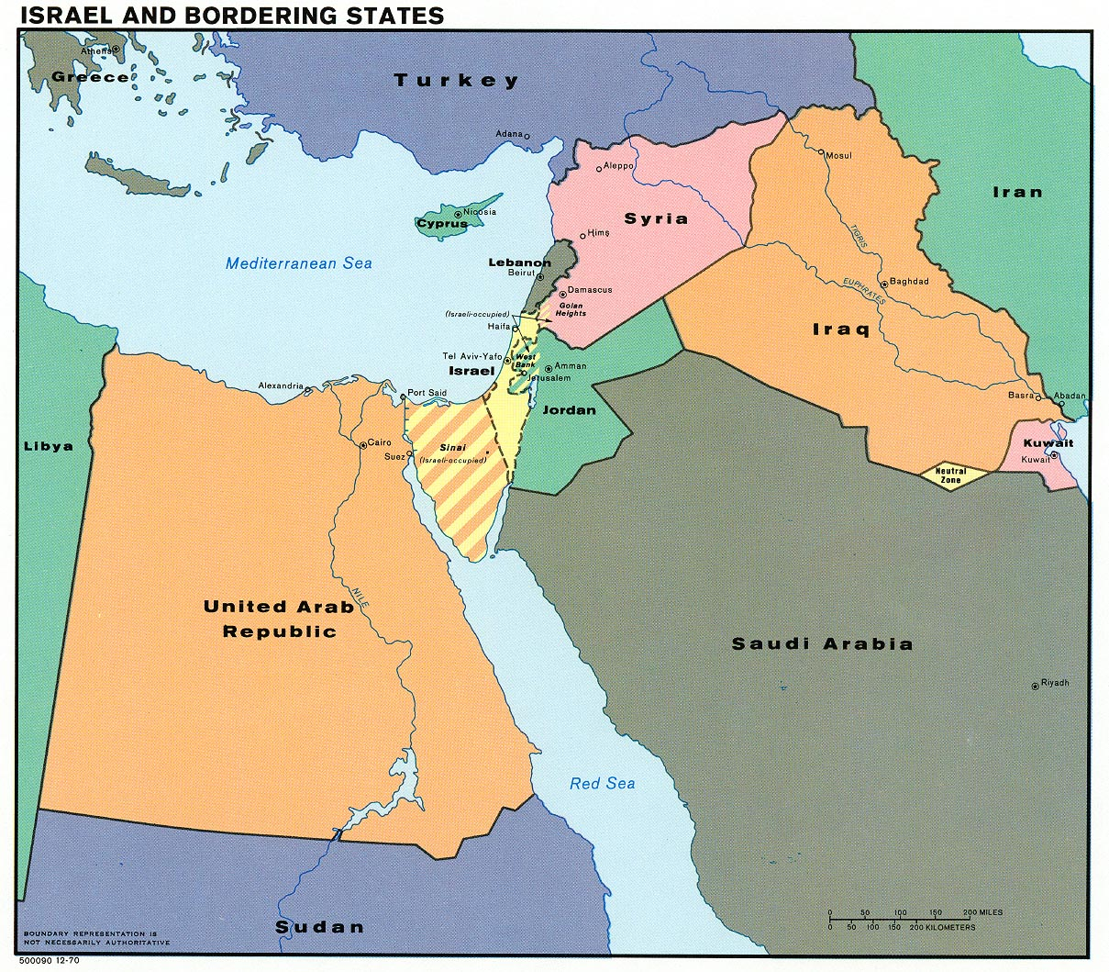
27.1 cont…..
11. In the Middle East, Jews and Arabs both claimed the region of Palestine.
12. The country of Israel was created by dividing Palestine.

Slide 16
27.2 Postwar Politics
1. President Truman’s plan for domestic reforms was called the Fair Deal.
2. In 1946, the slogan “Had Enough” helped Republicans win control of both houses of congress.
3. The G.I. Bill provided unemployment and health benefits for GI’s and their families.

Slide 17
27.3 The Korean War
1. On June 25, 1950, the armies of North Korea crossed the 38th parallel into South Korea. Within days the communist forces had gained control over much of South Korea, including Seoul, the capital city. (map p. 803)

Slide 18
27.3 cont….

Slide 19
27.3 cont…
2. General Douglas MacArthur was put in command of UN forces in Korea.
3. China fought on the side of North Korea. (p.804)
4. On April 11, 1951, President Truman relieved MacArthur of his command in Korea.

Slide 20
27.4 The Red Scare
1. The Red Scare was the fear of communist or the spread of communism in the U.S. from about 1947 until the mid 1950s.
2. The House Un-American Activities Committee (HUAC) began investigating communist activity in the nation.

Slide 21
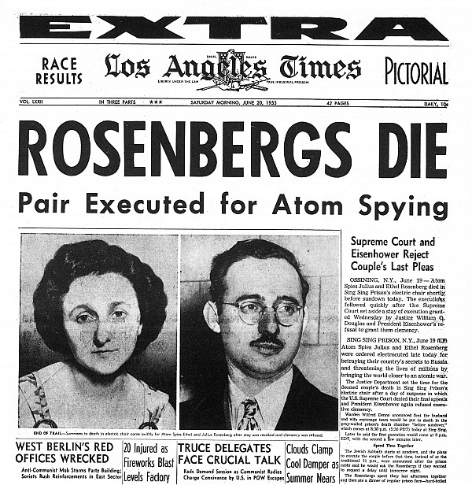
27.4 cont…..
3. The most dramatic spy case to come before HUAC involved the atomic bomb and a New York couple named Julius and Ethel Rosenberg.

Slide 22
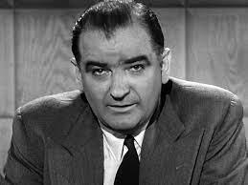
27.4 cont….
4. From 1950 to 1954, the hunt for Communists in America was dominated by senator Joseph McCarthy from Wisconsin.

Slide 23
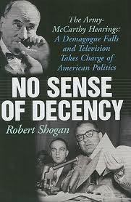
27.4 cont….
5. McCarthy’s downfall was the televised Army-McCarthy hearings.

