Slide 1
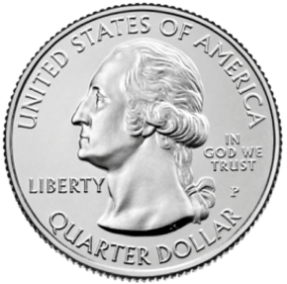
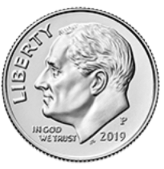
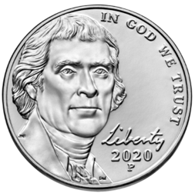
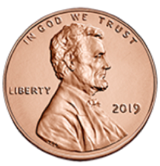
EXAMPLE
Notes:
Drag the coins you need to the piggy bank. This is an example slide.

Slide 2
Notes:
Drag the coins you need to the piggy bank.

Slide 3
Notes:
Drag the coins you need to the piggy bank.

Slide 4
Notes:
Drag the coins you need to the piggy bank.

Slide 5
Notes:
Drag the coins you need to the piggy bank.

Slide 6
Notes:
Drag the coins you need to the piggy bank.

Slide 7
Notes:
Drag the coins you need to the piggy bank.

Slide 8
Notes:
Drag the coins you need to the piggy bank.

Slide 9
Notes:
Drag the coins you need to the piggy bank.

Slide 10
Notes:
Drag the coins you need to the piggy bank.

Slide 11
Notes:
Drag the coins you need to the piggy bank.

Slide 12
Notes:
Drag the coins you need to the piggy bank.

Slide 13
Notes:
Drag the coins you need to the piggy bank.

