Slide 1
Recycling
The “Green Team”
Saraland Early Education Center

Slide 2
What is Recycling?
Recycling is taking materials ready to be thrown away and changing them into usable materials.

Slide 5
What does the Recycling Symbol Mean?

Slide 6
The first top arrow represents the collection of recyclable materials for processing.
The bottom right arrow represents the recyclables being processed into recycled products.
The bottom left arrow is the most important. It represents when the consumer actually buys a product with recycled content.

Slide 7
Why should we recycle?
By recycling 1 ton of paper we save:
17 trees
7,000 gallons of water
38 gallons of oil
3 yards of landfill space
Enough energy to heat a home for 6 months

Slide 8
What will our school be recycling?
Paper
Plastic
water
bottles
Plastic

Slide 9
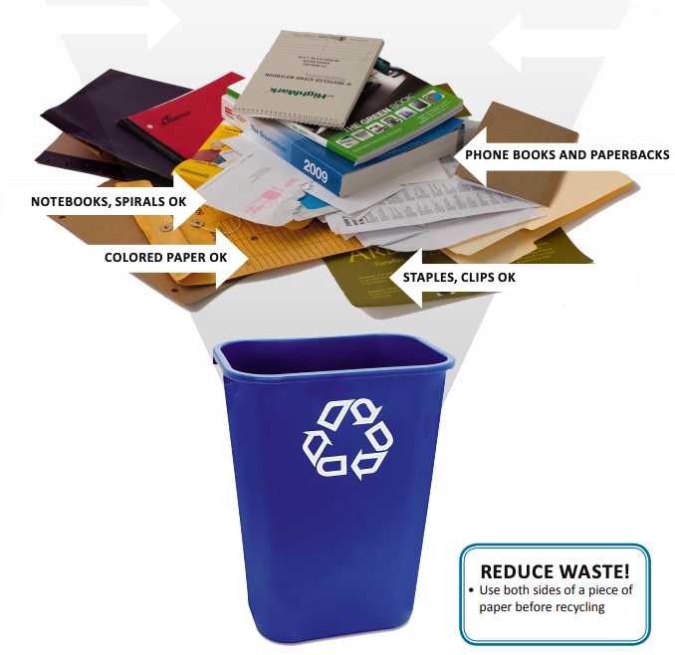
How to recycle at school?
Each classroom and designated areas around the school will have bins to put the paper and bottles in.

Slide 10
SEEC Green Team Club
Two students from each class will be chosen to represent the Green Team.
These students will model ”green” behavior and encourage others to recycle.
These students will be responsible in making sure the recycling bin is brought to the correct spot when it is full.
These students will participate in a monthly club meeting to learn more about recycling and make creations from recyclable material.

