Slide 1
UNIT 2
INVESTING

Slide 2
Section 2.01
Investment Terms

Slide 3
Investment Terms
Stock – The proprietorship element goods or merchandise in a corporation usually divided into shares and represented by transferable certificates.
Supply – The amount of goods and services available to consumers.
Demand – The willingness and ability to purchase a commodity or service.
Revenue – The total income produced by a given source.
Profit – The excess of returns over expenditure in a transaction or series of transactions.

Slide 4
Investment Terms
Scatter plot – A graph of plotted points that show the relationship between two sets of data.
Regression Equation – An equation that models the dependent relationship of two or more variables. Y = a + bX = e
Ratio – The relationship in quantity, amount, or size between two or more things. Example: 14 boys:12 girls
Proportion – A statement of equality between two rations.

Slide 5
Section 2.02
Stock Simulations

Slide 6
Stock Simulations
Stock Video
High Speed Trading In Action

Slide 7
Stock Exchange Game
MarketWatch Virtual Stock Exchange Game
To create an account:
Open the MarketWatch Virtual Stock Exchange website.
Marketwatch.com/game
Select the orange "Join Now" button.
On the Sign In page, scroll to the bottom and select "Not a member? Register here." under the sign in buttons.
Register your account by adding your name, email, and create a password.
Once submitted, go to your email. You should receive an email titled "Please verify your email address for MarketWatch" from Dow Jones. Follow the instructions to verify your email and then proceed to the next tab for game creation instructions.

Slide 8
Stock Exchange Game
To set up a game:
Log in and select Create a Game
Choose Normal level
Enter your first name as group name
Enter today's date as the start date. You will play for one week so enter the date of one week from today as the end date.
Select YES for the answer to "Can new players join after the game has started?"
You may choose your own tag line or leave it blank.
Proceed to next step.
To accept the symbols offered in step 4, proceed to the next step.
Set game to private. Enter a password of your choice.
Set player portfolios to private.
Proceed to the next step.
Join your game by entering your password.

Slide 9
Section 2.03
Scatter Plot Construction

Slide 10
Scatter Plots

Slide 11
Constructing a Scatter Plot
Start with two axes.

Slide 12
Constructing a Scatter Plot
2. Label your axes x and y.

Slide 13
Constructing a Scatter Plot
3. Look at your data and determine your maximums and minimums. Label your axes based on this information. The data we're graphing the following points: (2,3) (3,4) (4,2) (6,5) (5,4) (2,2) (3,3)

Slide 14
Constructing a Scatter Plot
4. Plot the points on the graph.

Slide 15
Scatter Plot Relationships
By plotting the information in a scatter plot, we are able to look at the information and see if there is any relations.

Slide 16
Positive Correlation
Although the relationship is not linear, we can see that there is an upward movement of the points.
This is called a positive correlation. This means that as the x increases, y also increases.

Slide 17
Negative Correlation
A negative correlation would look like there is a downward movement.
This means that as x increases, y decreases.

Slide 18
No Correlation
There are also times that there is no correlation at all.
This means there is a random scattering of the data.

Slide 19
Section 2.04
Scatter Plot Trends

Slide 20
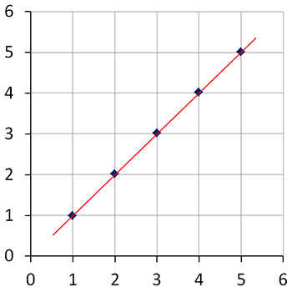
Trend Line
The points in this plot fall in a line. We say that a strong positive association exists between the variables plotted here. This is not normally the case for scatter plots.

Slide 21
Drawing a Trend Line
When drawing a trend line, you should try to place it through the center of the points that have been plotted.
Sometimes you will have outliers. An outlier is a point that lies outside the main body that it is a part of.

Slide 22
Where to place the trend line?
When deciding where to place your trend line, keep in mind that you should try to have it as close as possible to all points with as many points above it as are below it.

Slide 23
Equation of a Line
Once you have drawn the trend line, you will write an equation of the line.
Identify two points on the line.

Slide 24
Equation of a Line
You will calculate the slope of the line using the slope formula:
$$m=\frac{y_{2}−y_{1}}{x_{2}− x_{1}}$$

Slide 25
Equation of a Line
As long as you know the slope and a point on a line, you can use the slope-intercept equation to find the y-intercept and then write the equation of the line.
y = mx + b
m = 1 passing through (5,5)
y = mx + b
5 = (1)(5) + b
5 = 5 + b
0 = b
y = x

Slide 26
Window

Slide 27
Window

Slide 29
Section 2.08
Spreadsheets

Slide 30
Functions
Spreadsheet functions are predefined formulas that perform calculations by using specific values, called arguments, in a specific order. They can be used to perform simple or complex calculations.

Slide 31
Components
Parentheses – control the Order of Operations
Conditions or criteria tell the function how to calculate the results and what data to use. Tells the computer what to do.

Slide 32
Let’s Look at a Function . . .
Tells which Function to use
Here’s the criteria: ADD the numbers in the range B1:B5
=sum(B1:B5)
Tells us where on the spreadsheet to go

Slide 33
Mathmatical Operators
+ Add
- Subtract
* Multipy
/ Divide
= Tells the computer that there is a Formula!
: - means Through

Slide 34
Basic Functions
Basic functions include the following:
Sum, for example, =Sum(C4:C18) adds the range of cells from C4 through C18
Average, for example, =Average(C4:C18) determines the average of the range of cells from C4 through C18
Maximum, for example, =Max(C4:C18) finds the highest number in the range of cells from C4 through C18
Minimum, for example, =Min(C4:C18) finds the lowest number in the range of cells from C4 through C18

Slide 35
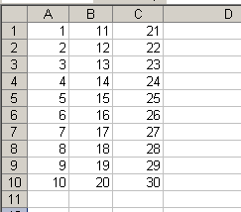
Components of a Function
Cell reference – indicates a cell’s address (ex. A4 is 1) and provides instructions for how cell data is copied or used in calculations

Slide 36
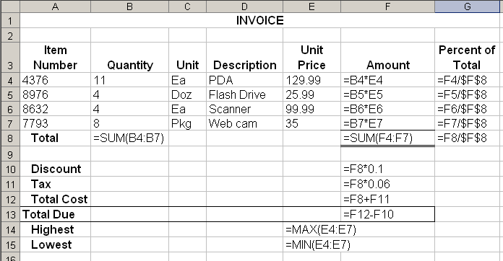
Cell Reference – Relative Value
Relative (cell value changes as the formula is copied)

Slide 37
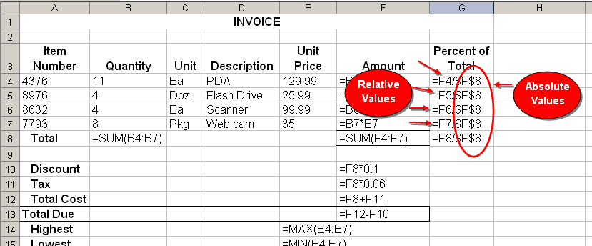
Cell Reference – Absolute Value
An Absolute reference never changes!
Ex. If you wanted to input a formula and wanted to keep a constant in the formula, you would make it absolute

Slide 38
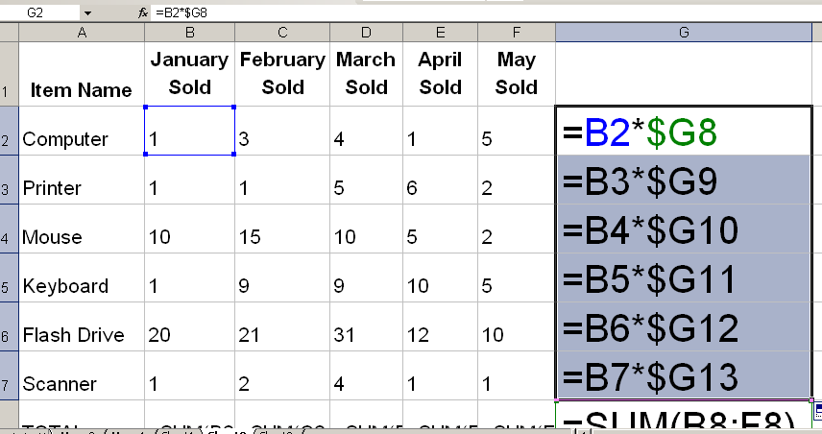
Cell Reference – Mixed Value
Mixed reference indicates the combination of an absolute cell and a relative cell, such as $G8 or B$2

Slide 39
Cell Reference
Absolute (cell value remains static when copied to other locations) $G$8

Slide 40
Cell Reference
A Relative Cell Reference Changes!
Ex. =D5/$F$8
What is the relative reference?
Why?

Slide 41
Cell References
Absolute Column and absolute row.
Ex. $A$1
Relative column and Absolute Row
Ex. A$1
Absolute column and relative Row
Ex. Starts with $A1
Relative column and relative row
Ex. A1

Slide 42
Google Sheets
Google Sheets for Beginners

