Slide 1
Unit 3
Budget and Retirement planning

Slide 2
Section 3.01
Retirement Planning and budgeting

Slide 3
Retirement and Budgeting
At what age would you like to retire?
How would you like to spend your retirement?
How to you plan to save for your retirement?

Slide 4
Retirement Planning and Budgeting Terms
Debt – Money, goods, or services you owe to someone else. (Mortgage, car, credit cards, late payments, interest charges, yearly fees)
Cash Flow – The amount of money that comes in and goes out of your account.
Net Worth – The total of everything you own, as well as the amount of money you have on hand, in checking, savings or other investment accounts less the total amount of money you owe.
Budget Line Graph – A line graph that illustrates an income which sets limits to one’s maximum behavior.

Slide 5
Periodic Investment Formula
A common financial planning concept used to estimate the amount of money that will be paid to an investor on a future date if the investor makes a series of deposits prior to that date.
P = PMT [((1 + r)^{n} – 1) / r]
Where:
P = The future value of the annuity stream to be paid in the future
PMT = The amount of each annuity payment
r = The interest rate
n = The number of periods over which payments are made

Slide 6
Section 3.02
Net worth

Slide 7
Net Worth Video
Video Link

Slide 8
Calculating Net Worth
Someone’s net worth is their total assets minus their total property (everything they owe).
Complete Class Activity

Slide 9
Section 3.03
Personal budget

Slide 10
Personal Budget
It is 2020 and you are about to graduate from high school. You are now ready to be on your own and be FREE of your parent’s rules.
Since you will be on your own, you need to learn how to budget your money. Remember, you will have to pay bills… AND money does not grow on trees!

Slide 11
The Importance of a Budget
When planning a budget for your self, remember the following important details.
A budget is a spending plan.
A budget enables you to use your money wisely.
A budget enables you to make sure that your money covers all necessary financial needs.
A budget helps to control spending habits.
A household budget will better prepare you to live on your earnings.
If you do not live on your earnings, you will go into debt!

Slide 12
How to Prepare a Budget
There are many different ways to prepare a budget. You are going to learn to prepare a budget using the “Six Step Method”.
Determine your gross income.
Determine any deductions that will be subtracted from your total income. (28% is a good estimate)
Determine net income.
Determine fixed expenses.
Determine the amount of spendable income.
Develop a plan to manage spendable income.

Slide 13
What are Monthly Fixed Expenses?
Monthly fixed expenses include:
Rent
Food
Personal Care
Savings (needed for those emergencies that may/will happen)
Monthly Payments
Car Payments, insurance payments, utilities, phone, and water

Slide 14
Example 1
John is attending college in his hometown. John has a part-time job. He earns $7.50 per hour and he works 32 hours per week. His payroll deductions is 28% of his gross income.
John is renting an efficiency apartment which costs $200 per month. Electricity, water, and gas is included in the rent. He has a cable bill that is $45 per month and a cell phone bill that is $75.00 per month. John has a motorcycle payment of $125 per month, plus insurance and operating expenses which total $40 per month.
John uses an estimate of 15% of his net income to determine how much he will spend on food.
Prepare a budget using John's information. Assume that there are 4 weeks in a month.

Slide 15
Example 1 Continued
 | Per Month
Gross Income | _________
Payroll Deductions | _________
Net Income | _________
Fixed Expenses
Food 15% of net income | _________
Housing | _________
Cable Bill | _________
Phone Bill | _________
Transportation | _________
Total Fixed Expenses | _________
Spendable Income | _________

Slide 16
Example 2
Janet has finally graduated from college. She was hired for a job in her field making $41,000 per year. Janet payroll deductions are 28% of her gross income.
She has rented an apartment that costs $450.00 per month. Water and cable are included in the rent of the apartment. She has a cell phone bill of $100.00 per month. Electricity is $120.00 per month. Janet has a car payment of $342.00 per month. Insurance and operating expenses for the car are $150.00 per month.
She purchases a $50.00 savings bond every month which costs her $37.50. Janet pays 5% of her net income for medical insurance. 15% of her net income is allocated for food. 10% of her net income is for clothing/personal items.

Slide 17
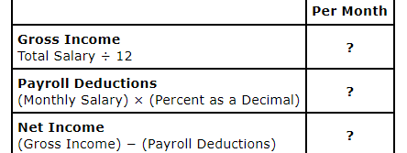
Example 2 Continued
Example #2: Net Income
Let's begin by considering Janet's income and deductions. Remember that gross income is before taxes and net income is the actual amount she is paid. Recall that her total salary is $41,000 and her payroll deductions are 28% of her gross income.

Slide 18
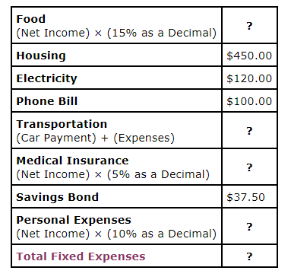
Example 2 Continued
We will use $2,460 (her net income) to prepare a budget for Janet. We will look at her monthly expenses next. Remember the information from the problem, especially that these amounts are per month. Identify the missing amounts for Janet's food budget, transportation, medical insurance, personal expenses, and her total fixed expenses.

Slide 19
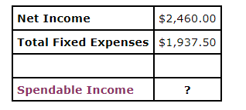
Example 2 Continued
Example #2: Spendable Income
Using the calculated amounts of her net income of $2,460.00 per month and $1937.50 as her total expenses, answer the following questions.
What is the total amount of money she will have remaining after her total expenses?

Slide 20
Example 2 Continued
Example #2: Saving Money
Let's consider Janet's case and look at her options for saving extra money for emergencies.
Suppose she wanted to save $20 per month for her emergency fund. How much would she have after...
One Year?
Two Years?
Ten Years?

Slide 21
Graded Assignment
Analyzing a Personal Budget Activity

Slide 22
Section 3.04
Budget line graph

Slide 23
Budget Line Graph
Fixed Expenses – Expenses that occur every month like the power bill, cable bill, cell phone bill, insurance, and rent. They are fairly consistent in their cost, or at least predictable.
Spendable Income – Additional expenses that occur throughout the year that vary in price, such as camping, fishing, traveling, etc.
Variable Expenses – An expense that can change over time according to a number of factors.

Slide 24
Budget Line Graph
Suppose you go shopping with your friends and you have $45 to spend. Your friends want to go and eat while you are out. As the amount you spend on food increases, the amount you have to shop decreases.
Let’s say you have spend $12.00 for your food. How much do you have to spend shopping?
$33
What if you spend $30 on food? How much do you have to spend shopping?
$15

Slide 25
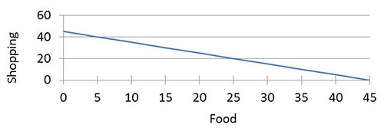
Budget Line Graph
You can model this situation with a budget line graph such as the one below. Any point on the line will give us a possible spending plan for the day. Notice if you spend $45 shopping, you have $0 left to spend on food and vice versa.

Slide 26
Budget Line Graph
We can write an equation of the budget line. You need the slope and y-intercept. By looking at the graph, the y-intercept is 45 and the slope is -1. Remember, slope-intercept form is y = mx + b.
What would the equation for this budget line be?
$$y=−x+45$$

Slide 27
Shopping for Jeans
Your mother has given you $150 to buy some new jeans for school. You tried some jeans on at Aeropostale last week that you liked and they cost $46.50. Your mother tells you that she found some similar to these at Marshalls for $16.00. Your mother will let you decide how to spend your jeans allowance but this is all she will be giving you. You could be only the ones you like from Aeropostale. You could check out the ones that your mother suggested and spend all of you money on them. Or you could get a combination of the two.
We will be assuming that tax is included in the price for this lesson.
If you were to get the ones from Aeropostale, how many pairs can you buy?
3 pairs

Slide 28
Shopping for Jeans
If you were to get the ones from Marshalls, how many pairs can you buy?
9 pairs

Slide 29
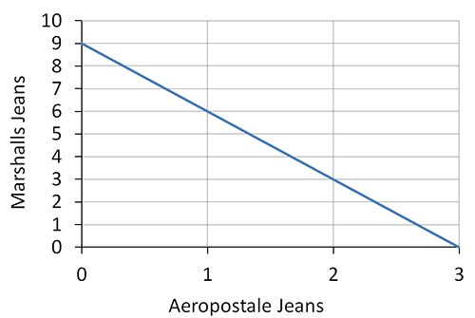
Budget Line Graph for Jeans
You can see the budget line graph of your situation below. This graph represents the number of pairs not the cost.

Slide 30
Budget Line Graph for Jeans
If you were to buy one pair from Aeropostale, how many could you buy from Marshalls?
6 pairs
If you were to buy two pairs from Aeropostale, how many pairs can you buy from Marshalls?
3 pairs

Slide 31
Equation - Budget Line Graph for Jeans
Let’s write an equation of this line.
What is the slope of the line?
-3
What is the y-intercept?
9
What is the equation of the line?
y = -3x + 9

Slide 32
Graphing Budget Lines
Use Geogebra to complete this activity.
https://www.geogebra.org/m/uSbGetKD

Slide 33
Section 3.05
Linear and piecewise functions

Slide 34
Linear and Piecewise Functions
In real world situations it can be difficult to describe events with a single smooth function. We sometimes need to use piecewise functions to describe these situations.

Slide 35
Piecewise Functions
Piecewise functions are functions that are defined to be smooth functions for specific intervals of the independent variable, most commonly the x-variable.
You will learn how to graph piecewise functions by using your knowledge of graphing other functions.
Things to remember:
A closed circle (filled in) ● , ≥ , ≤ , or = indicates that this point is part of the graph.
An open circle (not filled in) ○ , > or < indicates that this point is not part of the graph.

Slide 36
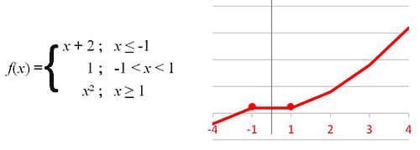
Piecewise Functions
A piecewise function often looks like pieces of graphs glued together. These pieces may all be linear or a mixture such as:

Slide 37
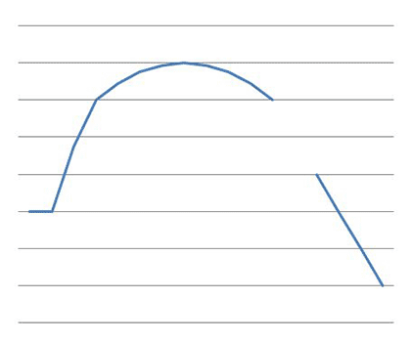
Piecewise Functions
When graphing a piecewise function, You will want to focus on where the changes in the graph occur. It could be continuous (there are no “gaps” or “breaks” in the plotting). Or, it could be discontinuous (having breaks, jumps, or holes) as seen in the example below.

Slide 38
Step Functions
Some functions are not easily written as a formula. On a graph, a piecewise function can look like a flight of stairs. This is called a step function.
The graphs of a step function have lines with an open circle on one end and a closed circle on the other to indicate inclusion, like number line inequality graphs.
The figure below shows the graph of a step function f(x) = [x-1] which is a greatest integer function.

Slide 39
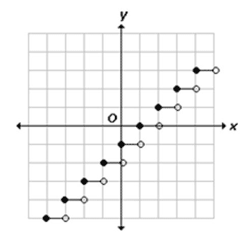
Step Functions
This is an example of a step function:

Slide 40
Step Functions
You can easily investigate the effects of the parameters on the step function by using the sliders in the interactive accessed below. Note that the function color changes with the signs of a and b, for a visual clue.
Also note that once the steps are a certain distance from the origin, the endpoints no longer appear.
Open the Step Function Explorer a-b Parameters Geogebra page. Use the sliders on the top left of the graph to investigate the effects of parameters a and b on f(x) = a[bx] by varying their values.

Slide 41
Step Functions
This is the website:
https://www.geogebra.org/m/jFxMZsVc
Work

Slide 42
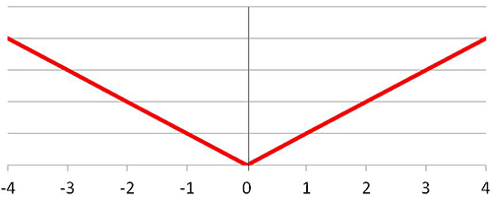
Absolute Value Functions
The Absolute Value Function is one of the most recognized piecewise functions. It has two pieces. In this graph, the two pieces merge at the point (0,0). This is the graph of f(x) = |x|

Slide 43
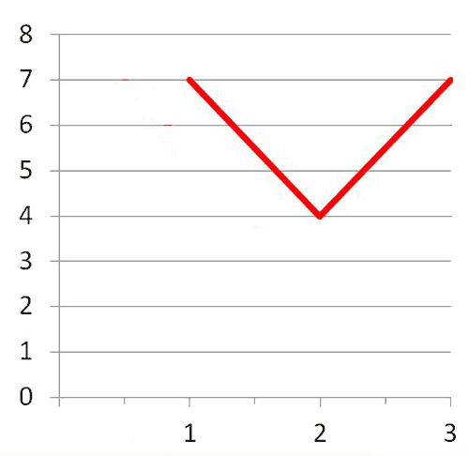
Absolute Value Functions
To graph f(x) = 3|x – 2| + 4, you will want to identify the vertex and the slope.

Slide 44
Absolute Value Functions
Below is a breakdown of this function: f(x) = 3|x – 2| + 4

Slide 45
Section 3.06
Retirement plans

Slide 46
Retirement Plans
Types of Retirement Plans
The Employee Retirement Income Security Act (ERISA) covers two types of pension plans:
defined benefit plans and
defined contribution plans.
Of course, you can (and probably should) have other retirement investments to supplement these.

Slide 47
Types of Retirement Plans
Defined Benefit Plan
A defined benefit plan promises a specified monthly benefit at retirement. The plan may state this promised benefit as an exact dollar amount such as $100 per month at retirement. Or, more commonly, it may calculate a benefit through a plan formula that considers such factors as salary and service – for example, one percent of average salary for the last five years of employment for every year of service with an employer.
The Bureau of Labor Statistics stated that only 19% of employees were offered this type of plan in 2013.

Slide 48
Types of Retirement Plans
Defined Contribution Plan
A defined contribution plan does not promise a specific amount of benefits at retirement. In these plans, the employee or employer (or both) contribute to the employee’s individual account under the plan, sometimes at a set rate such as 5% of earnings annually. These contributions generally are invested on the employee’s behalf. The employee will ultimately receive the balance in their account, which is based on contributions plus or minus investment gains or losses. The value of the account will fluctuate due to the changes in the value of the investments.

Slide 49
Types of Retirement Plans
Examples of Defined Contribution Plans:
401(k) plans
403 (b) plans
employee stock ownership plans (ESOP)
profit sharing plans
The Bureau of Labor Statistics stated that only 59% of employees were offered this type of plan in 2013.

Slide 50
Effects of Changing Interest Rates
If you are in a defined benefit plan, you may not feel any effects of changing interest rates. The possible effects you may feel from prolonged periods of low interest rates are: your employer may require you to make a larger (percentage) contribution, a new formula could be put into effect for new hires requiring larger contributions and promising lower payouts.
If you are in a defined contribution plan, you may be more inclined to make higher contributions if the interest rates are higher. You will see less growth in your account and possibly see losses when interest rates fall. Also, you (or your financial advisor) may be tempted to seek higher yield via riskier investments. This could bring about greater losses.

Slide 51
Effects of Changing Interest Rates
Let’s look at Henry. He inherited a great deal of money right after he finished college. He decided to put $100,000 in an interest bearing account to have when he was ready to retire. His plan was to retire in twenty-five years. We are just going to figure simple interest to see an approximation of how a small change in interest rates can make a difference in the money you earn.
Of course you understand if you double the rate and leave the rest of the variables the same, when figuring simple interest, your interest will double. What I want you to see is that a mere 4% change from 1% to 5% means an additional $100,000 in earnings.

Slide 52
Future Values
What we have actually been looking at is Future Values. A future value is the value of a current asset at a specified date in the future based on an assumed rate of growth over time. You will eventually get to the point that you wonder (or worry) if you will have enough money to retire. You first have to come up with an estimate of how much money you will need to live on when you retire and then you will have to see if you are on track to accumulate that amount of money.
We can compute these Future Values with an online calculator or the use of Microsoft Excel. We will take a look at how to find the Future Value from the previous slides where we figured simple interest on $100,000 for 25 years using Excel. We will only be looking at the .5% at this time.

Slide 53
Conclusion
Of course, your retirement plan, whether it is a defined contribution or defined benefit will not be placing your money in an interest bearing account paying simple interest. They will be diversified with investments in stocks, bonds, mutual funds, etc.
You will have the opportunity to make decisions about how to invest the additional funds that you invest yourself. You will want to be aware that the slightest difference in the return on your investment can have a significant impact on your final balance.

